Slide 1




Maths Week/Pāngarau Wiki
2024
The Maths Chaser/Whai Pāngarau!
Set B Monday

Slide 2
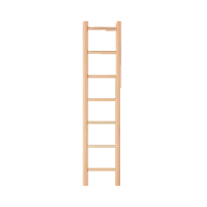
For contestants
There are two parts – the maths builder quiz and the head to head.
You choose which rung on the ladder you wish to start at, one step up or one step down from the result of the maths builder quiz.
The head-to-head chase begins with the first question.
If you get the answer correct you progress down the ladder one rung.
If you get the wrong answer you stay where you are on the ladder.
Your teacher may give you a record sheet to record your progress each day for the week.
The chaser does not get questions wrong and progresses down the ladder one rung at a time.
If the chaser reaches the same rung you, you are out and for you “the chase is over”!
If you reach the bottom of the ladder, you win the money (unfortunately, it’s not real)!!
Chaser starts here
10 x A
A
0.1 x A
End

Slide 3
QUESTION 1
Maths Builder quiz
Write the number four hundred and fifty-seven
Notes:
Answer 457

Slide 4
QUESTION 2
20 - ? = 7
Notes:
Answer 13

Slide 5
QUESTION 3
What number is ten less than 552?
Notes:
Answer 542

Slide 6
QUESTION 4
In the pattern 45, 50, 55, 60 . . . which number comes next?
Notes:
Answer 65

Slide 7
QUESTION 5
70 – 30 = ?
Notes:
Answer 40

Slide 8
QUESTION 6
Half of 16 = ?
Notes:
Answer 8

Slide 9
QUESTION 7
6 doubled = ?
Notes:
Answer 12

Slide 10
QUESTION 8
20 + 50 - 8 ?
Notes:
Answer 62

Slide 11
QUESTION 9
14 + ? = 25
Notes:
Answer 11

Slide 12
QUESTION 10
What is the name of a shape with five sides?
Notes:
Answer pentagon

Slide 13
Head-to-head
QUESTION 1
What is 7 x 2?
A 10 B 14 C 18
Notes:
Answer B

Slide 14
QUESTION 2
30 + ? = 100
A 50 B 60 C 70
Notes:
Answer C

Slide 15
QUESTION 3
3 + ? = 20
A 17 B 16 C 15
Notes:
Answer A

Slide 16
QUESTION 4
6 + 7 = ?
A 11 B 12 C 13
Notes:
Answer C

Slide 17
QUESTION 5
How many tens are there in 632?
A 632 B 32 C 63
Notes:
Answer C

Slide 18
QUESTION 6
100 - ? = 17
A 83 B 87 C 93
Notes:
Answer A

Slide 19
QUESTION 7
How many threes are in the number 27?
A 8 B 9 C 10
Notes:
Answer B

