Slide 1
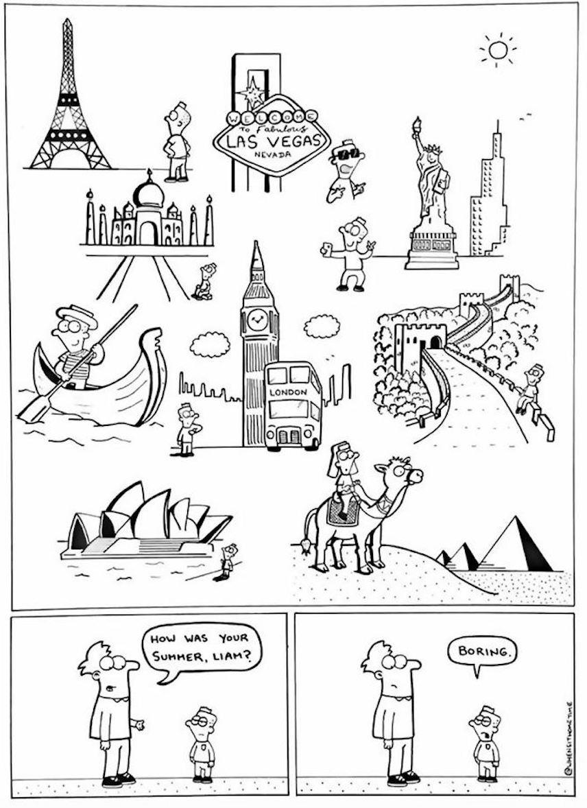
English
Term 1 Week 5

Slide 2
Wednesday Vocab Builder
In your book
How many words can you build from this word?
time

Slide 3
Wednesday
Quick write
We should get paid to attend school.

Slide 4
Finish your visual pepeha
Cut and glue a colour onto the back
Cut and glue your published writing on the back
Finished? Get started on Reading Plus.

Slide 5
Thursday Vocab Builder
In your book
How many words can you build from this word?
light

Slide 6
Thursday
Quick write
All fast food should be banned.

Slide 7
Friday Vocab Builder
In your book
How many words can you build from this word?
free

Slide 8
Friday
Quick write
Wealthy countries should share their money.

Slide 9
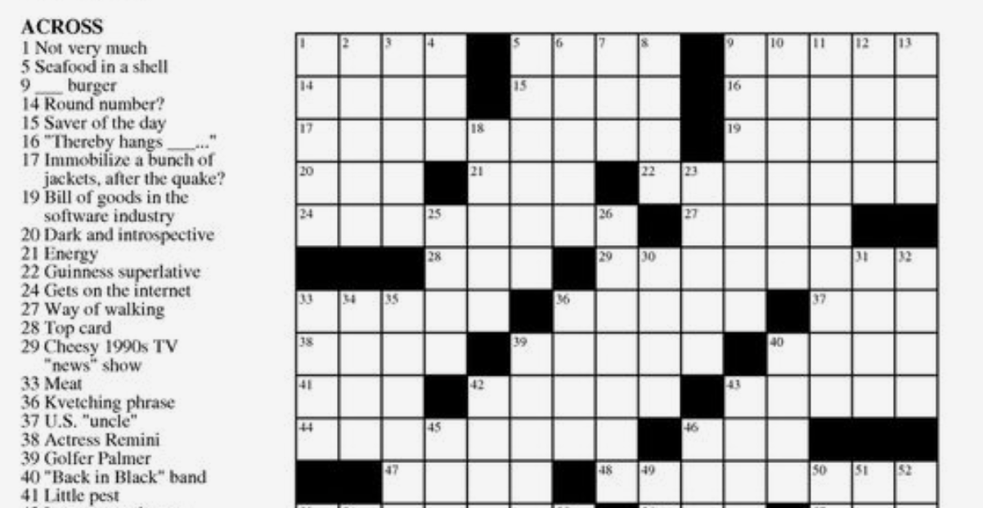
Friday revision
A homophone is a word that..
Some examples are…
Complete the homophones crossword in your book.

Slide 10
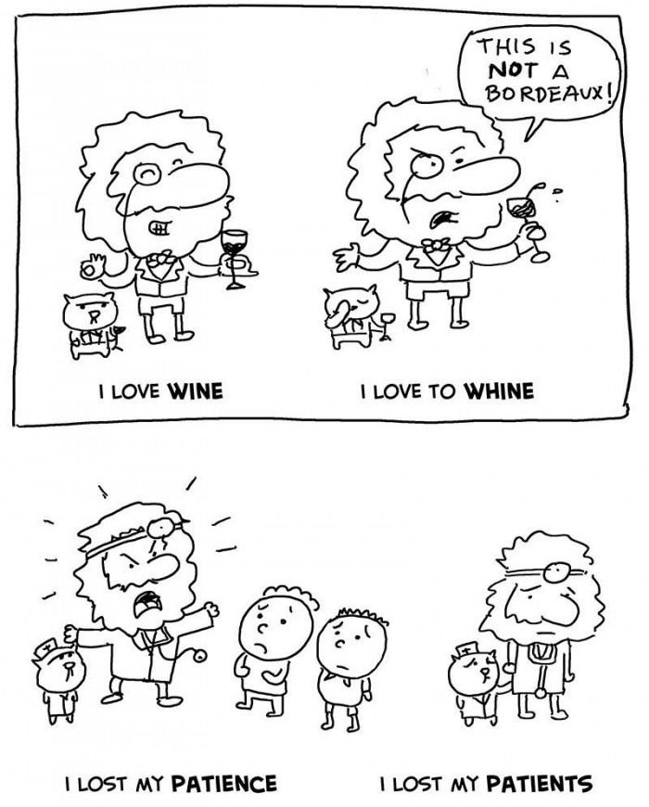
What is a homophone?
bear bare beer
hair here
sore saw

