Slide 1
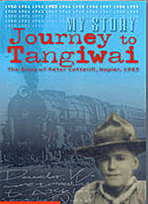
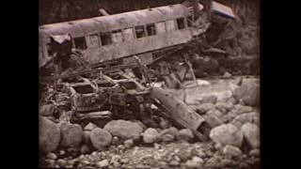
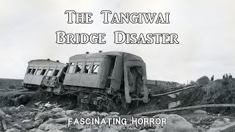
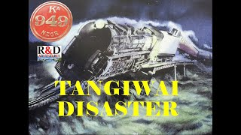

Slide 2
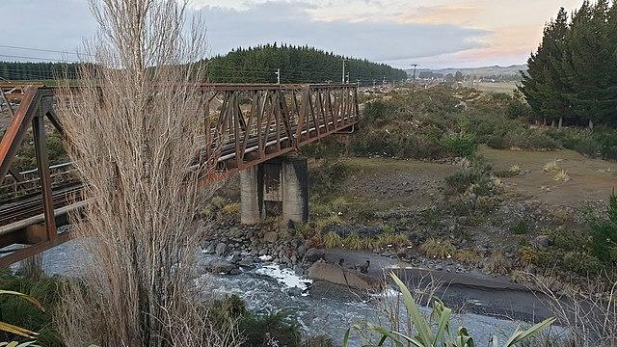
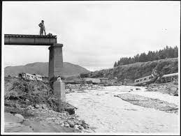
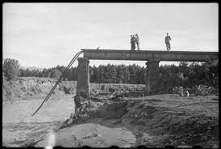
Railway bridge at Tangiwai before and after

Slide 3
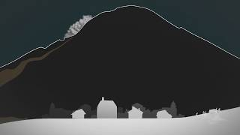
Words I need to understand and use:
lahar disaster
pier Mt Ruapehu
bridge survived volcano
erupted
What is a lahar?

Slide 4
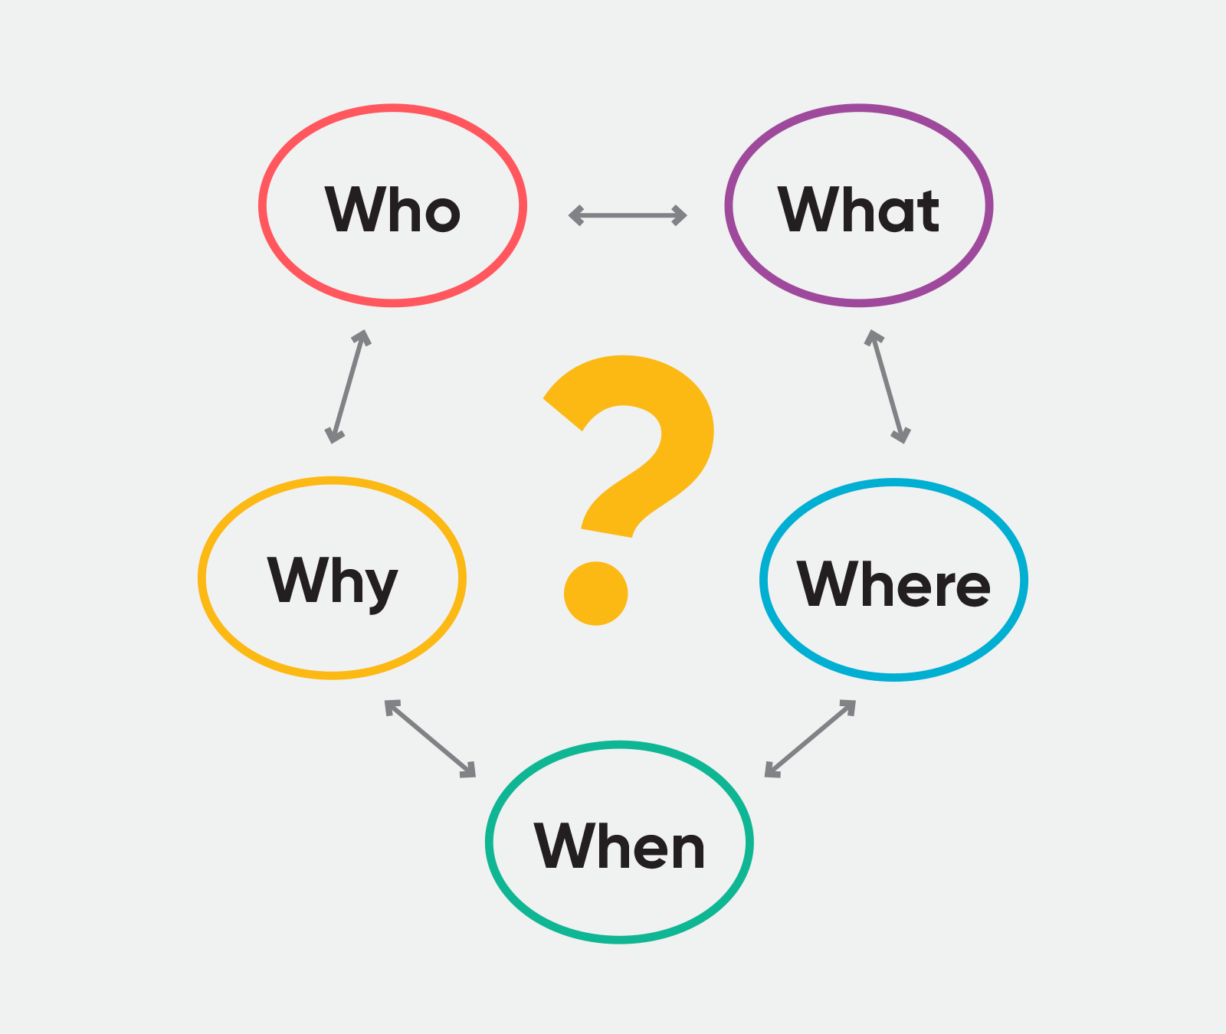
Wednesday-Planning for writing
Describe the events of 24 December, 1953 at Tangiwai
Plan using the 5 Ws

Slide 5
Thursday-writing
Opening sentence
Paragraph 1-What happened? When did it happen?
Paragraph 2-Why did it happen? Where did it happen?
Paragraph 3-Who did it impact?
Closing sentence

Slide 6
Friday-after library time.
Add the editing checklist at the end of your writing
Reread and edit your work
Tick each item on the checklist
BEFORE seeing Mrs Lowden

