Slide 1
LI: To understand the importance of creating an effective piece of description and do this in our travel writing

Slide 2
LO: To understand the importance of creating an effective piece of description and do this in our travel writing
Create this table in your books.
Smells
Sights
Thoughts and Feelings
Taste
Touch

Slide 3
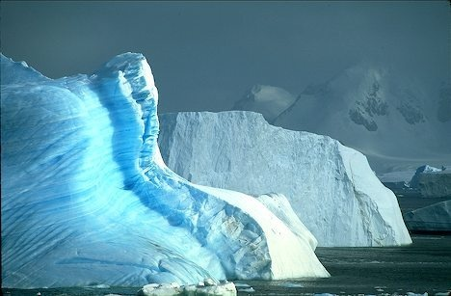
LO: To understand the importance of creating an effective piece of description and do this in our travel writing
Write down all the nouns / adjectives in this picture.

Slide 4
What would you expect from this holiday?

Slide 5
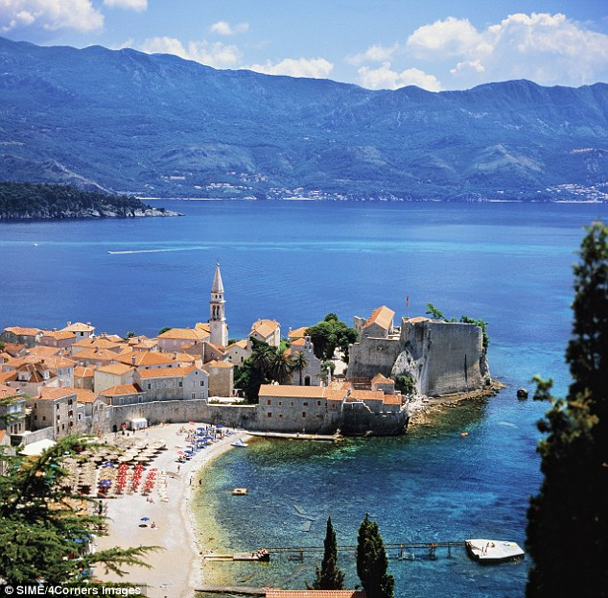
What would you expect from this holiday?

Slide 6
What do you notice about this text? Is it positive or negative towards the holiday?
Although the smell of dead fish cascaded from every orifice of the room, the beds were at least big enough for a person to sleep on. Well, a very small person to sleep on. Plugging in my phone charger proved more difficult than expected, as the plug socket was hanging by a thin decaying wire from the wall. In a place as beautiful as Spain, there was no need for a phone anyway; who needs electricity? And who needs hot water? Who needs a toilet seat? Well, not me! I opened the balcony windows and looked out at the building site, as the door slowly crunched and swung on its single hinge. As the drill began to shake the ground below me, I took in a deep breath of dust, as the builders stared and swore at me in a language I did not understand. Oh my, what a perfect holiday this was going to be.

