Slide 1
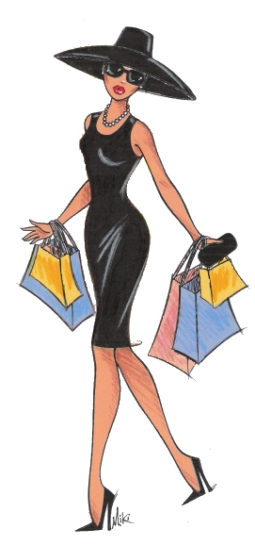
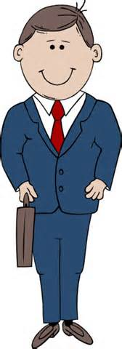
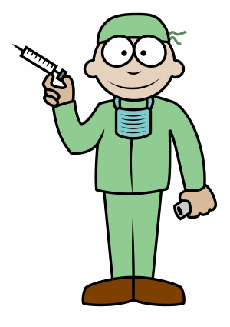
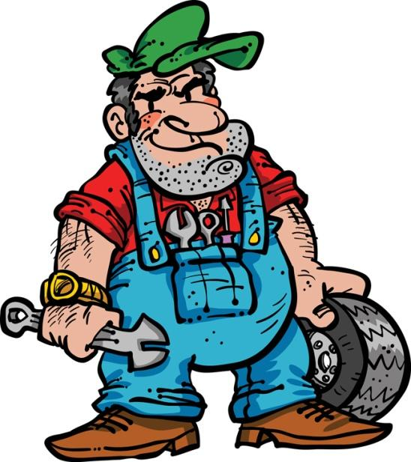
Characterisation
Aim: Improve characterisation in our writing.

Slide 2
What is characterisation
Is the concept of creating characters in a story.
Effective characterisation makes a literary character realistic and believable.
‘Direct characterisation’ – explaining the character to the audience.
‘Indirect characterisation’ – showing the reader the character through his thoughts/speech /appearance/action.

Slide 3
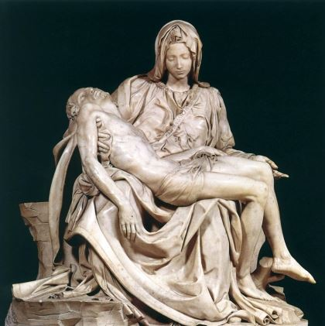
Pieta – Michelangelo
What is the man doing?
What is the woman doing?
What can we tell about their relationship?
An example of ‘indirect characterisation’.
Notes:
The pieta. Found in Rome. Sculpted by Michelangelo in 1498 out of marble. Depicts body of Jesus on the lap of his mother after the crucifixion.

Slide 4
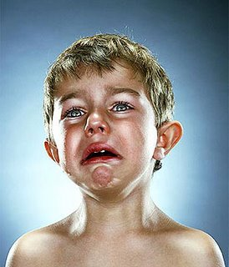
Actions to show emotion
The little boy was crying.
His trembling bottom lip hung down, his shoulders shook violently and hot, fat tears rolled down his cheeks.

Slide 5
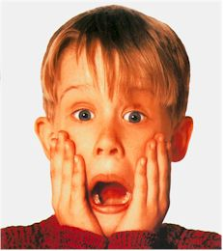
Actions to show emotion
The little boy was scared.
Describe the reaction his body would have to this emotion. Do not state that he was scared.

Slide 6
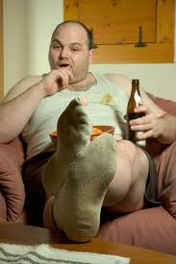
How characters move
The man was lazy.
He stretched lethargically over his bulging stomach to reach the remote. He gave up straining. He lazily picked the crisps from his teeth with a dirty finger. He’d get it later.

Slide 7
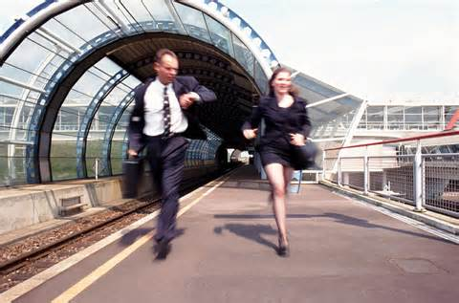
How characters move
He was in a rush.
Without stating that he was in a rush, describe how his movements might demonstrate this idea.

Slide 8
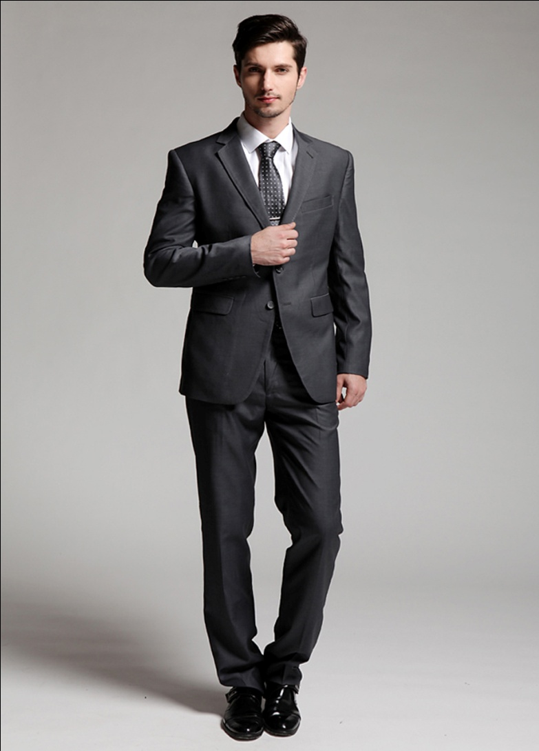
Appearance
What assumptions come to mind when you see the way this man is dressed?
Rather than stating ‘he is a businessman’, it is much more effective to describe the way he is dressed and allow the audience to figure it out for themselves.

Slide 9
Appearance
He checked his watch for the twelfth time that minute, readjusted his tie and smoothed his immaculate pinstripe suit. His briefcase hung heavy by his side and his highly-polished shoes glinted under the fluorescent lights.

Slide 10
Appearance – Your Turn
What does this woman do?
Describe her appearance (and mannerisms, if you like), making her occupation clear, without actually stating that she is a doctor.

Slide 11
Your Task
Using the worksheet provided, you should demonstrate your skills at creating believable characters and using characterisation effectively.
Remember to show rather than state what your character is like.

