Slide 1
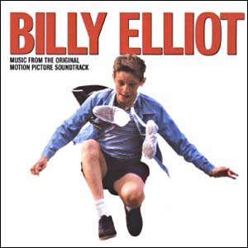
The elements of a poster

Slide 2
Visual Verbal
layout rhetorical questions
balance pun
colour vocabulary
font dialect/jargon
image emotive language
allusion rhyme/rhythm
alignment
texture/pattern
These features combine to deliver a message

Slide 3
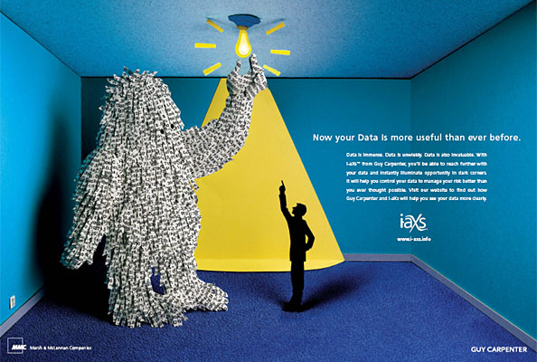
What are the key elements of this poster?

Slide 4
Balancing the layout – the large monster figure on the left is balanced by the writing on the right

Slide 5
Colours – range from black to white, with mid-tones between - with calm blues which complement each other - yellow is a positive, high energy colour

Slide 6
The link between lightbulbs and good ideas

Slide 7
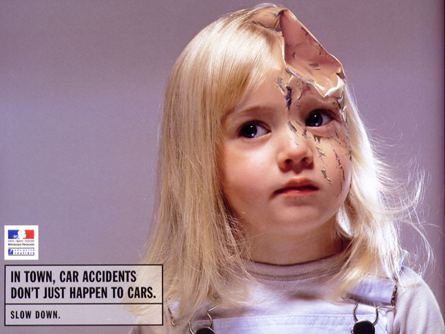
Is there balance in this poster?

Slide 8
-The girl is off-centre, but she is ‘looking’ towards the block of empty space on the left. -the colour purple tones with the pink of skin and T shirt -tones range from the black of lettering and dark eyes to white

Slide 9
Balance can be achieved through:
Symmetry of layout [ horizontal, vertical or diagonal]
colour – white through to dark with shades in between
Tying visual image with words/slogans
Don’t be afraid of using empty space to balance your poster

Slide 10
What about other visual features of the poster?

Slide 11
The girl’s injury is made to look like a dent in a car’s bodywork. This ties in directly with the poster’s message. It is startling enough to make you want to look twice at the image.

Slide 12
Visual messages
Your image must link to the verbal features you choose. They must complement each other. [ you may also attract viewer’s attention by having a clever, contradictory visual+verbal]
An image may speak for itself

Slide 13
What is the significant verbal feature of this ad?

Slide 14
A pun – the original would have been ‘crying over spilt milk’, ie don’t dwell on past defeats but suck it up

Slide 15
What do you notice about the colour in this poster?

Slide 16
Yellow in lettering matches the Warriors’ singlet under the skin. White and blue lettering match colours in the image.

Slide 17
Notice too, that the lettering touches the player’s shoulder and the slant matches the angle of the rips in the man’s back. Unless you are going for something very symmetrical, having overlap is a good way of making the eye glide from one object to another.

Slide 18
This poster has limited colours. Why has the creator used red?

Slide 19
The creator has also used a visual image as an allusion. What is it?

Slide 20
Allusions and associations
Use the knowledge that people already have to make links and imply messages
Common symbols are –
crowns dove heart roses barbed wire…
Use your viewers’ associations with colour to suggest ideas/moods…
Blue = cold, water, pure
Red = passion, anger love etc

Slide 21
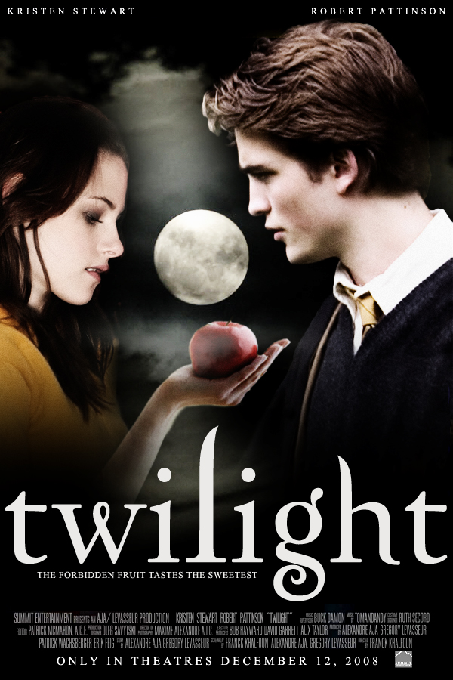
What is the allusion in this poster?

Slide 22
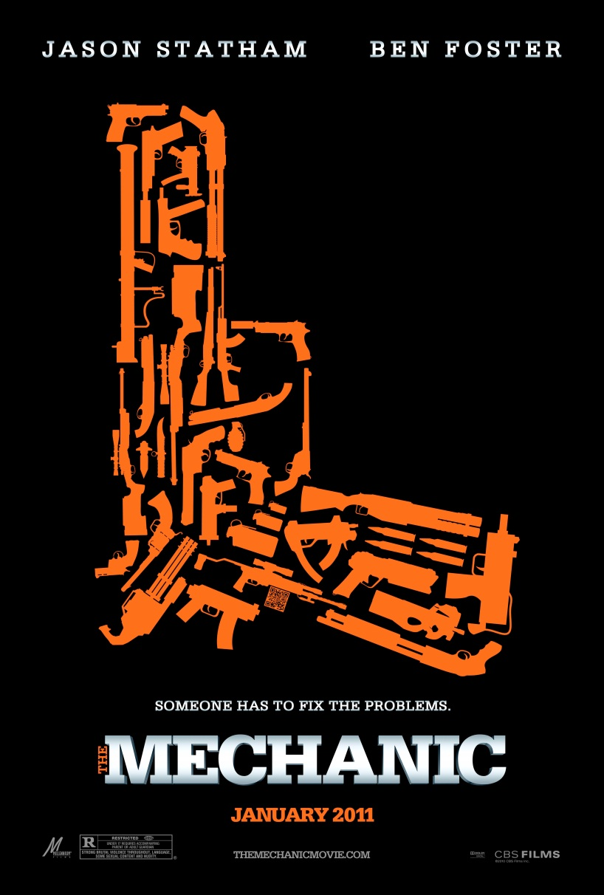
What do you notice about the alignment in this poster?

Slide 23
‘The Mechanic’ is aligned exactly with the horizontal limits of the gun

Slide 24
What is clever about the central image of the gun?

Slide 25
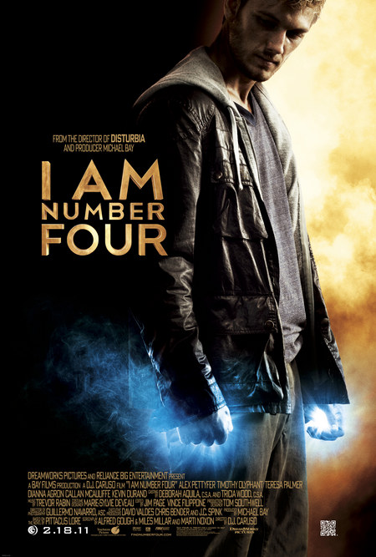
By contrast, notice that the figure is cropped top and bottom, don’t be afraid to align your image to the edges of the page.

Slide 26
Alignment
Don’t take words too close to the edge, but you may crop images
Posters are tidier when words and images are aligned

Slide 27
What else can you see in this poster?

Slide 28
What are the strengths of this?

Slide 29
Notice the font in this poster. It is rounded, complementing the curves of the stick man. Think carefully about your choice of font – don’t simply choose your favourite, select one that matches your message.

Slide 30
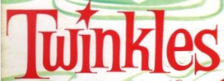
Look at each of these fonts. What kinds of messages would you associate with these fonts?
…

Slide 31
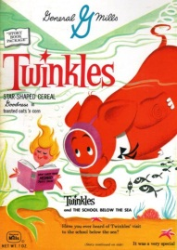

Slide 32
..

Slide 33
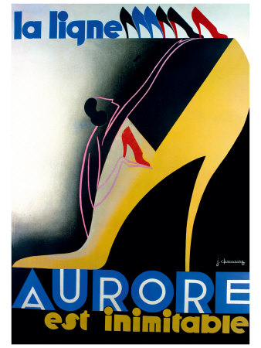

Slide 34
.

Slide 36
..

Slide 37
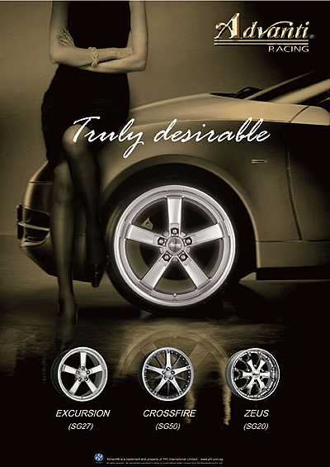

Slide 38
..

Slide 39
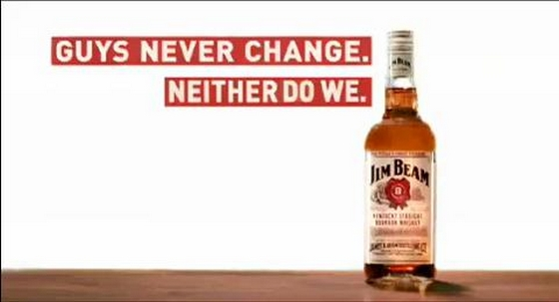

Slide 40
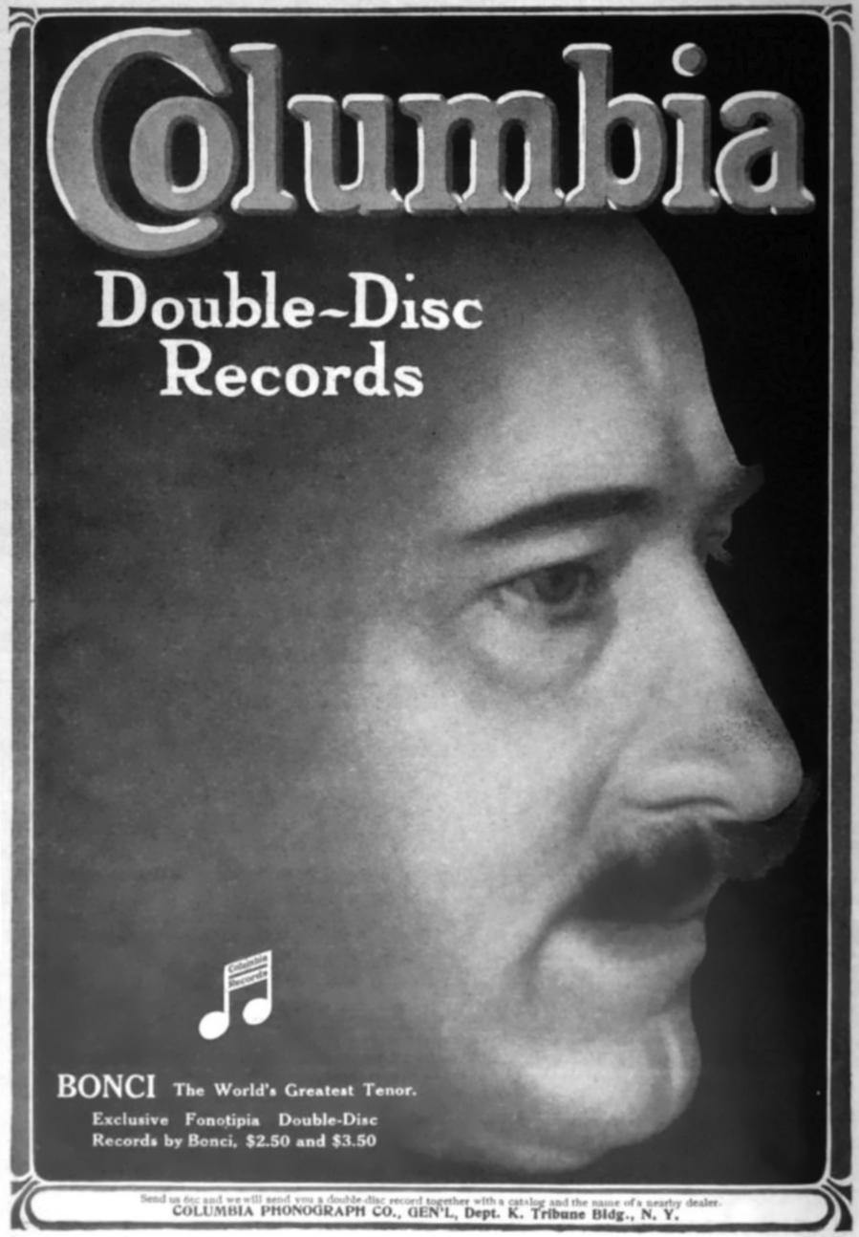
And this?

Slide 41
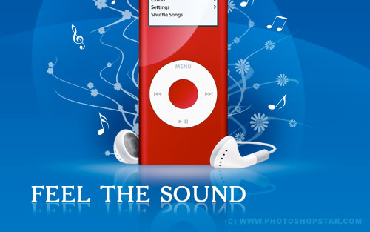
Why is this visually pleasing?

