Slide 1
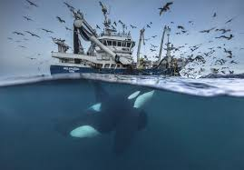
Wai and Kai not
An inquiry into our fishing industry through Art

Slide 2
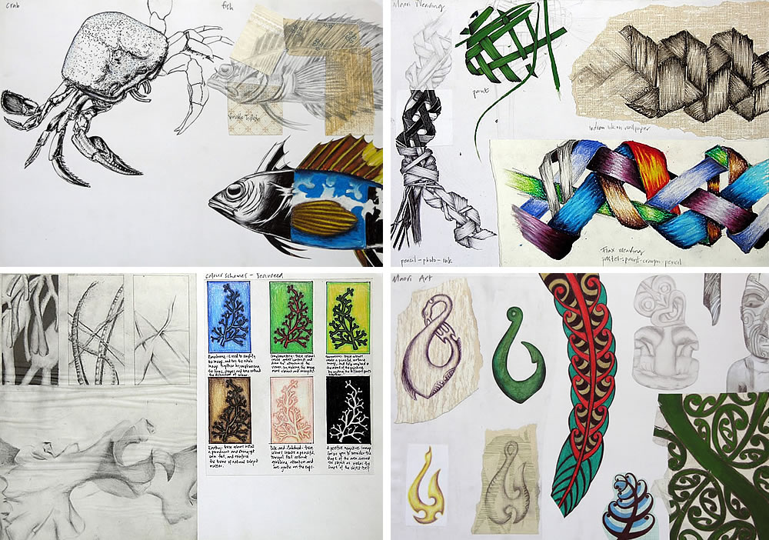
Setting up your Visual Diaries
For this term you are required to use a Visual Art diary where you will keep all of your practise drawings, plans and reflections.
You need
1 visual diary
1 6 B pencil
1 drawing pen
1 eraser or rubber

Slide 3
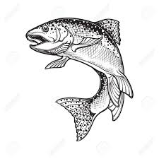
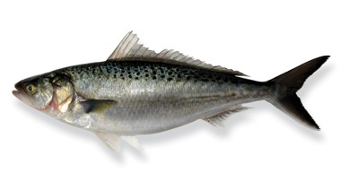
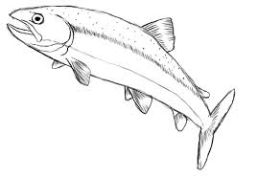
Observational drawing challenge
We are learning to: Draw with accuracy, correct proportion and to challenge yourself to add shading in the correct places to show form.
We will start the term with some observational drawing practise. Below are three levels of scaffolding for you to challenge yourself against.
Copy the first two drawings as accurately as you can and see how realistic you can make the final photograph of a fish. Use pencil for the final drawing and try to replicate the tones and details.
Notes:
Teaching points: To follow an outline to copy correct proportion and accuracy
Teaching points: To use a variety of marks to show detail and shading with a pen
Teaching points: To use a 6 b pencil to accurately draw from a photo, achieving correct accuracy, proportion and shading

Slide 4
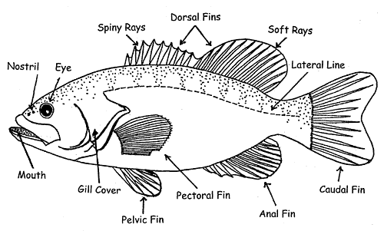
We are learning to draw and label the various features of a fish to help our planning
Before we can create our fish sculptures we need to recognise the different types of fins and features that a fish has. Most fish will have these features but of course there will be lots of variations amongst the differents species.
Copy the picture and label the different parts of a fish onto a new page in your visual art diary

Slide 5
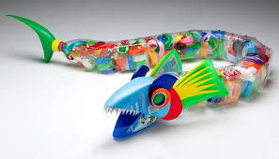
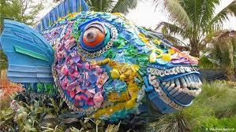
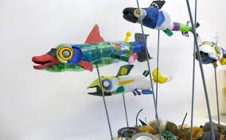
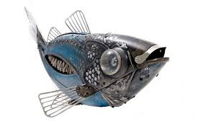
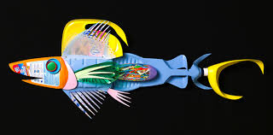
These are some examples of fish that have been created from recycled objects. You need to look at a variety of ideas to spark your own imagination.
Notes:
Recycled metal objects are great to collect as well.

Slide 6
We are learning to:
Recognise that there are several issues that threaten the sustainability of our fishing industries
Use our imagination to design a fish that is morphing into a plastic bottle
Success Criteria:
Watch two videos and read the resources from the teacher to answer the following questions
Make a title page called…..THE PROBLEM
Using this link, watch the first two videos. The first one is about the five facts you need to know about our oceans, and the second short video about types of fish to eat.
List the main points from each video
After looking through the link below, list the 7 ways we can help make a difference to our marine
environments.
ttps://oceana.org/living-blue/10-ways-you-can-help-save-oceans
https://www.mfe.govt.nz/marine/we-all-have-role-play/what-you-can-do

Slide 7
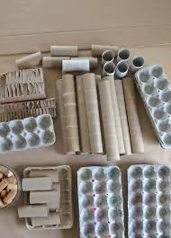
We are learning to look for resources around home to help create a recycled fish sculpture
We are learning to manipulate and change the forms of our collected resources to create a fish
You need to find stuff like…...
plastic bottles,
card, bottle tops
Cardboard rolls
Egg cartons
Buttons
Plastic spoons or forks
Plastic mesh
Ping pong balls
Old toys that you could break up for bits
Nails,
plastic golf tees
Ice block sticks
Springs
Tooth picks
Meat skewers

Slide 8
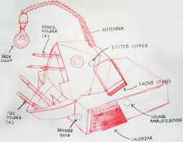
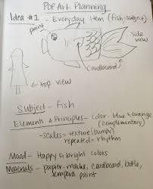
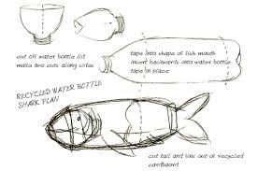
We are learning to create a detailed sketched plan of what our fish will look like and show how we will create different features
Now that you have collected lots of different objects, have a go at creating a drawn plan of what your fish could potentially look like.
Be sure to add notes beside how you’re planning to create features and what materials you will need.

Slide 9
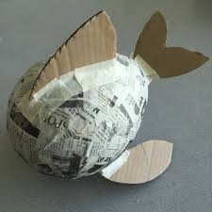
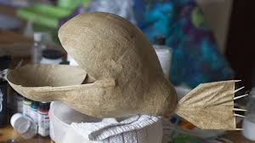
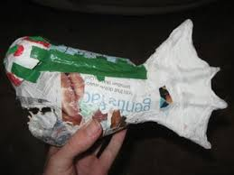
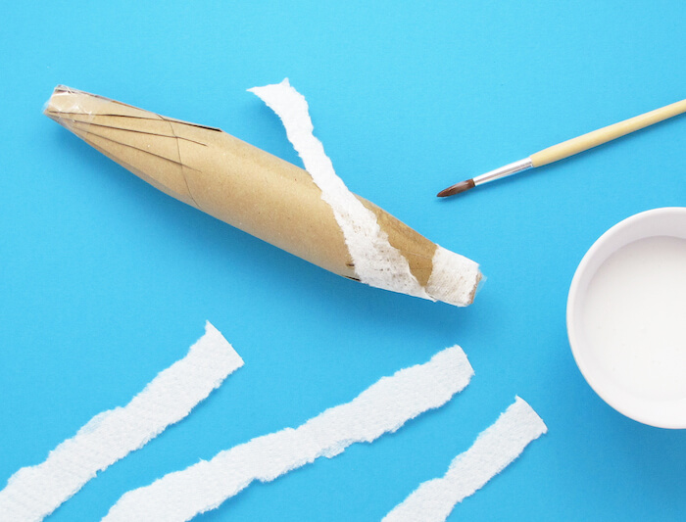
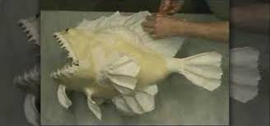
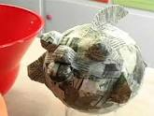
We are learning to problem solve and be creative
What with and how are you going to make and attach the features?
Notes:
The fish structure is really important to get right as it needs to be sturdy and have secure joins before you begin the paper mache process

