Slide 1
Hi class, thinking of you and missing you at school, here is a little task you can work on:
KINDNESS WEEK PROPOSAL
This is an individual task, where you can think about the issues that we have discussed in class, about how MHJC can be kinder towards each other. Be creative and think about what activities of action you can do around MHJC during Kindness week. I have provided a template, please add your own words, change the fonts and the photos.
Back at class, we will share our ideas with the group, and select our favourite action plan to carry out. The assignment will be set on Google classroom.
Instructions:
Set up a template with 2 slides titled “(Name) - Safe schools week idea”
Answer the 5 Ws - who, what, when, where, why, how this will take place
Add two pictures of the action. One picture will be a drawing and the other can be an image found online.
Write a few sentences to describe the social action
Use as much detail as possible
Ideas of the social action could be: post it notes of kindness around the school, puns, a performance, a Kindness poster, encouraging bracelets, one pink fingernail with nail polish… (think of your own- yours will be much more creative than mine!)
Remember that this is only two slides. Be creative! Think of different ways to lay out the information.
EXTENSION: as an extension, please make sure you have finished the rest of the activities on the “Face-off! Management plan,” as we will be sending the Google form out back at school.
Hope you are all doing well.

Slide 2
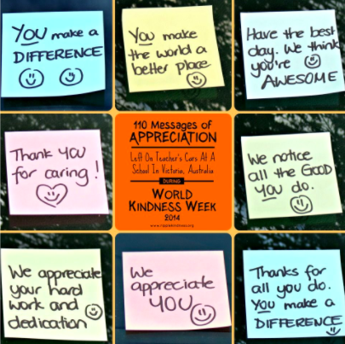
SLIDE ONE - (Write your name here) - Proposal for Kindness Week
This is a drawing you have done
This is the photo you found online
A few sentences to explain my social action
(EXAMPLE ONLY) My social action idea is to create post it notes to put up around the school, to be kind to others. An example words I would write on the post it note is “Stand up for bullying!” or “Bee kind!”
I am going to use different coloured post it notes, and also paint the post it notes….

Slide 3
SLIDE TWO - (Write your name here) - Proposal for Kindness Week
The 5 Ws
Who: people in your group
What: (you social action) e.g putting up posters around the school
When: During Kindness Week
Where: e.g flash mob- outside the playground. Put up posters in the library, Forest Whanau…..
Why: To promote being caring to others
How this will take place: posters (A3 sized paper, draw on the paper…. Coloured felts to stand out. One person will be collecting paper, one person drawing….

