Slide 1
Micro:bits

Slide 2
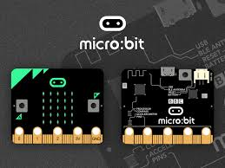
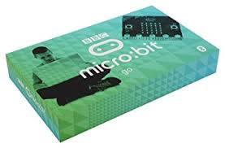
Background info
Developed in the UK so all students would have access to a tool to learn about computer science
Computer science → the study of how users can actually use a computer
Clip to see how they are used

Slide 3
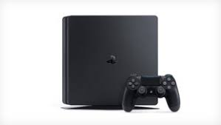
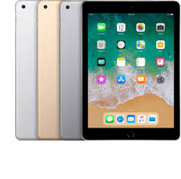
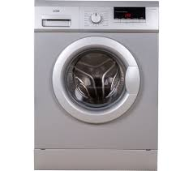
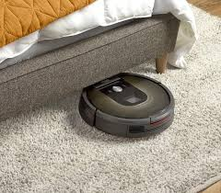
Need for Computer Science
Computers are important to everyone’s lives in the current world
Computer examples
Can we use them effectively until we know how they communicate with the user?

Slide 4
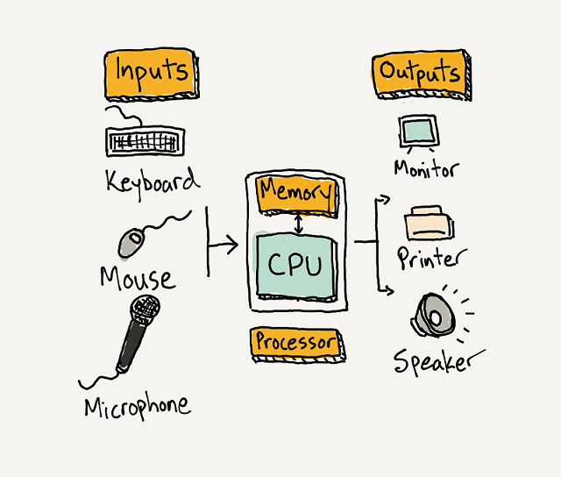
Computers
All computers have four parts:
Input
Processor
Output
Memory
How do these compare to humans?
Input - Senses
Output - Speech / Blushing
Processor and Memory - Brain
Notes:
Input - how it takes information in
Processor - the capability of analysing the information and transforms it to something usable
Output - how it communicates what was processed
Memory - how the computer remembers things …. RAM (random access memory) is for short-term memory and hard drive is for long-term memory

Slide 5
Micro:bit components
Can you locate these parts on the Micro:bit?
Processor
Inputs → buttons, pins, accelerometer, compass, light sensor
Outputs → LED lights, pins, Bluetooth
(Memory is 16K RAM)

Slide 6
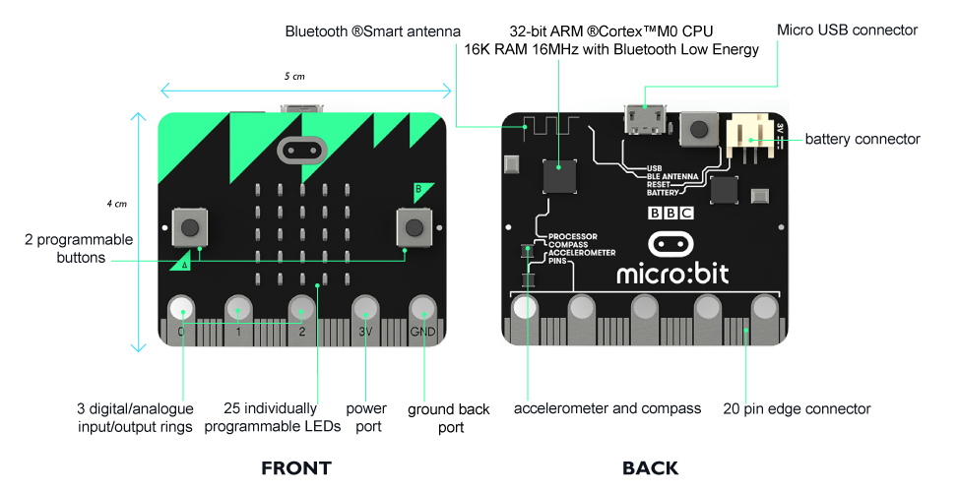
Micro:bit components

Slide 7
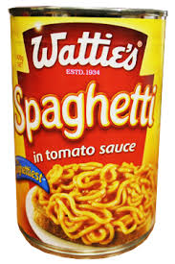
Computer Science: Algorithms
Computers use algorithms to process the information in the form of instructions.
Precise set of ordered instructions.
Goal is to solve the problem presented.
Usually accurate (or no point using it).
Example:
Input: Start with 6.
Process (algorithm): Multiply by 5.
Output: 30
Second example:
Input: Spaghetti.
Algorithm:
Open tin.
Put spaghetti into bowl.
Place bowl in microwave.
Close microwave door.
Press 30 seconds.
Output: Warm spaghetti.

Slide 8
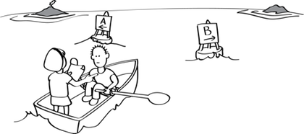
Algorithms
Algorithms can be:
Finite (yes / no)
Conditional (and, or, and/or)
Examples:
When the light turns red, you stop.
If a student is well behaved and wearing something purple, they get a cookie.
A doctor prescribes antibiotics if a patient has swollen tonsils but could also prescribe them if the patient had an earache too.

Slide 9
Algorithms activity
Step #1: In groups of 3-4, you’ll be given a series of “If” statements.
For example, “If I were hungry...” or “If my cat escaped for the day…”
You need to complete the statement. One answer per blank piece of paper.
Step #2: Shuffle up your answer statements and turn them face down.
Step #3: One “If” statement will be read out. Select the statement at the top of your pile to complete the sentence.
Does this make any sense?? No - which is why algorithms make sure this doesn’t happen.

Slide 10
Using the micro:bits coding site
Coding is done online at https://makecode.microbit.org
Three main parts:
Workspace - where the code is written
Toolbox - what you use to write the code
Simulator - what the code does to the micro:bit (lets you see what happens before you download the code)

Slide 11
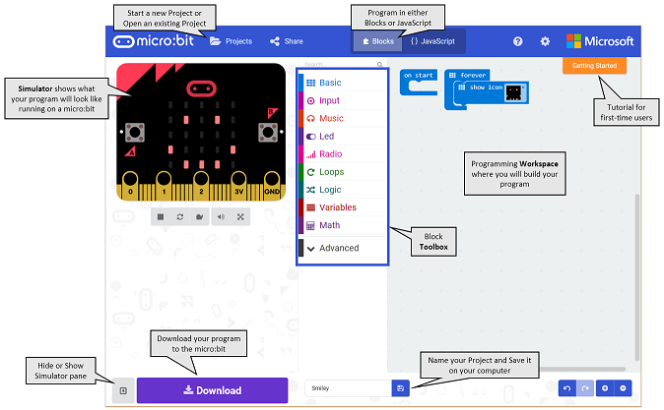
3
1
2

Slide 12
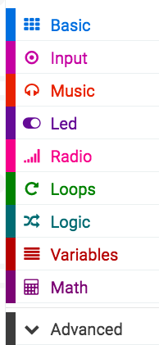
Using the micro:bit
Tools you will commonly use to start with:
Basic
Starting command (if click spacebar, tab, etc)
Shows LED pad
Input
Uses the inputs to collect info
LED
Using specific LED lights on the screen
Loops
Do you want things to happen once, twice, forever
Logic
Conditional algorithms (if … then …)

Slide 13
Using the micro:bit - Happy face, Sad face
Happy and sad faces
Write out what you want the micro:bit to do in basic terms
Blank screen
Press button A to get a happy face
Press button B to get a sad face
Use the tools to “solve the problem”
What command do you need to start with?
How can you make the faces with the LED lights?

Slide 14
Using the micro:bit - Happy face, Sad face
The LED screen is a table format, similar to a multiplication table.
0 1 2 3 4
0 1 2 3 4
0 1 2 3 4
0 1 2 3 4
You need to enter the correct grid sequence.

Slide 15
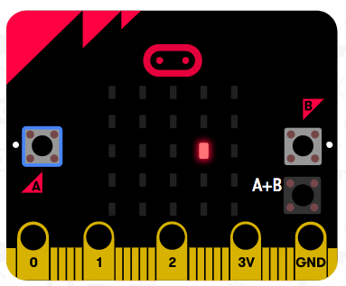
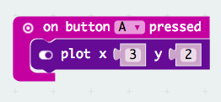
Using the micro:bit - Happy face, Sad face
The LED screen is a table format, similar to a multiplication table.
0 1 2 3 4
0 1 2 3 4
0 1 2 3 4
0 1 2 3 4
0 1 2 3 4
What are the plotted points needed for this example?
Now complete for the happy faces!

Slide 16
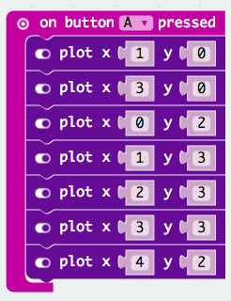
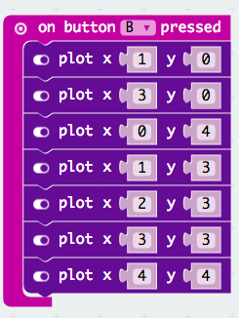
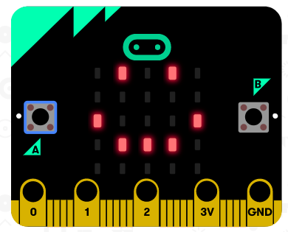
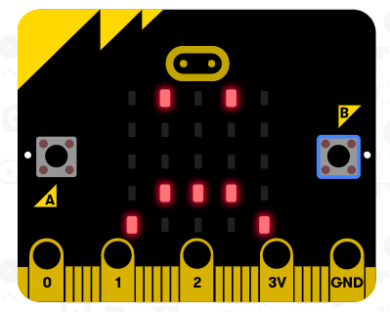
Using the micro:bit - Happy face, Sad face

Slide 17
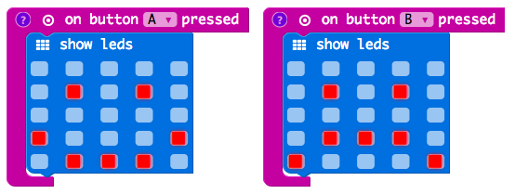
Using the micro:bit - Happy face, Sad face
To make it easier to view the LEDs, you could also use the following:
If you want the screen cleared, you have to include that in your code:

Slide 18
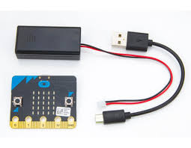
Loading the info to the micro:bit
Previewing in the simulator lets you see what happens before you download.
When the simulator shows your desired output, SAVE your work.
To get the programme on the micro:bit:
Plug the micro:bit in using the USB
Attach the battery pack to the micro:bit
Click “Download”
USB end for computer
End for micro:bit
Battery pack end for micro:bit

Slide 19
Give it a go…
Code your Micro:bit so that it reads out your name when you click on the “A” button and your partner’s name when you click the “B” button.
For something harder (using variables):
Aim to use the “shake” feature, when it randomly selects either of your names when it is shaken.

Slide 20
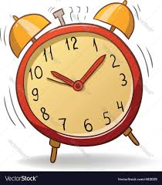
Computer Science: Use of variables
Similar to when working through a science experiment you have variables.
Constant: something that does not change
Variables: something that does change
Examples:
The weather goes from sunny to rainy.
There are 24 hours in a day.
The value of pi is 3.14.

Slide 21
Types of variables
Number -- numerical like a temperature or score
Boolean -- true or false
String -- alphanumeric like a password
Sprite -- represents a dot on a screen with two grid point references

Slide 22
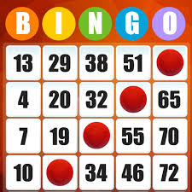
Examples of using variables
Play either Rock Paper Scissors.
What variables are involved?
What about Bingo? Higher/Lower?

Slide 23
Using the micro:bit - Rock Paper Scissors
We are going to design a program to record the Rock Paper Scissors score.
What variables do we need?
1.
2.
3.
What should we call the variables?
What values of the variables can we have?

Slide 24
Using the micro:bit - Rock Paper Scissors
We are going to design a program to record the Rock Paper Scissors score.
What variables do we need?
How many times Player A wins
How many times Player A wins
How many times they tie
What should we call the variables? PlayerAWins, PlayerBWins, PlayersTie
What values of the variables can we have? 0, 1, 2, 3 … (up to the number of rounds)

Slide 25
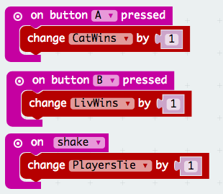
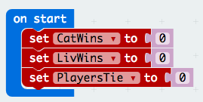
Using the micro:bit - Rock Paper Scissors
What to consider:
We are all starting at zero (no one has played yet)
Each entry will only increase one of the variables
In maths that’s like x+1

Slide 26
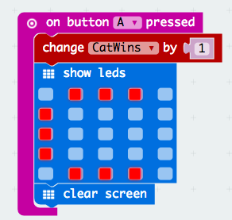
Using the micro:bit - Rock Paper Scissors
Add in an LED screen for each sequence to show the letter for the player’s first initial.
Clear the screen after each variable is displayed

Slide 27
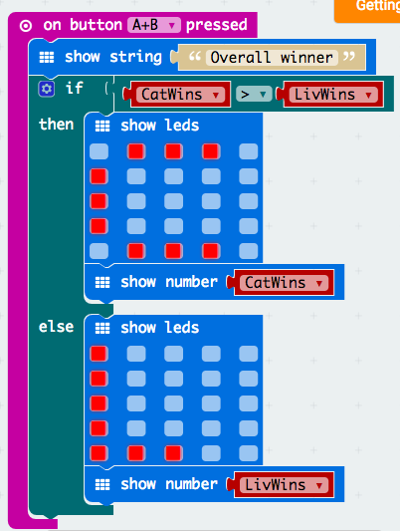
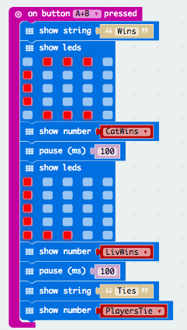
Using the micro:bit - Rock Paper Scissors
To display the overall winner:
MORE
ADVANCED
→

Slide 28
Micro:bot activity
Design something that you can use the micro:bit to count. You may need to modify the micro:bit’s appearance for this.
Examples:
Basketball (counts 2 and 3 pointers for each team)
Pedometer (number of steps)
Marks of the class (WT, A, M, E)

