Slide 1
Karakia Timatanga - Beginning Prayer
Me karakia tātou
Whakataka te hau ki te uru
Whakataka te hau ki te tonga
Kia mākinakina ki uta
Kia mātaratara ki tai
E hī ake ane te atakura
He Tio, he huka, he hau hū
Tihei mauri ora!

Slide 2
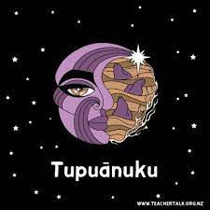
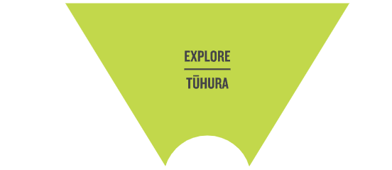
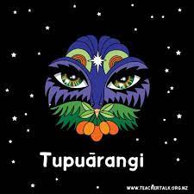
This week we are EXPLORING Tupu-ā-nuku and Tupu-ā-rangi by observing how they connect to te taiao
By the end of today’s lesson you should be able to:
Explain what Rongoā Māori is
Name (and describe/explain) at least 3 plants used in Rongoā Māori and what medicinal use they have

Slide 3
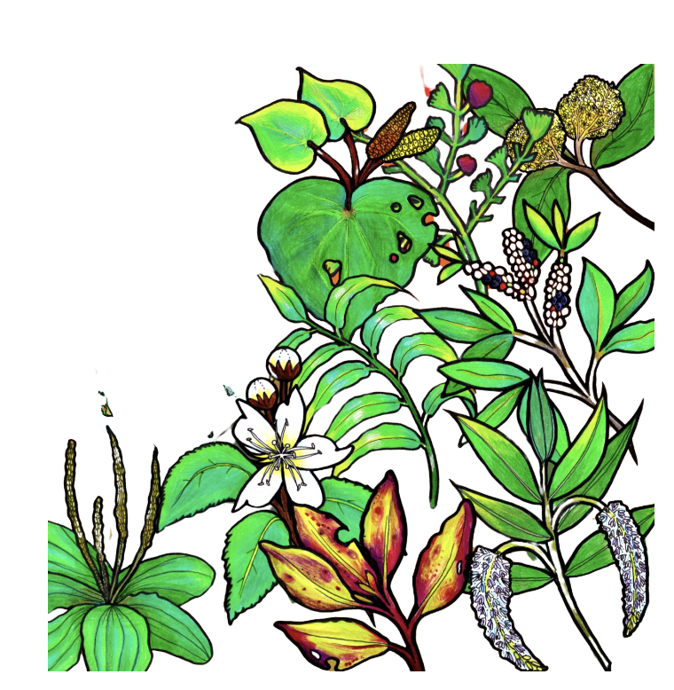
Rongoā Māori
TASK: with a partner / small group - discuss and look up what is “rongoā” or “rongoā Māori”. Write down your answers in your book.
Traditional Māori healing passed down through many generations
Includes plant use (rongoā rākau)
Includes (mirimiri) massage
Includes incantations (chants)
Rongoā is about wellbeing, the wellbeing of the person, the whenua, the soil, and the water flowing through the whenua.

Slide 4
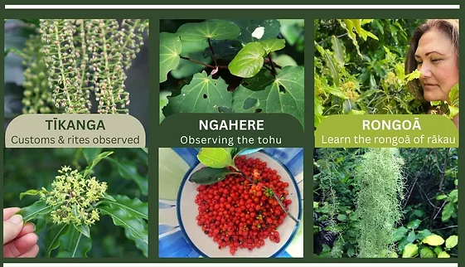
Rongoā Māori
TASK: Read this slide and then fill in the blanks on the next slide
In traditional Māori medicine, the illnesses or diseases are treated using a ‘holistic’ approach. This involves spiritual healing, the power of karakia (prayer), the mana of the tohunga (expert) and use of herbs.
Knowledge of rongoā was tapu (sacred) and was only passed on to selected people. The people who were given the knowledge were chosen and trained by a tohunga pu (expert) from the whare wānanga (house of learning).
Some herbal treatments were used for illness or diseases such as; asthma, bronchitis and coughs. They were also used for stomach problems, difficult births and for fractures, wounds, boils and burns.

Slide 5
massage tapu power boils chosen traditional medicine chants plant use tohunga burns plants karakia knowledge asthma mana fractures
Rongoā Māori is a ______________ type of healing. It includes _________, ______ ____ and incantations (__________).
Rongoā Māori spiritual healing uses the _________ of _____________ (prayer) and the ______ of the tohunga.
A _________ is an expert who uses traditional ___________ and healing. They pass down their _____________ but only to a few people who are _________. This knowledge was considered to be _____ (sacred).
There are many ways the herbal treatments can be used. Some examples can be; to help with ________, bronchitis and coughs. Other uses include; __________, stomach problems, ______ and _______.

Slide 6
massage tapu power boils chosen traditional medicine chants tohunga burns plant use karakia fractures knowledge asthma mana
Rongoā Māori is a tradtional type of healing. It includes massage, plant use and incantations (chants).
Rongoā Māori spiritual healing uses the power of karakia (prayer) and the mana of the tohunga.
A tohunga is an expert who uses traditional medicine and healing. They pass down their knowledge but only to a few people who are chosen. This knowledge was considered to be tapu (sacred).
There are many ways the herbal treatments can be used. Some examples can be; to help with asthma, bronchitis and coughs. Other uses include; fractures, stomach problems,boils and burns.

Slide 7
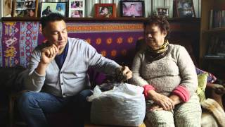
TASK: we will watch this video together as a class.
Think about what you found interesting, what surprised you, do you know of anything similar that people do in your own or other people’s cultures?

Slide 8
TASK: display information about rongoā Māori plants and their uses
Choose on of the following tasks to complete. Use the worksheet from when you went to the MHJC rongoā garden to help you and online research LINK 1
Make a poster. You can use Canva to make your poster or hand draw on paper.
OR
Make a set of google slides. Create one information slide per plant.
OR
Make a video e.g. documentary style, news report style.
You must provide information about at least 3 different plants and how they are used for medicine.
Depending on which task you choose - try to include headings / pictures / links to videos or websites or make it engaging.

Slide 9
Karakia whakamutunga - Ending Prayer
Me karakia tātou
Kia whakairia te tapu
Kia wātea ai te ara
Kia tūruki whakataha ai
Kia tūruki whakataha ai
Hāumi e, Hui e
Tāiki e

