Slide 1
Myths

Slide 2
What are the Pleiades/Seven Sisters?
Pleiades are a natural phenomena that occurs every year, where a cluster of stars become visible.
Different cultures around the world have different myths explaining the origin of the star cluster.
For example, we all know about Matariki. Which is Maori mythology about the origin of the 7 stars.

Slide 3
Remember: A myth often explains a natural phenomena
Such as earthquakes, weather, the passing of time and how things that we know today came to be.
When we are looking at the Pleiades myths, we are looking at the way different cultures explain the phenomena of the star cluster (Pleiades).

Slide 4
Matariki Video - what did it tell us?
The origin of the Matariki myth
What Matariki symbolises and represents
The names of the 7 stars
HINT: these are questions you can answer in your research and put on your poster about the Pleiades
Notes:
https://www.youtube.com/watch?v=MN-OluHpI6I&ab_channel=TheWirelessNZ

Slide 5
In your groups, each pick a culture, and you will be in charge of researching the myth and will record the information on the A3 document in your groups.
See if you can make any links between your myths, do they have anything in common?
HINT: Wikipedia should have some good info on your chosen culture
Notes:
When we are looking at myths, we know we are looking at natural phenomena… We should all be familiar with Matariki.

Slide 6
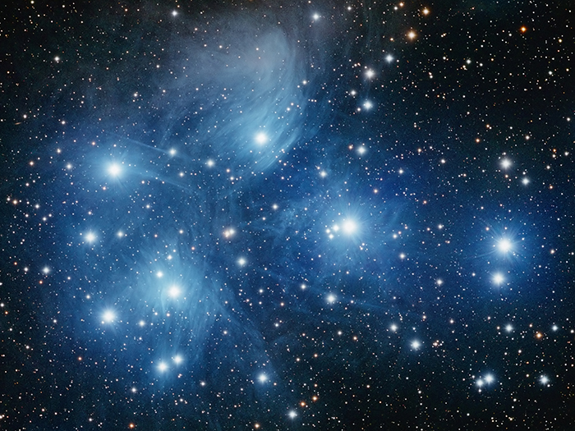
The Stars of the Pleiades
Maori - Matariki
Greek - Pleiades
Aborignial - 7 Sisters
Thailand - Chick Stars
Norse - Freyja's hens

