Slide 1
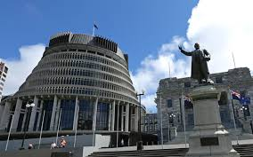
Politics and You
Project

Slide 2
Task 1: Getting our heads around Government
Create an A3 poster.
Draw a political continuum from left to right and place the five parties along the continuum and explain why you have done so. (This is what we mean by Left-wing, Right-wing)
What do we refer to when we refer to the cabinet? Name some of the people in our current cabinet?
What is a coalition?
When leaders say “we will discuss that in caucus today” what does that mean?

Slide 3
Task 2: Party time
This will be your individual project/homework: Present it as a brochure:
Research a famous past Prime Minister! Try and find one the class may not know a lot about!!!
What was his Party?
What were his ideas?
Write a short bio (100-150 words on each)
What actions did he take during his term(s)?
What did people think about him and why?
Include any other interesting information of your choice! Remember specific details!!!

Slide 4
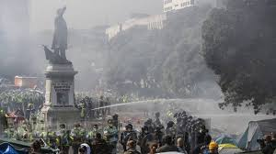
TASK 3: Current Issues Presentation
Group Presentation or Individual
Research a current/recent political issue. (It must be different to the others in the class)
Some ideas could be: pandemic, homelessness, dirty dairying/waterways, refugee quota, housing crisis, kiwi build, petrol taxes, euthanasia, abortion laws, policing, strikes of midwives, nurses, teachers etc., TPPA (or its new form), foreign companies bottling water, water charges…..THE LIST IS ENDLESS!
Try and find the perspectives of at least 3 parties on this issue.
What are some of the views of the experts and NZ public?
What progress has been made on these issues to date?
What is your position on these issues?

Slide 5
TASK 4: extra for experts:
Politics is often rocked by “Scandal”…. Look at some of the recent newsworthy “political dramas” that have made the news this year:
choose 1 or 2 (depending on time)
What party did it concern
What was the summary of the “drama”/what happened
What did the Media say about it?
What outcome was there?
How did the opposition “capitalize” on it?
What were the major “oops” moments that made the situation worse?
How would you have managed the situation differently?

