Slide 1
Consumer Rights

Slide 2
Week 7: Consumer Rights The Week of September 5 to September 11, 2022
Success Criteria
Students will become familiar with the 8 consumer rights and be able to apply them to real-world situations based on a Current Event in New Zealand in 2022. You will be able to explain at least one consumer right and describe how it applies to a recent current event.
Task 1: Read about the 8 consumer rights and make a list of these rights in your Red Book (to be completed during the 1st half of the class).

Slide 3
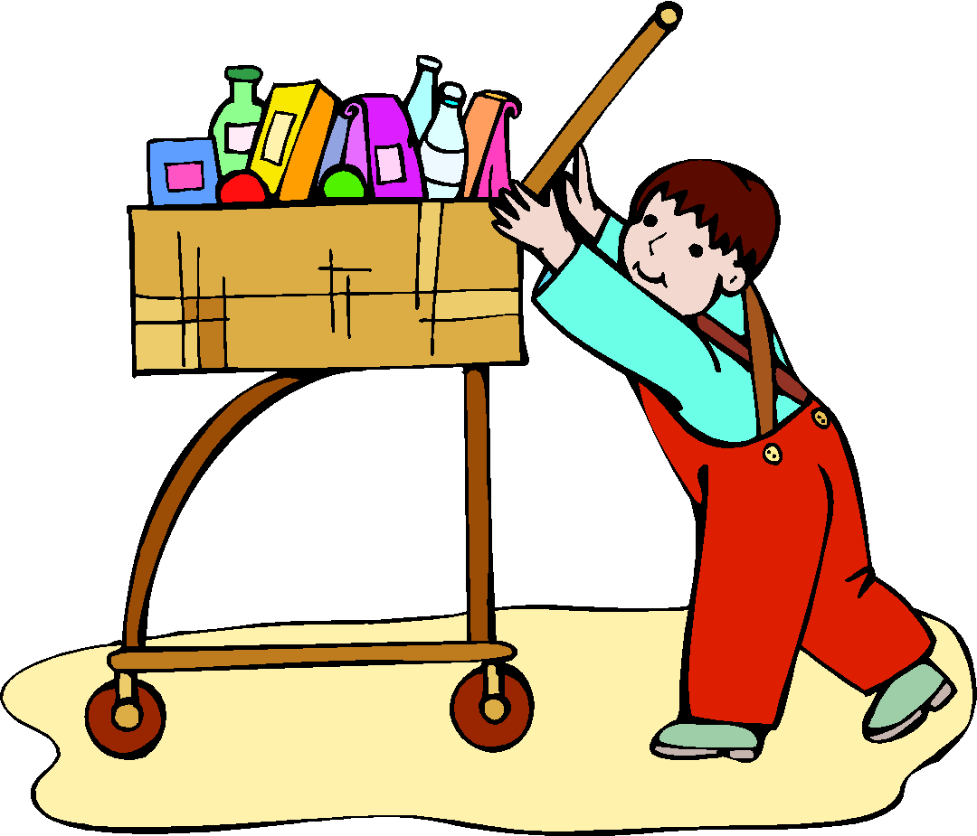
The right to satisfaction of basic needs

Slide 4
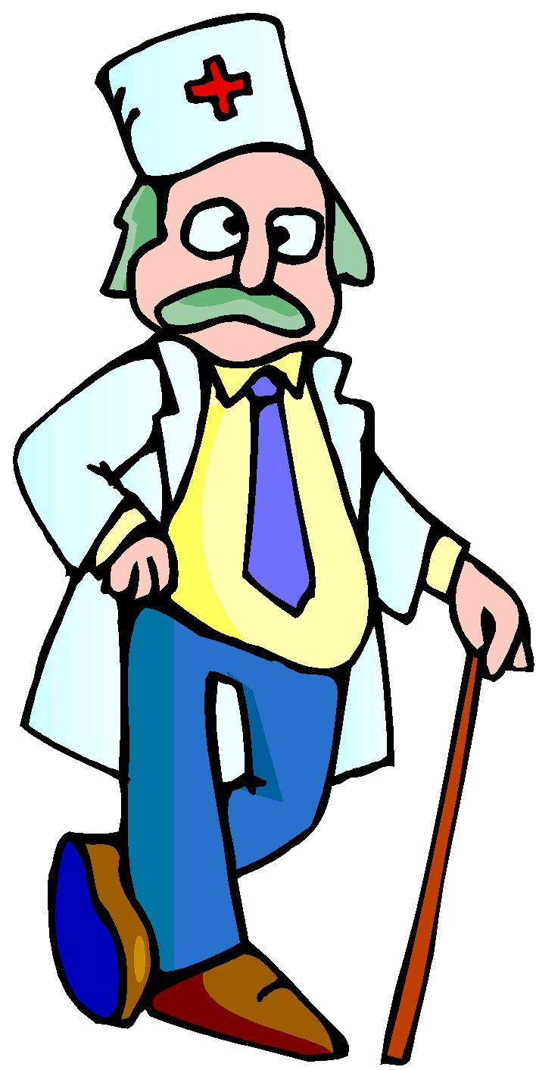
The right:
To have access to basic, essential goods and services: adequate food, clothing, shelter, health care, education and sanitation.

Slide 5
2. The right to safety

Slide 6
The right:
To be protected against products, production processes and services which are hazardous to health or life.

Slide 7
3. The right to be informed

Slide 8
The right:
To be given the facts needed to make an informed choice, and to be protected against dishonest or misleading advertising and labelling.

Slide 9
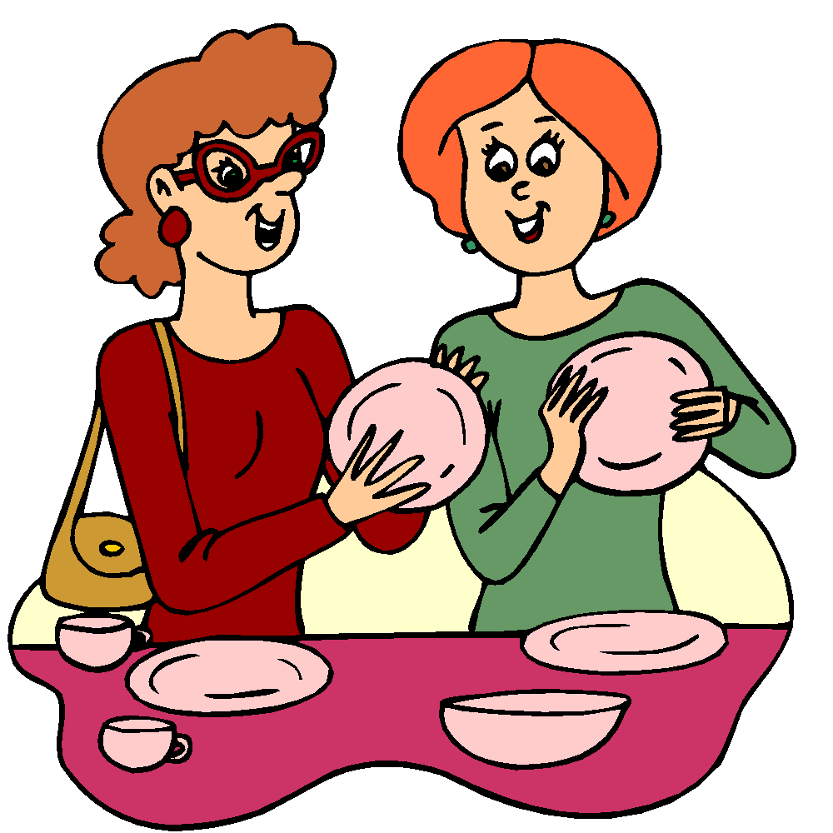
4. The right to choose

Slide 10
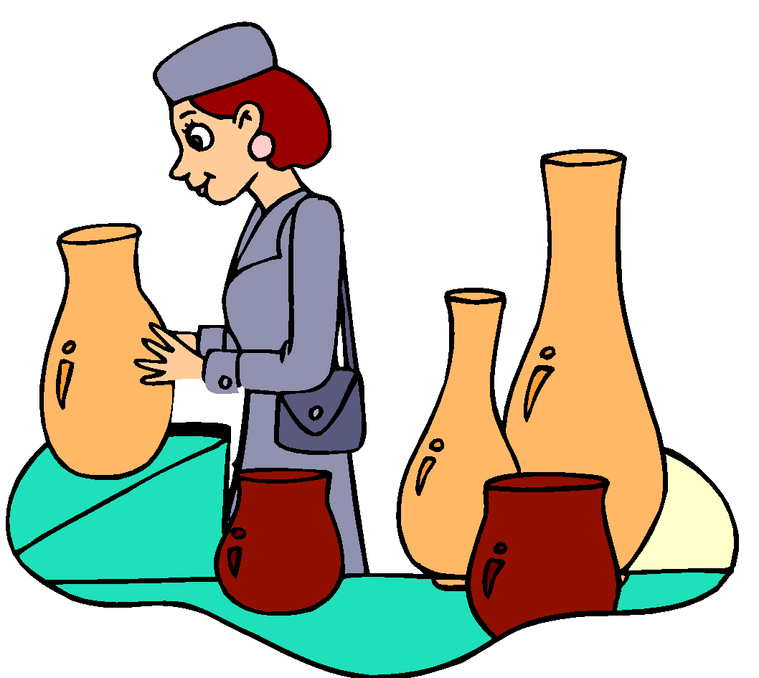
The right:
To be able to select from a range of products and services, offered at competitive prices with an assurance of satisfactory quality.

Slide 11
5. The right to be heard

Slide 12
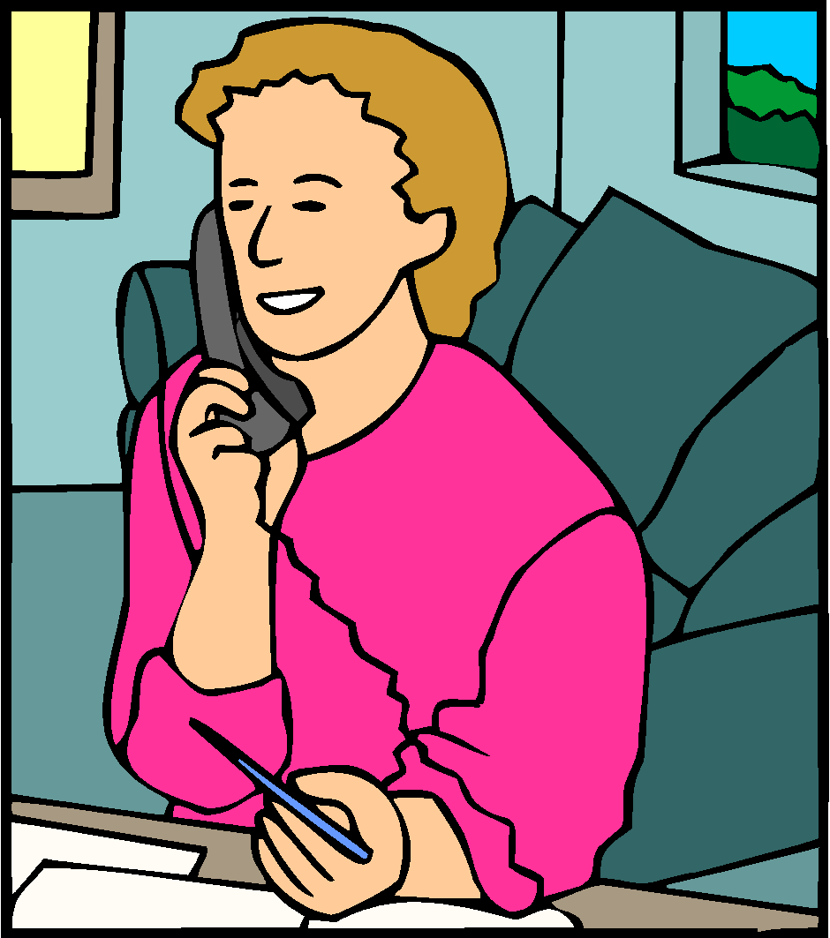
The right:
To have consumer interests represented in the making and execution of government policy, and in the development of products and services.

Slide 13
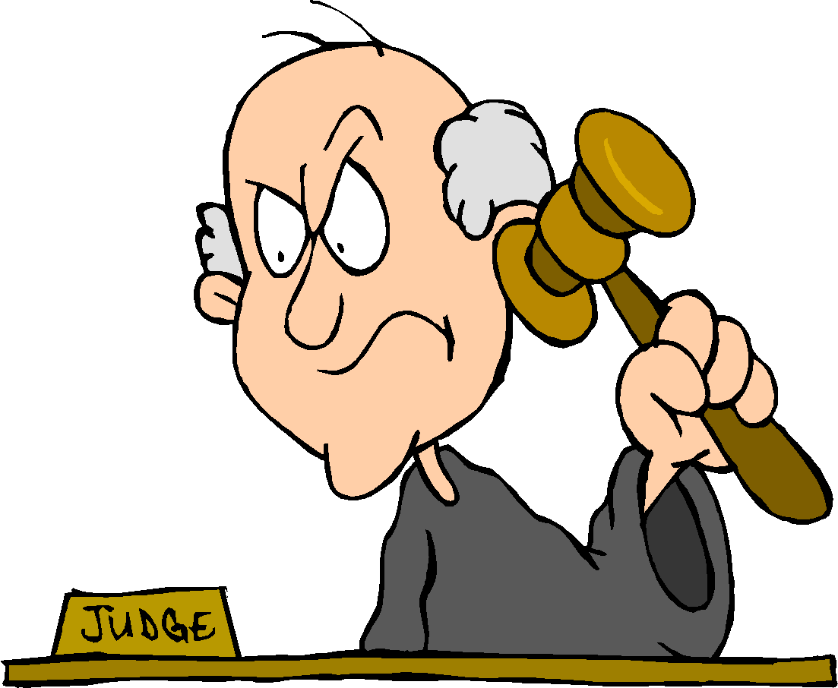
6. The right to redress

Slide 14
The right:
To receive a fair settlement of just claims, including compensation for misrepresentation, shoddy goods or unsatisfactory services.

Slide 15
7. The right to consumer education

Slide 16
The right:
To acquire knowledge and skills needed to make informed, and confident choices about goods and services, while being aware of basic consumer rights and responsibilities and how to act on them.

Slide 17
8. The right to a healthy environment

Slide 18
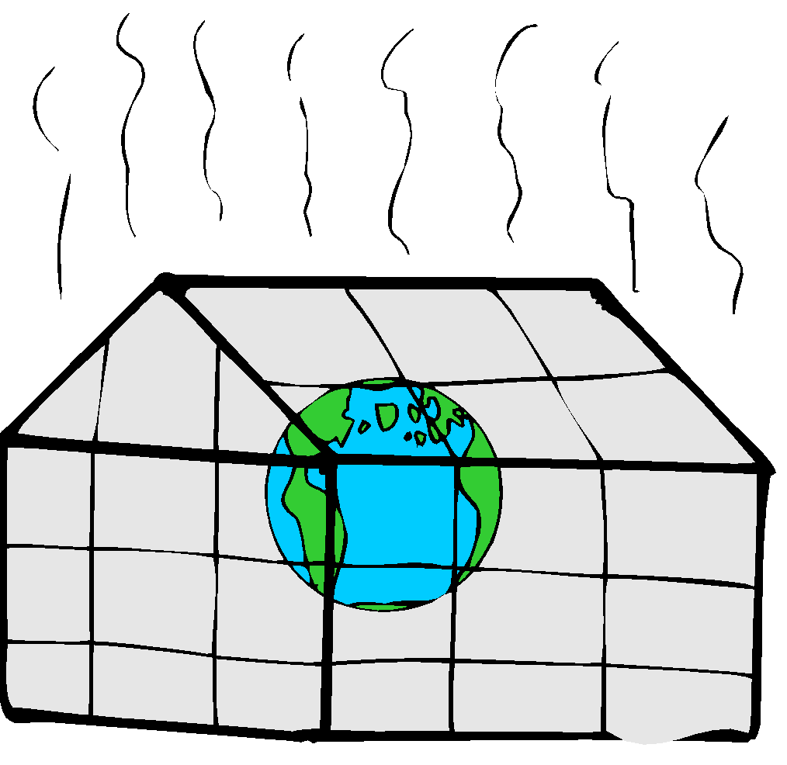
The right:
To live and work in an environment which is non-threatening to the well-being of present and future generations.

Slide 19
To think about
Research has shown that if someone has a consumer complaint they will tell at least 9 other people about their unhappiness. But if the complaint is handled well by the trader, the consumer is likely to recommend that trader to about 15 other people. So it is in the best interests of the trader to try his/her best to solve customer complaints.

Slide 20
Lesson 1 Task 2: (to be done during the 2nd half of the class and all of Lesson 2)
Break up into small groups of 3 to 5. You are going to spend the first 2 lessons identifying a major current event from 2022 in New Zealand that deals with one or more consumer rights. Each group will create a Powerpoint of 3 slides (& NO MORE than 3 slides) that 1) describes the event, 2) what consumer rights were violated, and 3) what was done or planned to address it. You will begin this in Lesson 1 and finish by the end of Lesson 2.
They will then present to the class during Lesson 3. This lesson will help you next week when we start our assessment.

