Slide 1
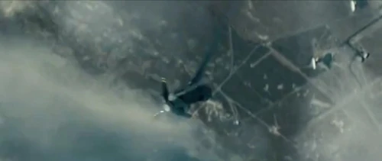
Hurricane Slideshow
L.I: We are EXPLORING articles by recognising texts that have multiples purposes and knowing the context of the creator helps us understand the purpose.

Slide 2
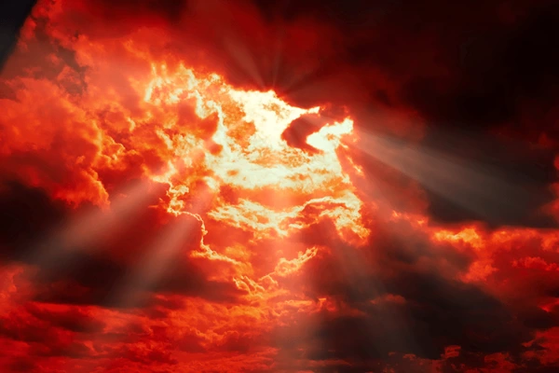
In Bermuda
Watch the following video about Hurricane Ernesto in Bermuda.
Then read this article about “Hurricanes are intensifying rapidly – this is what it could mean.”

Slide 3
Answer these questions in your English book:
What is the primary reason cited for the rapid intensification of Hurricane Beryl in 2024?
A) The storm's unusual path through the Atlantic Ocean.
B) The presence of a strong El Niño event.
C) Unusually high ocean temperatures in the Caribbean.
D) A combination of factors, including wind patterns and atmospheric pressure.
According to the text, what is the primary source of energy for hurricanes and cyclones?
A) The heat and water vapor from the ocean's surface.
B) The release of latent heat from condensation in the atmosphere.
C) The kinetic energy of the Earth's rotation.
D) The gravitational pull of the moon.
What is the main point the author is trying to convey about the future of hurricanes?
A) Hurricanes are becoming more frequent and intense due to climate change.
B) Hurricanes are becoming more predictable and easier to prepare for.
C) Hurricanes are becoming less dangerous due to improved forecasting models.
D) Hurricanes are becoming more common in the Pacific Ocean than in the Atlantic.

Slide 4
Answer these questions in your English book:
1. What is the significance of Hurricane Beryl's rapid intensification in the context of the Atlantic hurricane season?
2. How does the text explain the relationship between global warming and the intensity of hurricanes?
3. What evidence does the text provide to support the claim that hurricanes are becoming more common and intense?

Slide 5
Answer these questions in your English book:
1. The article discusses the increasing intensity of hurricanes and the potential impact on human lives and infrastructure. Reflect on how this information makes you feel and how it might influence your perspective on climate change and its consequences.
2. The text highlights the role of ocean temperatures in fueling hurricane intensity. Consider how this information connects to your understanding of the interconnectedness of natural systems and the importance of environmental stewardship.
3. The article explores the challenges of predicting and preparing for increasingly powerful hurricanes. Reflect on how this information relates to your own experiences with uncertainty and the importance of resilience in the face of unpredictable events.

Slide 6
Answer this question in your English book:
1. The article discusses the increasing intensity of hurricanes and the potential impact on human lives and infrastructure. Reflect on how this information makes you feel and how it might influence your perspective on climate change and its consequences.

Slide 7
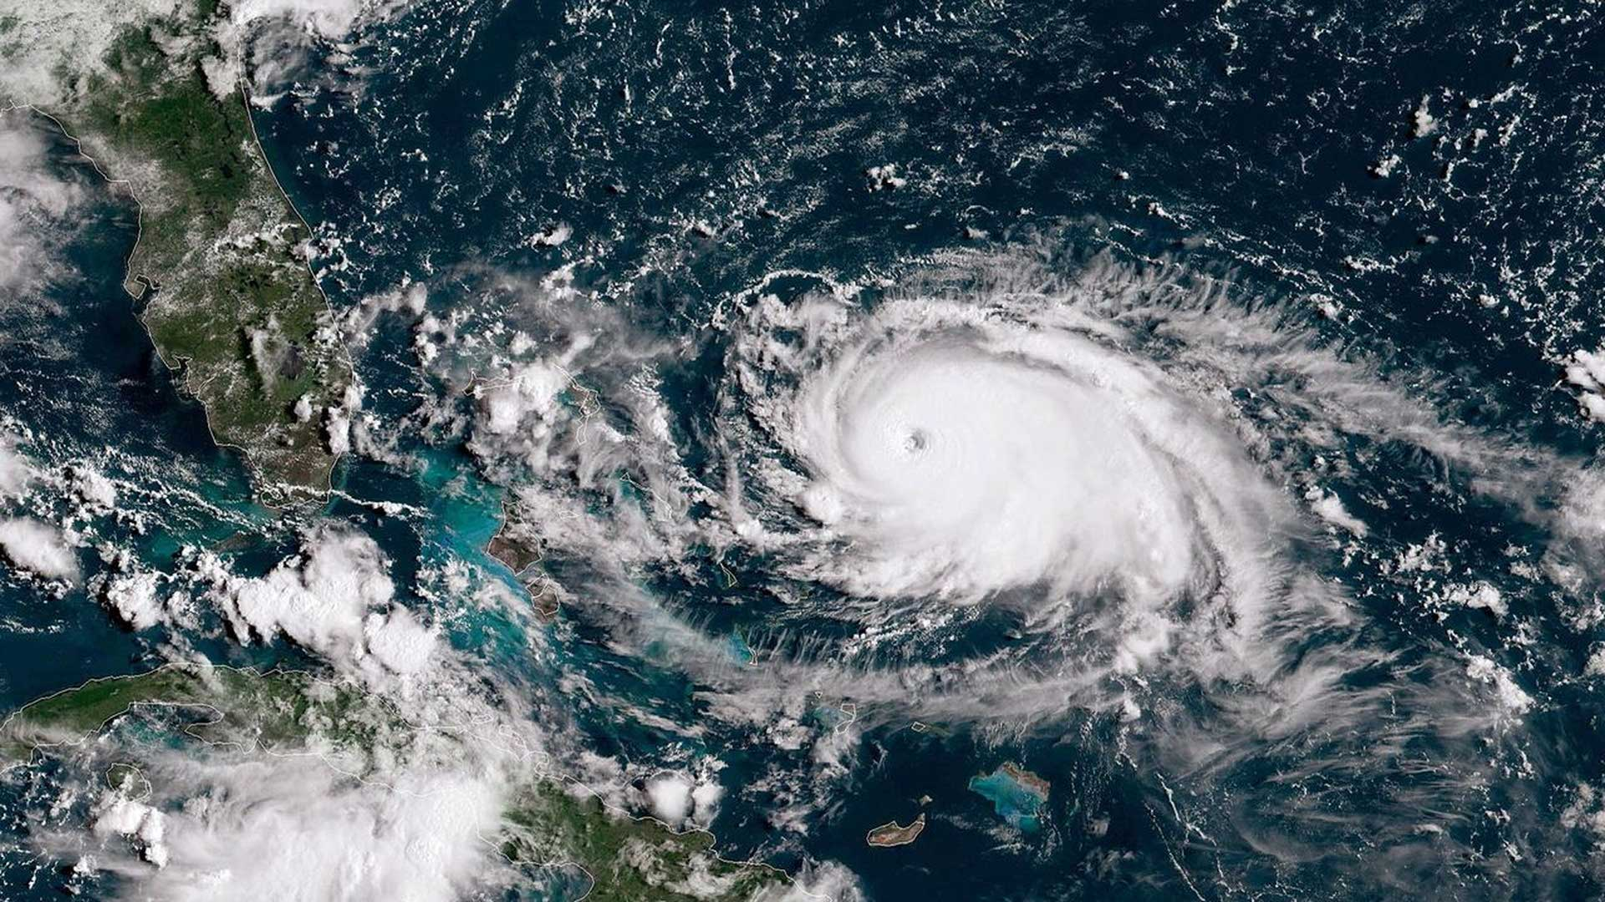
Answer this question in your English book:
Instructions: Look at the image below and write 2-3 things you notice (key details, main ideas, themes) and then write down 2-3 things you wonder (questions you have because of the image, things you are curious about when you look at the image).
What do you notice?
What do you wonder?

Slide 8
Answer this question in your English book:
Instructions: The center of the bubble map has an image that represents the reading to help get you started. Fill in the connecting bubbles with concepts, ideas, questions, and details that connect the image to the reading. Example: “This image connects to the reading because_____”
Hurricane Beryl, the first category five storm of 2024, intensified rapidly, raising concerns about the potential for more intense hurricanes in the future.
Experts attribute the rapid intensification of hurricanes to rising ocean temperatures, which provide more energy for storms to develop and strengthen.
The increasing frequency and intensity of hurricanes pose significant risks to coastal communities, infrastructure, and economies, highlighting the need for preparedness and mitigation strategies.

