Slide 1
Marine Reserves
Term 1 Week 3

Slide 2
Research questions:
What is a marine reserve?
Do we have any in New Zealand?

Slide 3
In your own words means….
Research online
Read and discuss
Close the tabs
Write your own sentences now
DO NOT cut and paste!! This is against the law.

Slide 4
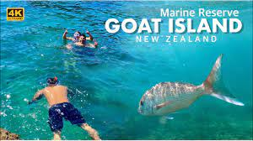
What is a marine reserve?
Marine means…
Reserve means…
A marine reserve is…

Slide 5
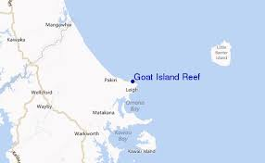
Do we have any in New Zealand?
Yes, we have 44 marine reserves in New Zealand.
One of them is called Goat Island.
Here it is.

