Slide 1
Food Technology
Mrs. Roodt
Takutai/Coast

Slide 2
What is food technology?
The use of practical and intellectual resources to develop food products
Practical hands on experiences
Produce quality food products
Involving critical and creative thinking
Develop concepts and prototypes to address stakeholders’ needs.
Food technology vs hospitality

Slide 3
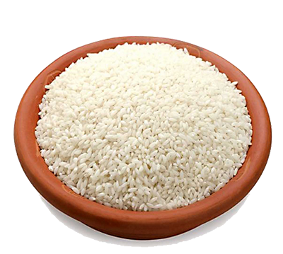
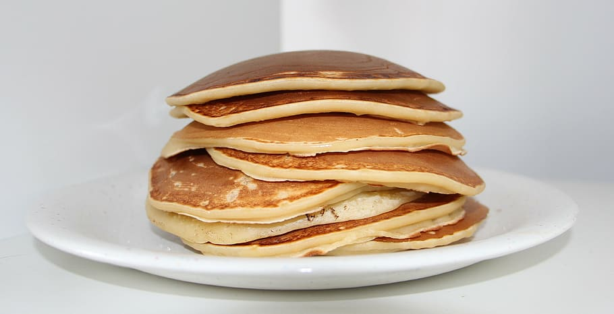
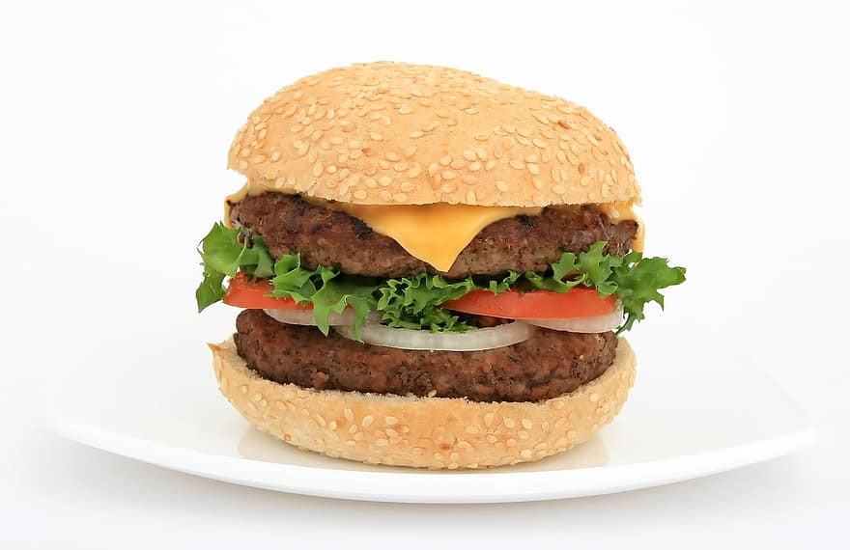
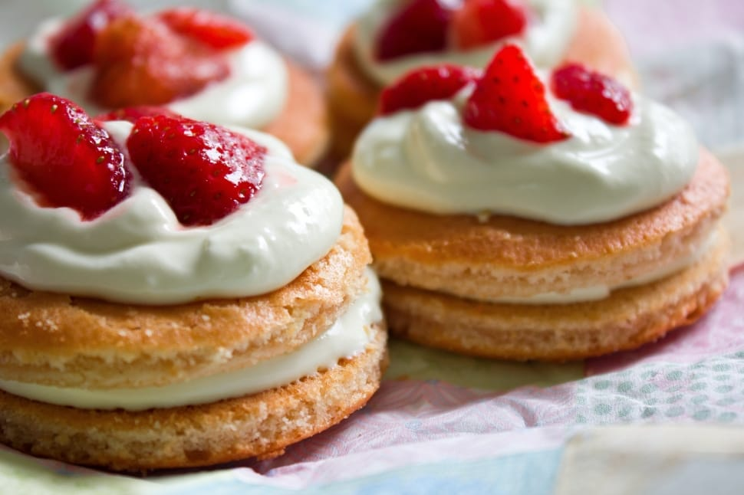
Year 9 Food Technology
Term 1: | Rice Assessment 1: Researched based
Term 2: | Pancakes
Term 3: | Gourmet burgers Assessment 2: Design brief
Term 4: | Baking

Slide 4
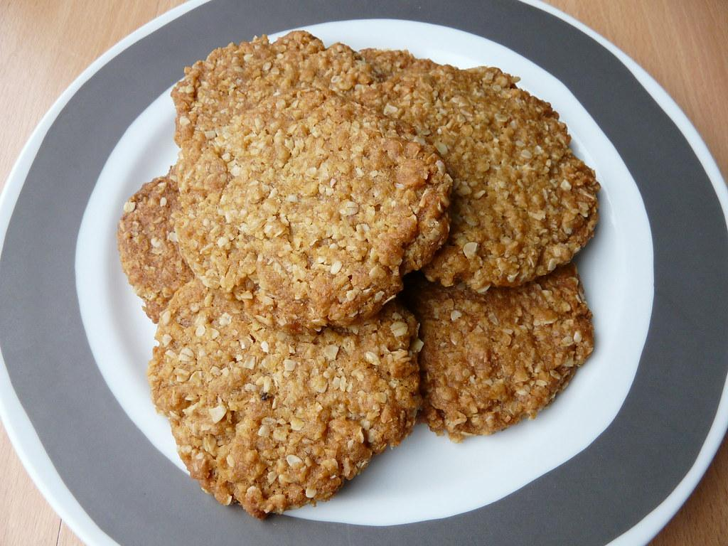
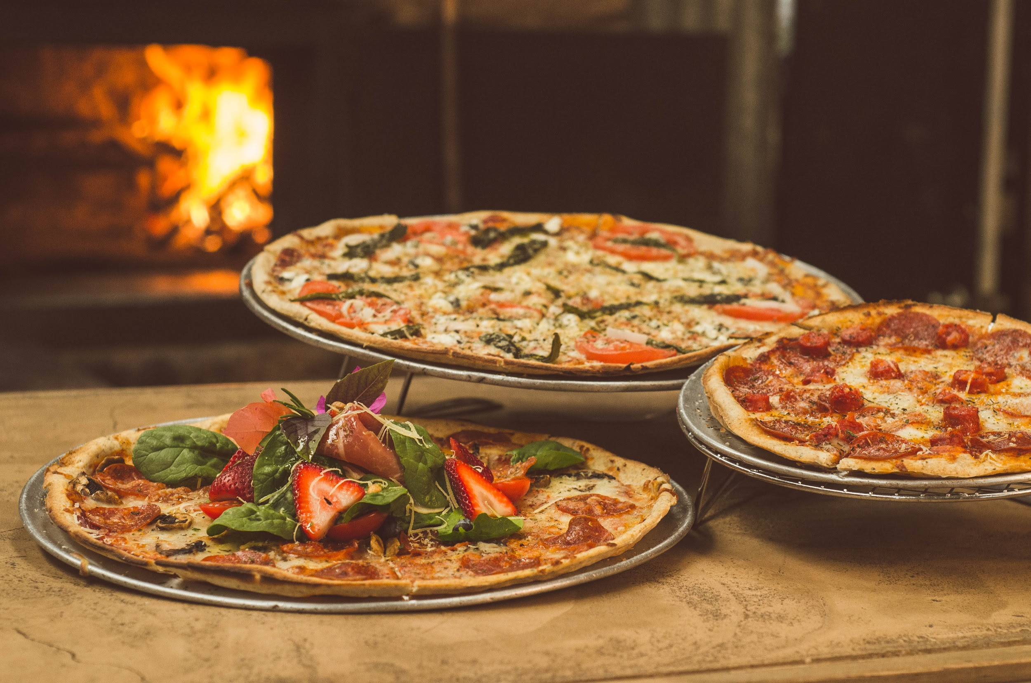
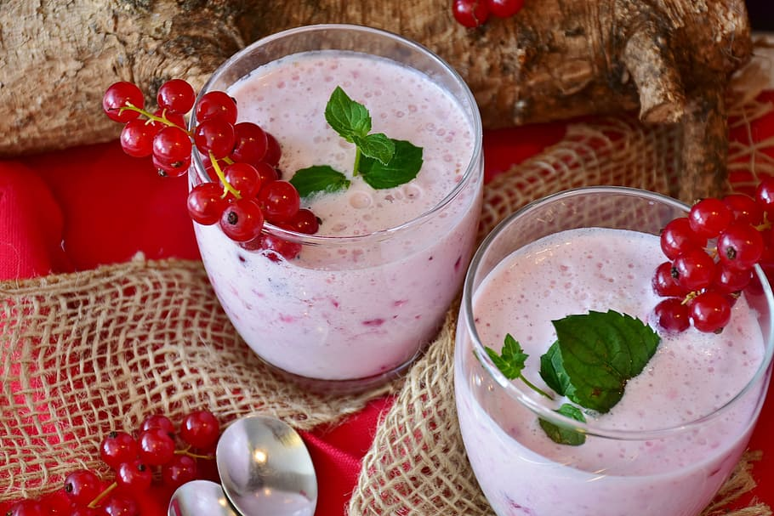
Year 10 Food Technology
Term 1: | Kiwi Classics Assessment 1: Outcome evaluation
Term 2: | International Foods
Term 3: | Pizzas Assessment 2: Planning for Practice
Term 4: | Milkshakes/Ice cream

Slide 5
Important:
1 x theory & 1 x practical lesson per week
Practicals: Tuesdays for year 9s and Wednesdays for year 10s
Cooking groups (4 - 5 members per group) - take dietary requirements in consideration
Stay up to date with theory work
All assessments are individual work (NOT group work!)

