Slide 1
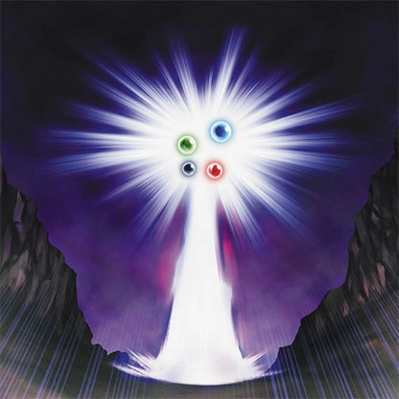
Bad Travel Articles Slideshow
L.I: We are EXPLORING articles by recognising texts that have multiples purposes and knowing the context of the creator helps us understand the purpose.

Slide 2
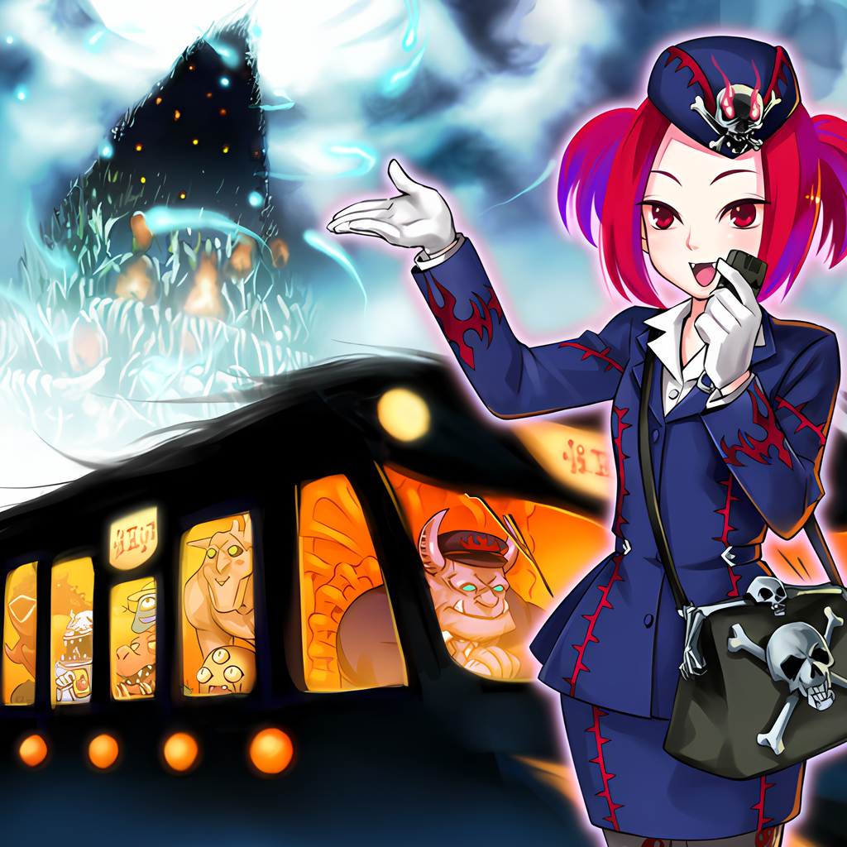
Bad For The World
Read this article about why travel is bad for the world.

Slide 3
Answer these questions in your English book:
1. What is one way that travel can hurt local economies?
A) Travelers often buy souvenirs from big companies.
B) Travelers often stay in big hotels and eat at chain restaurants.
C) Travelers often bring their own food and drinks.
D) Travelers often visit places that are already popular.
2. What is one way that travel can hurt the environment?
A) Travelers often buy souvenirs made from endangered animals.
B) Travelers often leave trash behind.
C) Travelers often use a lot of energy to fly, drive, and stay in hotels.
D) Travelers often visit places that are already crowded.
3. What is one way that travel can hurt cultures?
A) Travelers often take pictures of people without asking.
B) Travelers often bring their own way of life with them.
C) Travelers often try to learn the local language.
D) Travelers often respect the local customs.

Slide 4
Answer these questions in your English book:
1. What is one way that travel can make places feel like Disneyland?
2. What is one way that travel can hurt places in the long run?
3. What is one way that travel can be good for the world?

Slide 5
Answer these questions in your English book:
1. The text talks about how travel can hurt local economies. Think about a time you traveled to a new place. Did you spend money at local businesses or at big chain stores? How do you think your choices impacted the local economy?
2. The text says that travel can make places feel like Disneyland. Have you ever felt like a place you visited was too touristy? How did that make you feel? What could be done to make the experience more authentic?
3. The text asks if we are traveling too much. Think about your own travel habits. Do you think you travel too much? How could you be a more responsible traveler?

Slide 6
Answer this question in your English book:
1. The text talks about how travel can hurt local economies. Think about a time you traveled to a new place. Did you spend money at local businesses or at big chain stores? How do you think your choices impacted the local economy?

Slide 7
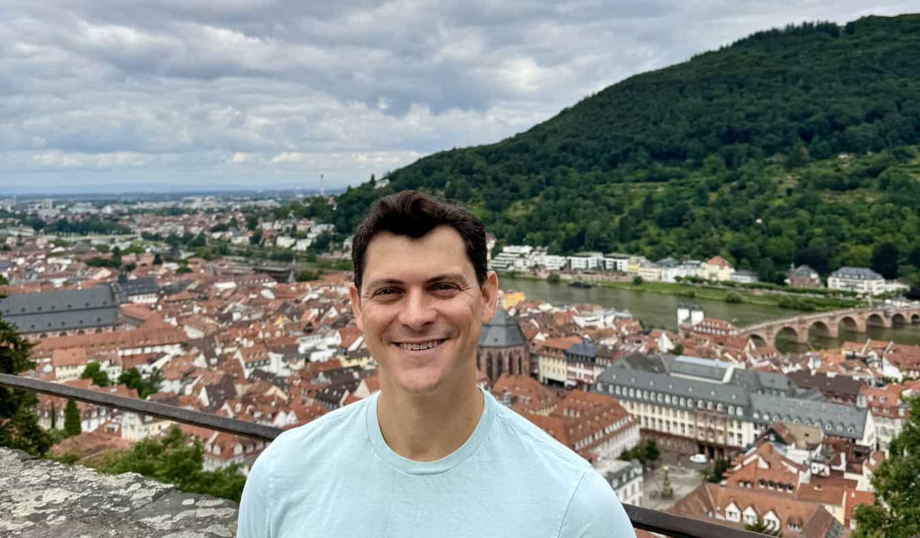
Answer this question in your English book:
Instructions: Look at the image below and write 2-3 things you notice (key details, main ideas, themes) and then write down 2-3 things you wonder (questions you have because of the image, things you are curious about when you look at the image).
What do you notice?
What do you wonder?

Slide 8
Answer this question in your English book:
Instructions: The center of the bubble map has an image that represents the reading to help get you started. Fill in the connecting bubbles with concepts, ideas, questions, and details that connect the image to the reading. Example: “This image connects to the reading because_____”
Traveling can be good because it helps us learn about other cultures and meet new people, but it can also have bad effects on the places we visit and the environment.
When we travel, we can sometimes forget about the real culture of the place we're visiting and make it feel like a Disneyland, hurting the local economy and environment.
We can be responsible travelers by staying in local places, eating local food, and being careful about the environment to make sure our travels are good for the world.

