Slide 1
Week 10
Culture –
How societies adapt to survive:
Exploring a Foreign Culture –
The Bushmen of the Kalahari

Slide 2
The San Bush People
The San people of Southern Africa are thought to be the oldest culture on earth – and at the very least they are certainly one of the oldest. Watch the video to get a big picture overview on the San.
Stop when you reach the 20-minute mark. It is for your own knowledge. You do not need to write anything down, but it will help you to better understand the readings.
https://www.youtube.com/watch?v=1oQ5Jd7p2aY&t=622s
https://www.youtube.com/watch?v=1oQ5Jd7p2aY&t=1172s

Slide 3
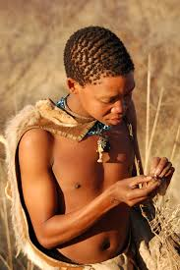
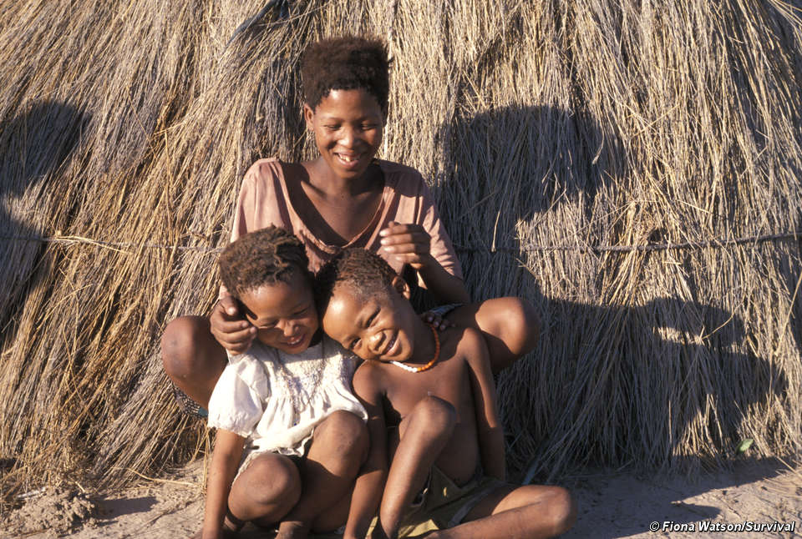
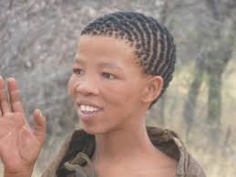
Lessons 1 to 3 Reading about the Life of the Bush People
Read the excerpt from the book Kalahari Bushmen by Alan Bernard (pages 4-24).

Slide 4
Instructions
Answer the questions in your RED Book. Write each question into your book, followed by the answer. I suggest you do not write all of the questions out first because it is difficult to judge how much space you will need for writing your answers – and some answers are longer than others.

Slide 5
Questions
Write each question in your red book starting with number 1.
List four different names for the “Bushmen” of the Kalahari. (the answer can be found on page 4).
a.
b.
c.
d.

Slide 6
2. Of the four names listed in question one, which is the most appropriate and why? (see p. 4)
a.
Why?

Slide 7
3. List three reasons why some people want to use the land of the “bushmen.” (p. 4).
a.
b.
c.

Slide 8
Global Studies
Week 6 Lesson 2
Continue with your reading and answer the questions. Please write in complete and full sentences. Please – no one word answers! Do not rush just to finish – take your time and enjoy learning about the San people.

Slide 9
4. Write down the six major sounds used by the ‘bushmen” and give their meaning (p. 5).
The first answer is provided as an example.
The / symbol represents a sucking sound that similar to “tsk” – an English expression of annoyance.
b.
c.

Slide 10
The San Language – Continued
d.
e.
f.

Slide 11
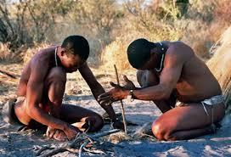
To hear a “bushman” speaking in clicks, see the following short clip: https://www.youtube.com/watch?v=W6WO5XabD-s

Slide 12
5. According to the reading, what do the modern-day bushpeople do with their wealth? (p. 6)
6. How many different groups of bushpeople live in the Kalahari region? (p. 6)
7. Most bushpeople live in small bands of between ____ and ____ people. (p. 7)

Slide 13
8. Three groups of bushpeople have become herders of animals, List each group and tell me something about them (p. 9).
a.
b.
c.

Slide 14
9. How did the Kalahari get its name and how was the original name spelled and pronounced?
a.
b.

Slide 15
10. Why is it that some bushpeople do not like to see livestock on the land? (p. 10).
11. What happened to the /Xam people?
What happened to the /Xam language?
a.
b.

Slide 16
Culture
Week 6 Lesson 3
Continue answering the questions from the San reading and write the answers in your Red Book.

Slide 17
12. Who was the god worshipped by the /Xam and what insect did it often take the form of?
13. What is the significance of the Nharo story involving a jackal tricking people?
14. What is the goal of the Herero game called “/wi .um.”

Slide 18
15. List 5 things that give !Kung people status:
1.
2.
3.
4.
5.

Slide 19
16. Who do the !Kung name their children after?
17. What are two uses of the tsi bush?
18. List the five !Kung seasons and what they represent.
For example, in Northern Australia where I once lived, the wet season is between November and April and is characterized by heavy rain, cyclone threats and an abundance of wild food and game animals.
1.

Slide 20
The !Kung Seasons Continued
2.
3.
4.

Slide 21
19. What is the significance of the place called Gautsha?
20. During the 1970s and 80s, what war interrupted the !Kung way of life?
21. Name a pastoral group who live in the Kalahari (a group who keep animals for food). What animals do they tend to?

