Slide 2
Term 4 Context
Throughout Term 4 our context is Masterchef. In Health we will be exploring Nutrition and the different types of food and how we need to fuel our bodies.

Slide 3
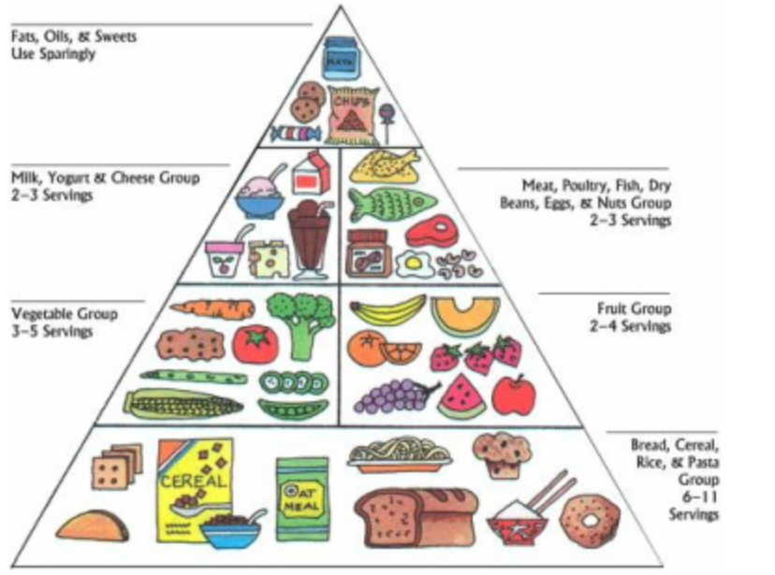

Slide 4
Why do we need food?
Just as a car requires fuel such as petrol, the human body must have a good supply of fuel.
This fuel comes via 3 important components:
Carbohydrates
Fats
Proteins

Slide 5
Carbohydrates
Simple carbohydrates: These are also called simple sugars. Simple sugars are found in refined sugars, like the white sugar you'd find in a sugar bowl. If you have a lollipop, you're eating simple carbohydrates. But you'll also find simple sugars in more nutritious foods, such as fruit and milk. It's better to get your simple sugars from food like fruit and milk.

Slide 6
Carbohydrates
Complex carbohydrates: These are also called starches. Starches include grain products, such as bread, crackers, pasta, and rice. As with simple sugars, some complex carbohydrate foods are better choices than others. Refined grains, such as white flour and white rice, have been processed, which removes nutrients and fibre. But unrefined grains still contain these vitamins and minerals. Unrefined grains also are rich in fibre, which helps your digestive system work well.

Slide 7
Carbohydrates activity
List 5 different simple Carbohydrates
List 5 different complex Carbohydrates

