Slide 1
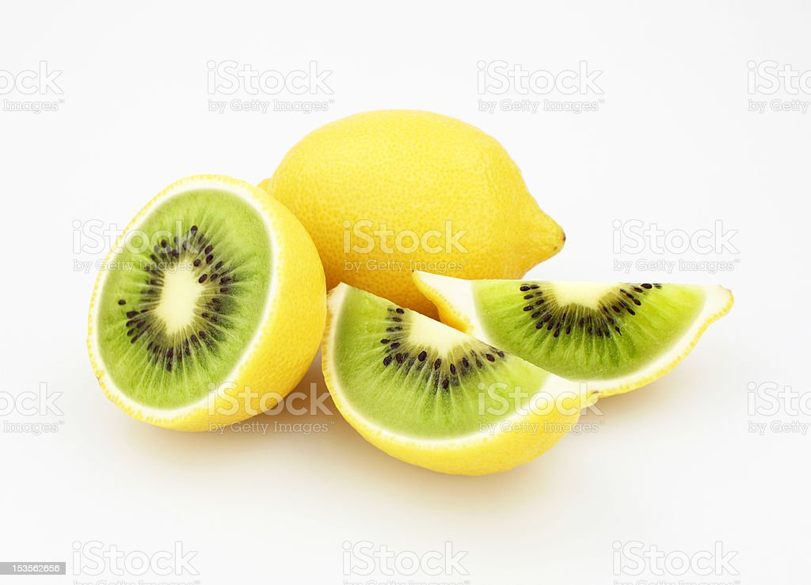
Week 8 Global Studies Kiwi Inventions

Slide 2
Group Task - Instructions
Read the laminated sheet presented to your group.
Look for the title of your group’s invention on the is slide show and answer the questions in your books.
After you finished, choose another laminated sheet from any group, read the sheet, find the title on this slideshow and answer the questions.
IN CLASS we will NOT use our computers. I have placed this online ONLY for people who are absent.

Slide 3
1 Wireless Charging
Some people think New Zealand is too small of a country to get into the wireless charging business. How did Finland prove this wrong?
What is a patent? You can look this up in the dictionary at the front of class.
What is meant by “loose coupling?”
PowerbyProxi have also invented a battery that is unlike all other batteries on the market. How is it different?

Slide 4
2 Powered Human Flight
Some people think that a Kiwi may have been the first human to engage in powered flight. What was his name and when did he live (when was he born and die).
Both the Wright Brothers and Richard Pearse worked in similar jobs. What was that job?
How far did the first flight of Pearse travel?
Explain the controversy surrounding whether Pearse or the Wright Brothers were the first to attain powered flight? In other words, why do most people still credit the Wright Brothers with the world’s first human powered flight. Explain in a short paragraph.
Was Pearse widely respected by others at the time of his invention?

Slide 5
3 The Eight-Hour Working Day
What was Samuel Parnell’s job?
When he worked in London, describe a typical working day for Mr Parnell.
Why did Mr Parnell want to work only 8 hours a day? Describe what he told others at the time as it why he would only work 8 hours in one day.
What year did the New Zealand Governmnet pass a law that recognizsed the role of unions?

Slide 6
4 Tullen Snips
When were the first known sissors invented?
Why are Tukken Snips better than sissors?
How hard was it for John Hough to invent the Snips? How many did he make before he got it the way he wanted it?
Give an example of just how powerful the snips are?
Why are the snips no longer around? Why do they no longer make them?

Slide 7
5 Refrigerated Shipping
By the 1880s, name two major Kiwi industries that were drying up?
By 1881, how many more sheep than people were in New Zealand?
By the late 1880s, New Zealand produced a lot of meat by they could not ship it overseas as it would go bad. Who is the man who overcame this problem and how did he do it?
In 1881, why were many sailors hesitant to sail on Davidson’s refrigerated ship? What did they fear might happen?
By the 1930s, what were New Zealand’s key exports (products shipped overseas) to Britain?

Slide 8
6 The Buzzy Bee
Who invented the Buzzy Bee?
Is the buzzy bee a popular toy outsifde of New Zealand?
Some people think that Maurice Schlesinger got his idea for the buzzy bee from someone overseas, Where and from whom?
Even if Schlesinger did get the idea from somewhere else, why is his toyed still being sold?

Slide 9
7 Childproof Lids
Read the article on childproof lids and create 5 questions about the reading.

Slide 10
8 Hamburger Holder & Navigation Lights Read the articles & generate 4 questions and answers for each

