Slide 1
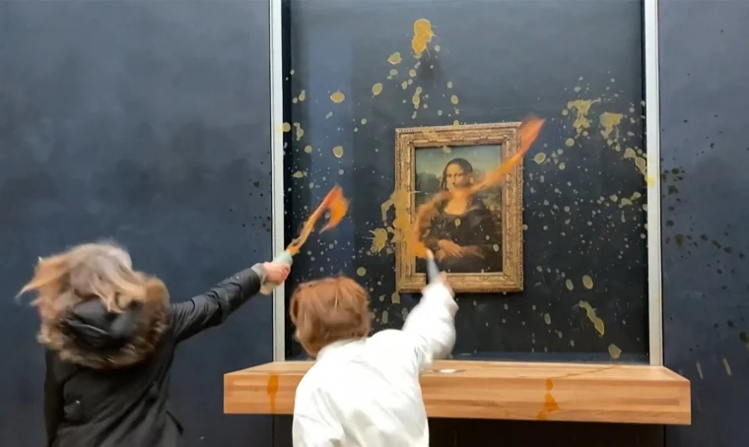
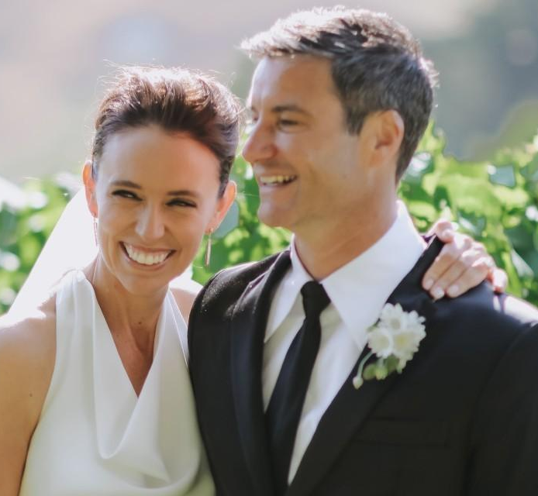
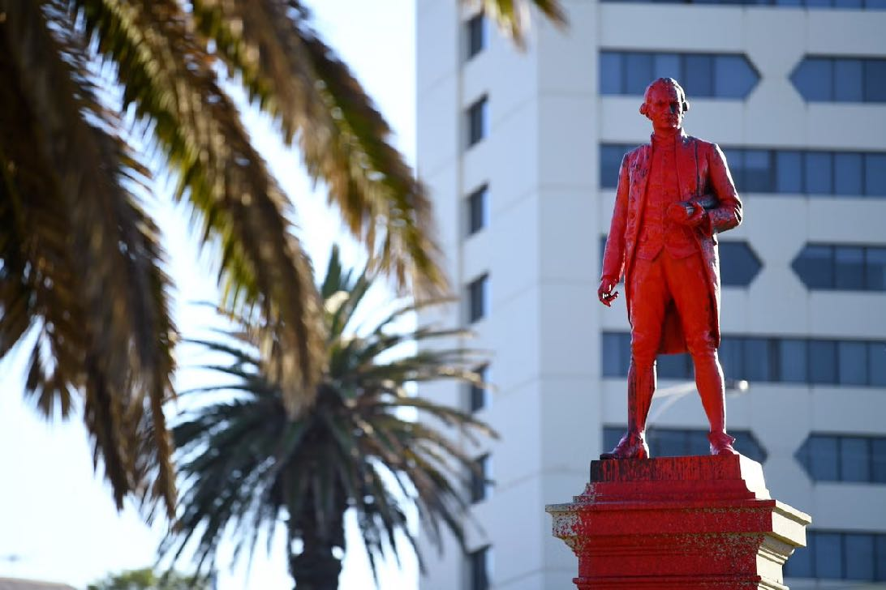
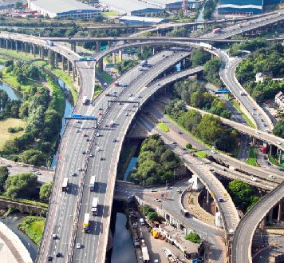
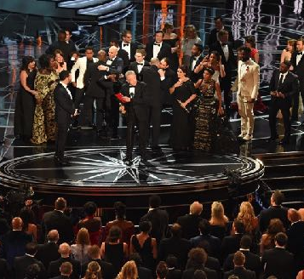
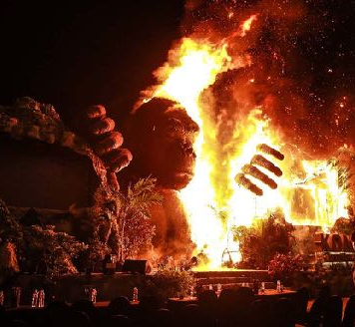
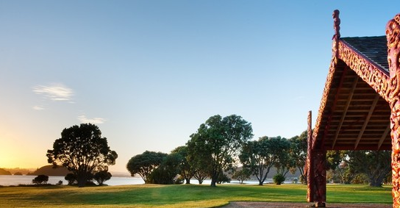
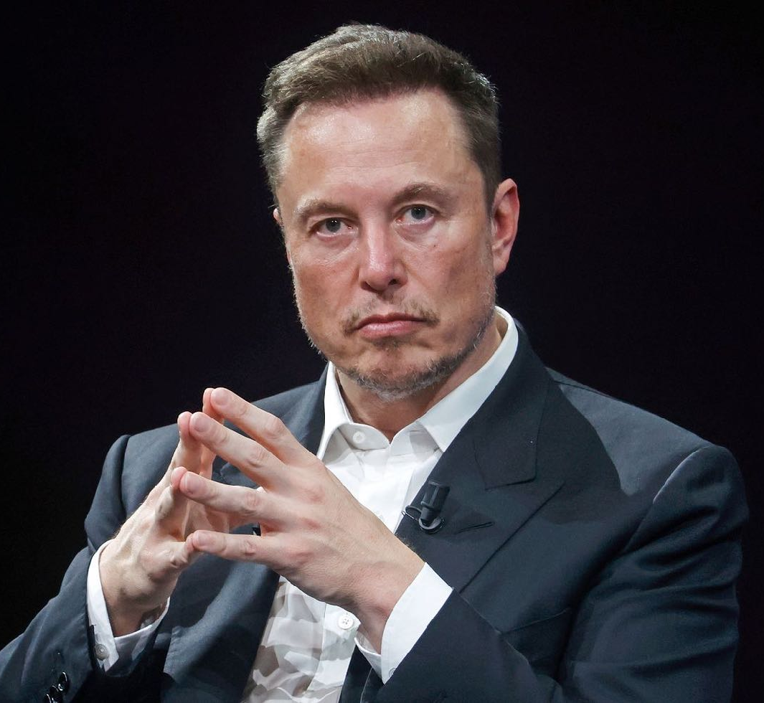
Weekly Quiz Current Events
05 February 2024
06/03/17

Slide 2
What year was the Treaty of Waitangi/Te Tiriti o Waitangi signed?
1
a. 1820 b. 1840 c. 1880

Slide 3
In which country have animal rights activists held protests against the return of bullfighting?
2
a. Italy b. Mexico c. Peru

Slide 4
In which sea have attacks on shipping by Houthi forces led to retaliation strikes by the British and United States military?
3
a. The Red Sea b. The Black Sea c. The Yellow Sea

Slide 5
What is the first name of the man on the right?
a. Simon b. Clarke c. Mark
4

Slide 6
Why was Auckland’s Muriwai Beach in the news recently?
5
a. There have been calls for a vehicle ban on the beach after a person died when a ute rolled b. Local Iwi have asked for a temporary pause on fishing in the area c. The Muriwai surf club was damaged in a storm

Slide 7
Which two members of the Royal Family have spent time in hospital recently?
6
a. The King and the Princess of Wales b. The Prince of Wales and the Queen Consort c. The King and the Duchess of Sussex

Slide 8
Which of the following caused the number of new Netflix subscriptions to surge recently?
7
a. The release of series four of Stranger Things b. The ability to download episodes to watch offline c. A crack down on password-sharing

Slide 9
What is the name of this famous painting?
a. Girl with the Pearl Earring
b. Mona Lisa
c. The Birth of Venus
8

Slide 10
Which South Island town has been crowned 2023’s sunniest place for the first time since records began?
9
a. Hokitika b. Tekapo c. Kerikeri

Slide 11
True or false, Margot Robbie and Ryan Gosling have both received Oscar nominations for their roles in the Barbie film?
10

Slide 12
Top Formula 1 driver Lewis Hamilton, has announced he is leaving Mercedes to sign with …?
11
a. Ferrari b. McLaren c. Red Bull

Slide 13
Where would you find this historic site that has special relevance this week?
12

Slide 14
Which platform has removed music by artists including Taylor Swift, The Weeknd and Olivia Rodrigo?
13
a. Spotify b. Apple Music c. TikTok

Slide 15
Auckland teenager Yanhao Li has created history by winning New Zealand’s first ever Youth Olympic medal in which winter sport?
14
a. Luge b. Speed skating c. Ice figure skating

Slide 16
Why has Sesame Street’s Elmo been in the news recently?
15
a. He went viral after he asked the internet “How is everybody doing?” b. He has announced a new Elmo movie with cameos from major Hollywood stars c. He is starting his own talk show

Slide 17
Which country has this flag?
16

Slide 18
Which famous cartoon character entered the public domain recently after its copyright protections expired (meaning it belongs to everyone, and can be used without restriction)?
17
a. Bugs Bunny b. Donald Duck c. Mickey Mouse

Slide 19
A French woman has become the richest female in the world with the makeup brand she inherited increasing in value to $100 billion. What is the name of the brand, the world's largest cosmetics company?
18
a. Chanel b. Estée Lauder c. L’Oréal

Slide 20
Which name has taken the title of the most declined baby name in New Zealand, beating 'King' for the first time in 13 years?
19
a. Anarchy b. Prince c. X

Slide 21
What is the last name of this man who has been in the news?
20

Slide 22
Answers

Slide 23
What year was the Treaty of Waitangi/Te Tiriti o Waitangi signed? a. 1820 b. 1840 c. 1880
1
b. 1840 - The Treaty is an agreement, in Māori and English, that was made between the British Crown and about 540 Māori rangatira (chiefs). The Treaty was prepared in just a few days. A missionary named Henry Williams and his son Edward translated the English draft into Māori overnight on 4 February. About 500 Māori debated the document for a day and a night before it was signed on 6 February.

Slide 24
In which country have animal rights activists held protests against the return of bullfighting? a. Italy b. Mexico c. Peru
2
b. Mexico - Mexico city recently held its first bullfight since 2022. A judge had ordered the suspension of the practice agreeing with animal rights activists who had filed a suit but the Supreme Court revoked the decision last month. Bullfights date back to the 16th Century in Mexico.

Slide 25
In which sea have attacks on shipping by Houthi forces led to retaliation strikes by the British and United States military? a. The Red Sea b. The Black Sea c. The Yellow Sea
3
a. The Red Sea - The Houthis, a Yemeni militia group, have been targeting international shipping, leading to significant international military action. British and US warplanes, ships and submarines launched dozens of air strikes across Yemen against Houthi forces in the Red Sea.

Slide 26
What is the first name of the man on the right?
a. Simon b. Clarke c. Mark
4
b. Clarke - Former Prime Minister Dame Jacinda Ardern married her long-time fiancé, TV presenter Clarke Gayford, in January. The wedding took place at Craggy Range, a premium winery in Hawke's Bay.

Slide 27
Why was Auckland’s Muriwai Beach in the news recently? a. There have been calls for a vehicle ban on the beach after a person died when a ute rolled b. Local Iwi have asked for a temporary pause on fishing in the area c. The Muriwai surf club was damaged in a storm
5
a. There have been calls for a vehicle ban on the beach after a person died when a ute rolled - A temporary rāhui was placed on the beach after the accident. Vehicle use on the beach has long been a source of controversy with some locals believing the 60km speed limit is not safe. Muriwai beach is 60km long.

Slide 28
Which two members of the Royal Family have spent time in hospital recently? a. The King and the Princess of Wales b. The Prince of Wales and the Queen Consort c. The King and the Duchess of Sussex
6
a. The King and the Princess of Wales - The Princess of Wales ad abdominal surgery and King Charles III also underwent a scheduled medical procedure of his own. Details about the health of royals are usually a closely-guarded secret and only announced to the public in limited circumstances, so the decision of the Palace to release two major updates in one day was striking. The Duchess of York Sarah Ferguson has also been diagnosed with malignant melanoma. Ferguson is the former wife of Prince Andrew.

Slide 29
Which of the following caused the number of new Netflix subscriptions to surge recently? a. The release of series four of Stranger Things b. The ability to download episodes to watch offline c. A crack down on password-sharing
7
c. A crack down on password-sharing - The streaming giant added more than 13.1 million subscriptions in the three months ended in December. Netflix sign-ups boomed as customers responded to the firm's crackdown on password-sharing by creating their own accounts.

Slide 30
What is the name of this famous painting?
a. Girl with the Pearl Earring
b. Mona Lisa
c. The Birth of Venus
8
b. Mona Lisa - Protesters demanding the right to "healthy and sustainable food" threw soup at the glass-protected Mona Lisa painting in Paris. The 16th Century paining by Leonardo da Vinci is one of the world's most famous artworks. It sits behind bulletproof glass so it is unlikely to have been damaged.

Slide 31
Which South Island town has been crowned 2023’s sunniest place for the first time since records began? a. Hokitika b. Tekapo c. Kerikeri
9
b. Tekapo - Tekapo recorded 2658 hours of sunshine followed by Richmond then Appleby, Cromwell and fifth place went to Blenheim. New Plymouth in Taranaki, which has held the crown for the past two years, was the North Island’s best showing, coming in sixth.

Slide 32
True or false, Margot Robbie and Ryan Gosling have both received Oscar nominations for their roles in the Barbie film?
10
False - Ryan Gosling received a nomination for his role as Ken but Margot Robbie missed out for her role as Barbie. Margot Robbie has downplayed the Oscar nomination snub, saying she's "beyond ecstatic" with the film's eight nominations. Greta Gerwig also missed out on a best director nomination.

Slide 33
Top Formula 1 driver Lewis Hamilton, has announced he is leaving Mercedes to sign with …? a. Ferrari b. McLaren c. Red Bull
11
a. Ferrari - Hamilton joined Mercedes from McLaren in 2013 and won six of his seven world titles at the Silver Arrows on his way to a record 103 race wins. His seven crowns are matched only by German Michael Schumacher, who raced for Ferrari from 1996 to 2006 during a golden era at Maranello and made a comeback at Mercedes.

Slide 34
Where would you find this historic site that has special relevance this week?
12
Waitangi - The Waitangi Treaty Grounds expected an attendance of 40,000 people for the Waitangi Day celebrations.

Slide 35
Which platform has removed music by artists including Taylor Swift, The Weeknd and Olivia Rodrigo? a. Spotify b. Apple Music c. TikTok
13
c. TikTok - TikTok has removed music by some stars after a row with their record label, Universal Music Group. UMG said TikTok wanted to pay a "fraction" of the rate other social media sites do for access to its songs. All videos which have UMG music on them will be muted and new videos will not be able to be made with those tracks.

Slide 36
Auckland teenager Yanhao Li has created history by winning New Zealand’s first ever Youth Olympic medal in which winter sport? a. Luge b. Speed skating c. Ice figure skating
14
c. Ice figure skating - The 15-year-old won a bronze medal at the Youth Olympic Games in Gangwon, South Korea, last week after landing a triple axel for the first time ever in competition. It is New Zealand’s first ever ice figure skating medal at any form of Winter Olympic Games.

Slide 37
Why has Sesame Street’s Elmo been in the news recently? a. He went viral after he asked the internet “How is everybody doing?” b. He has announced a new Elmo movie with cameos from major Hollywood stars c. He is starting his own talk show
15
a. He went viral after he asked the internet “How is everybody doing?” - After his post received 9,000 responses in less than a day, the account posted a follow-up: “Wow! Elmo is glad he asked!” it read. “Elmo learned it is important to ask a friend how they are doing.”

Slide 38
Which country has this flag?
16
South Korea

Slide 39
Which famous cartoon character entered the public domain recently after its copyright protections expired (meaning it belongs to everyone, and can be used without restriction)? a. Bugs Bunny b. Donald Duck c. Mickey Mouse
17
c. Mickey Mouse - Mickey Mouse entered the public domain in January 2024 after Disney's copyright protections expired after 100 years. However, Disney still retains some protections for more modern versions of the character.

Slide 40
A French woman has become the richest female in the world with the makeup brand she inherited increasing in value to $100 billion. What is the name of the brand, the world's largest cosmetics company? a. Chanel b. Estée Lauder c. L’Oréal
18
c. L'Oréal - The net worth of Ms Bettencourt Meyers, aged 70, of $100bn makes her the 12th richest person in the world. L'Oréal was founded by her grandfather in 1909. She and her family are the single biggest shareholders of L'Oréal with a stake of around 35%.

Slide 41
Which name has taken the title of the most declined baby name in New Zealand, beating 'King' for the first time in 13 years? a. Anarchy b. Prince c. X
19
b. Prince - The name Prince was declined five times as official titles are not allowed as names. Prince was followed by Bishop, lll, King, Major and Royal - all with three declines. Guidelines are in place in New Zealand to ensure names don't cause offence, are a reasonable length and don't represent an official title or rank. The Registrar-General can decline the registration of names which fail to comply with guidelines.

Slide 42
What is the last name of this man who has been in the news?
20
Musk - A judge in the United States has blocked a $55.8 billion (£44bn) pay deal to Elon Musk by the electric car company Tesla. The lawsuit was filed by a shareholder who argued that the pay-packet was too high. The judge called the compensation "an unfathomable sum" that was not fair to shareholders.

Slide 43
The End

