Slide 1
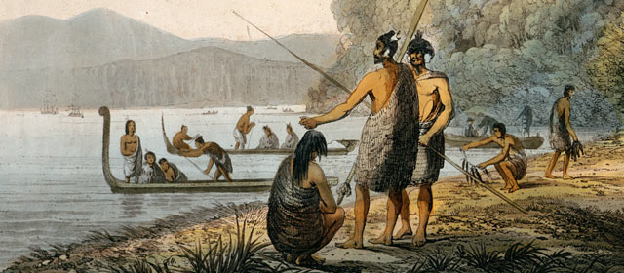
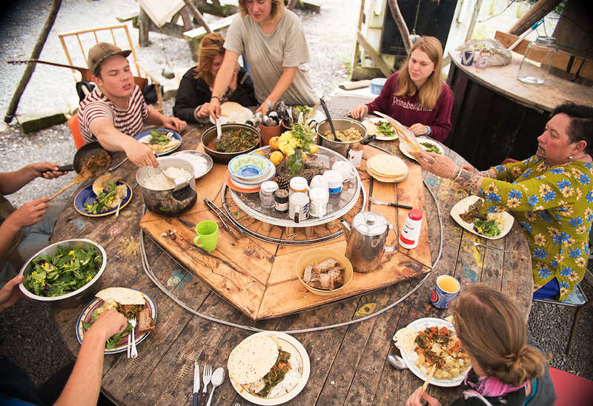
In this lesson . . .
Opportunity cost is
‘The loss of choice when a choice is chosen’
‘For the Māori in New Zealand’

Slide 2
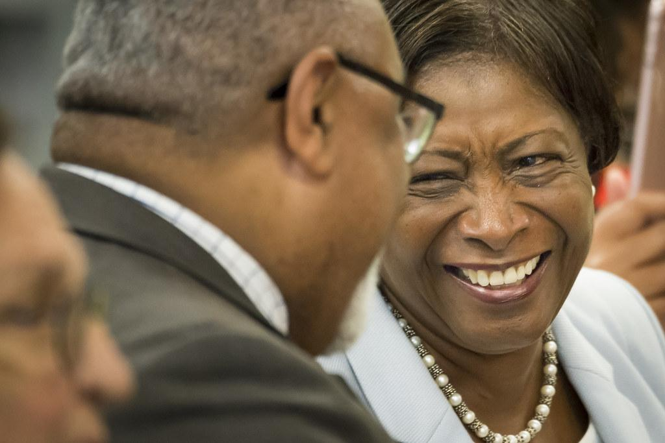
Māori Veteran
Watch the following video about a Māori veteran who was kicked out of a pub for having a face tattoo up to 5:39.

Slide 3
TASK 1
How did the man and the people in the pub feel when he couldn’t be served for having face tattoos?
What opportunities do you think the man missed out on by not being served in the pub for having face tattoos?
What did the man do as a result of what he experienced?
What would you have done if you were in the same situation as the man?

Slide 4
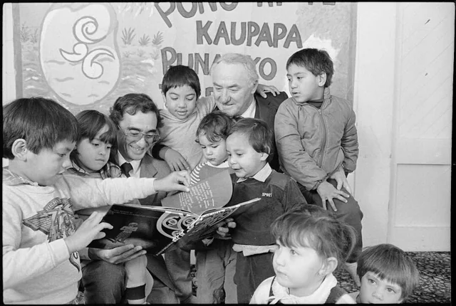
TASK 2
What might have happened if Hobson had kept to his original plans and not brought the signing of the Treaty a day forward?
Read the article at this link about what if there had been no treaty in New Zealand?
Summarise in bullet points the main items in your Global Studies books.
Illustrate your bullet points as a drawing.

Slide 5
What If There Had Been No Treaty In New Zealand?
The first outcome is possibly the most attractive to those who now champion the cause of Maori sovereignty. The existence of Maori as independent tribes and modern politics in their own right might well be the ultimate fantasy of many Maori nationalists.
However, the evidence suggests this situation would have been highly improbable. Why would Maori have been able to escape the web of empire, when its reaches were so vast? Why would they have been immune from colonisation? It is totally against the run of evidence and logic to assume that New Zealand, with its rich natural resources, would have been exempt from some form of external colonisation. After all, there had been successful trading relationships established between Europeans and Maori tribes from the late eighteenth century, and a good deal of missionary activity in the early nineteenth. On the whole, Maori had been eager to engage with Europe, its peoples and its technologies. Perhaps unwittingly, they had helped facilitate, or at least hasten, the processes of colonisation. For example, there is evidence that many tribes had, well before 1840, expressed a desire for British law and order.

Slide 6
TASK 3
Māori have been more involved in tech and so their children have been able to understand that more, so they view success in this field.
Click on this link about modern technology and Māori values.
In your Global Studies book, write the date and the heading “Modern Technology And Māori Values.”
In small groups, write 10 reasons for the opportunity cost of choosing modern technology over Māori values or choosing Māori values over modern technology.

Slide 7
Modern Technology And Māori Values
Straker Translations is contributing to the $50 billion Māori economy, which is defined as the Māori contribution to the New Zealand economy by Māori collectives, Māori employers and self-employed Māori.
Grant’s Māori heritage and culture has had a huge impact on both his success and the way he runs the business. He says it’s important staff understand that it is a New Zealand company, and when possible, he brings team members from overseas offices to New Zealand to have a marae experience.
“And we have just acquired another company and are going to have an additional 25 staff. It’s important that they understand the values of the company,” he says.
“If you are genuine, people trust you. Is that a Māori value or a Kiwi value? I think that’s a New Zealand value – people here are generally upfront and honest. In some cultures, that is not always the case.”
Looking after staff and whanau is key to the business, especially when operating across multiple cultures.

Slide 8
Flipgrid Video For Tasks
Create a video using Flipgrid to record the tasks that you did to help the others.

