Slide 1
Word Association
Write down the word and a word/phrase/idea you associate with it.

Slide 2
Word Association
New Zealand
Nature
Rivers
Oceans
Farming
Plastic
Landfill
Glass
Garbage
Pollution

Slide 3
What do you think of when you think of NZ’s environment?
NZ Environment

Slide 4
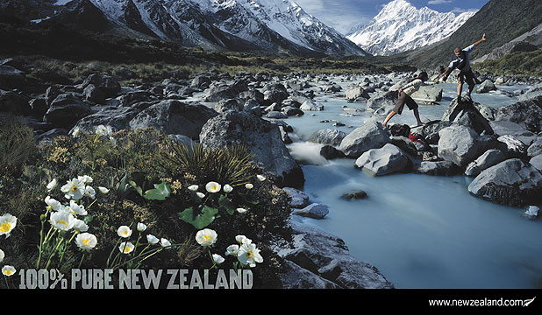
New Zealand – 100% Pure
How does this video present New Zealand?

Slide 5
Discuss: Is New Zealand a “pure” country? Why/why not?
YES
comparatively
still undisturbed bush
more gentle, laid back
smaller
NUCLEAR FREE
less crime, low population
more aware/protective
anti-smoking/clean energy
NO
produce a lot of rubbish for size (large footprint)
bush has been turned to farmland
FARMING - pollutants
Colonisation
OZONE ☹
Extinct species: moa, Haast eagles, huia

Slide 6
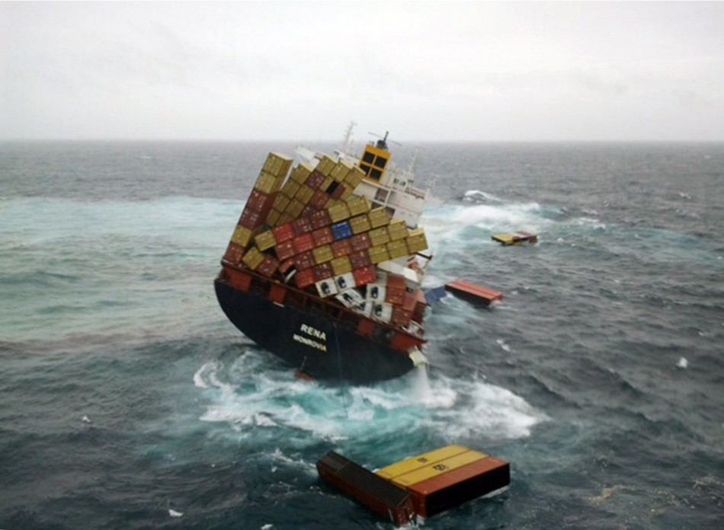
Do you remember this?

Slide 7
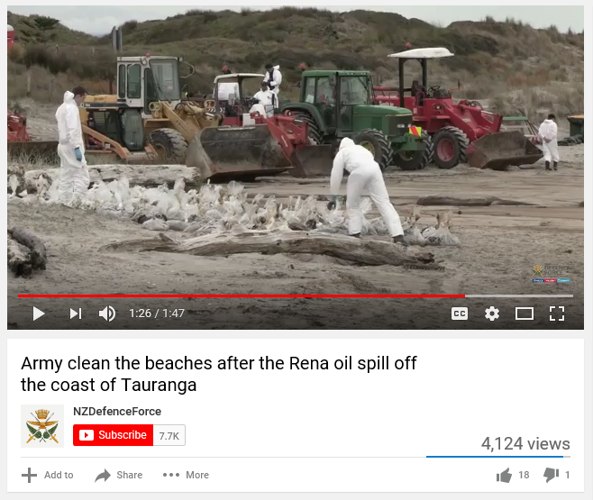
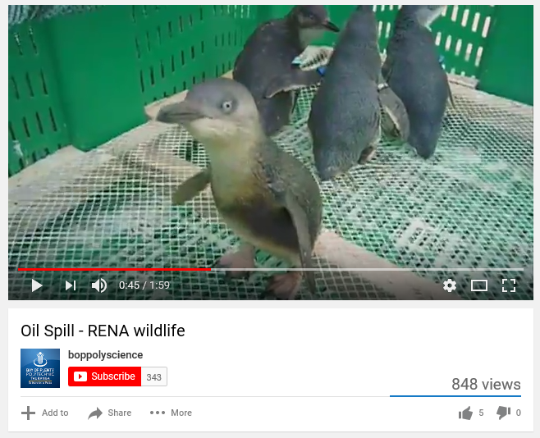
https://youtu.be/NMd8L63OQJc
https://www.youtube.com/watch?v=UScSfeBtfWQ

Slide 8
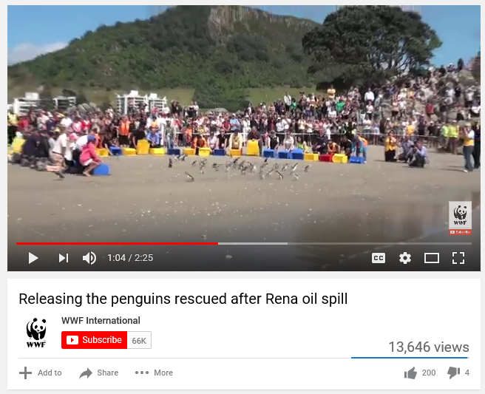
Happy ending(?)

Slide 9
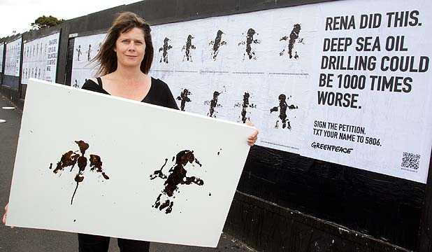
Posters couldn’t have prevented the Rena oil spill. Why then are environmental awareness posters important?

Slide 10
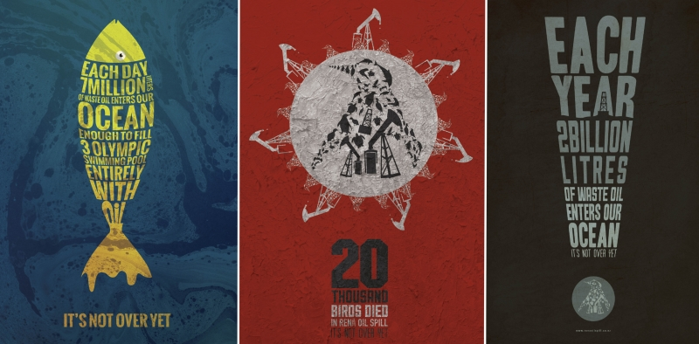
Why are these posters powerful?

Slide 11
Static Image
General Admin

Slide 12
Static Image
NCEA Level 1
3 credits
Task: you will create a visual text (a poster) that raises awareness of the threat to New Zealand’s sea, land, wildlife and economy due to pollution.
What are the keywords in our assessment task?

Slide 13
Static Image
You will read the poem Warned
You will show viewers what problems are caused by pollution in New Zealand
AND/OR
You will show what the consequences may be in the future if we don’t take action now

Slide 14
Static Image
Task | Deadline
A3 Planning Sheet | Friday Week 7
A4 Draft Ideas | Tuesday Week 8 (homework)
A3 Good copy | Friday Week 9
A3 Resub | Mid week 10

Slide 15
Complete the paragraph and jot down some initial planning ideas:
For my static image assessment, I have to create a p______ that raises a__________ of the threat of pollution to N___ Z______’s sea, land, wildlife and economy. My p________ has to show people what p________ are caused by pollution and/or what the c__________ may be in the f_______ if we don’t take action now.
I might focus my poster on…

