Slide 1
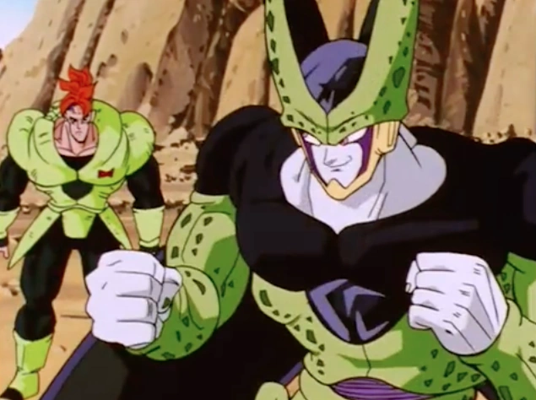
Rhyme Schemes Slideshow
L.I: We are FOCUSING on rhyme schemes by explaining the effects of conventions in a written/visual text.

Slide 2
Rhyme Scheme
Watch the following video about what is rhyme scheme?

Slide 3
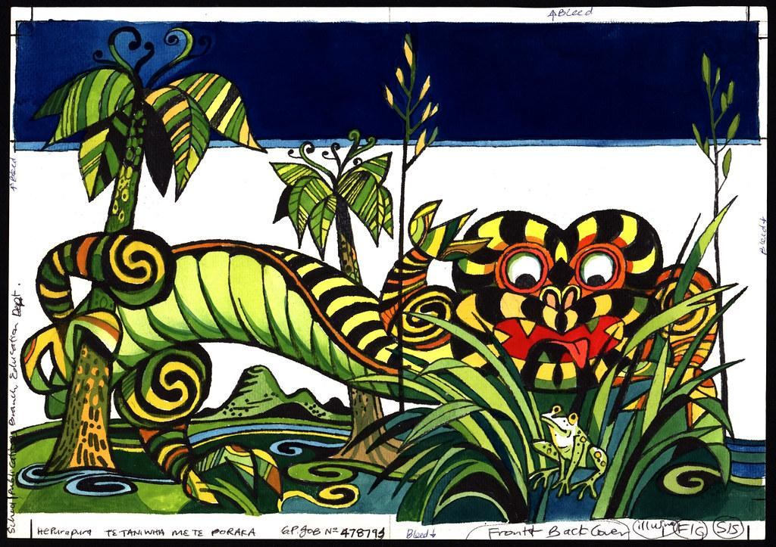
Before we dive into specific expressions, it’s essential to grasp the role of figurative language in Te Reo Māori. Like many indigenous languages, Māori is deeply rooted in oral traditions. Storytelling, proverbs (whakataukī), and metaphors are integral to conveying wisdom, humor, and cultural values. These expressions are not just linguistic quirks; they are windows into the Māori way of life, their environment, and their social structures.
Proverbs, or whakataukī, are an essential part of Māori culture, offering wisdom and humor in equal measure. These sayings often use metaphor and imagery to convey deeper meanings, and their humor can be both subtle and striking.
Many Māori expressions bring humor into everyday situations, making even mundane activities more enjoyable and memorable. These sayings often use playful language and imagery to capture the quirks of daily life.

Slide 4
Rhyme Scheme Definition
A rhyme scheme is the pattern according to which end rhymes (rhymes located at the end of lines) are repeated in works poetry. Rhyme schemes are described using letters of the alphabet, such that all the lines in a poem that rhyme with each other are assigned a letter, beginning with "A." For example, a four-line poem in which the first line rhymes with the third line, and the second line rhymes with the fourth line has the rhyme scheme ABAB:
"Roses are red, / Violets are blue. / Shakespeare is dead? / I had no clue."
Here is an example of an AABB rhyme scheme:
In the jungle of Nool, / In the cool of the pool, He enjoyed the jungle's joys, / When the donkey heard a small noise.

Slide 5
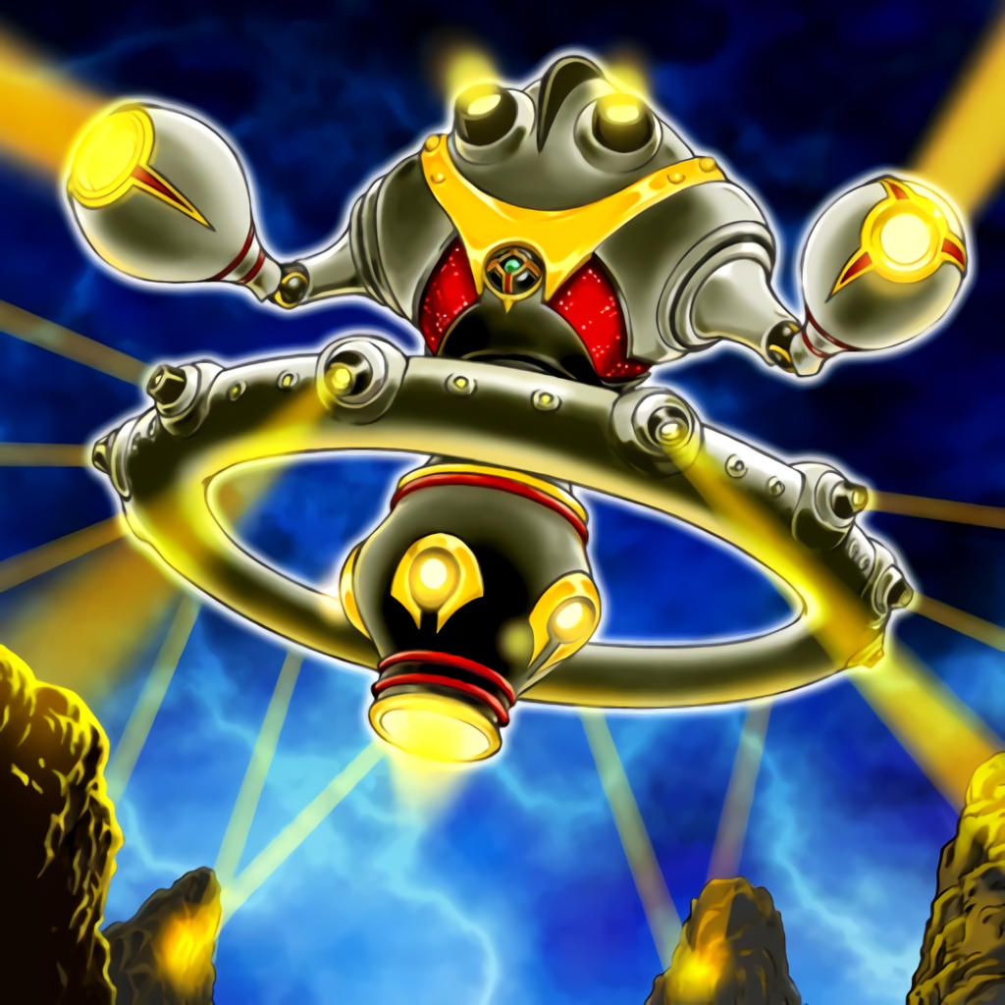
Task 1
On the next slide you will see a list of different rhymes.
You will need to write which rhyme scheme you think it is. That is, it will be “ABAB” or “AABB.”

Slide 6
Stop all the clocks, cut off the telephone. / Prevent the dog from barking with a juicy bone. / Silence the pianos and with muffled drum / Bring out the coffin, let the mourners come.
I was angry with my friend; / I told my wrath, my wrath did end. / I was angry with my foe: / I told it not, my wrath did grow.
They cannot look out far. / They cannot look in deep. / But when was that ever a bar. / To any watch they keep?"
Here take my picture; though I bid farewell. / Thine, in my heart, where my soul dwells, shall dwell. / Tis like me now, but I dead, ’twill be. / When we are shadows both, than ’twas before.
The land may vary more; / But wherever the truth may be- / The water comes ashore, / And the people look at the sea.
As long as it takes to pass. / A ship keeps raising its hull; / The wetter ground like glass. / Reflects a standing gull.
I have a little shadow that goes out with me, / And what can be the use of him is more than I can see. / He is like me from the heels up to the head; / And I see him jump, when I jump into my bed.
The people along the sand. / All turn and look one way. / They turn their back on the land. / They look at the sea all day.

Slide 7
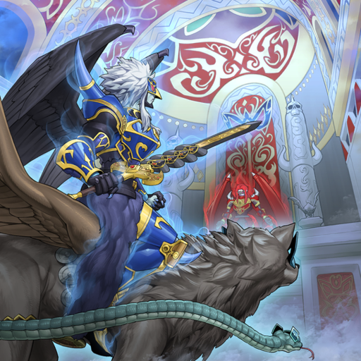
Task 2
Create 8 of your own rhyme schemes just like the ones in the previous slide with the context being about spooky mysteries.

Slide 8
Task 3
Look at this link about short stories to read online.
Choose one short story and write it in the style of a rhyme scheme rather than the way it is originally written.

Slide 9
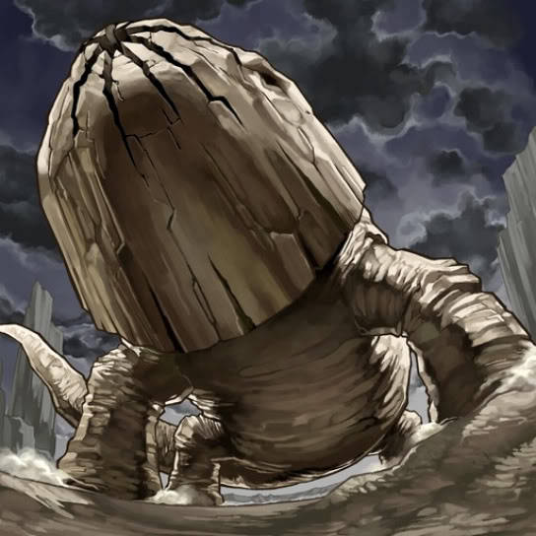
Task 4
Draw, label and colour what you have written about to AT LEAST A YEAR NINE STANDARD.

