Slide 1
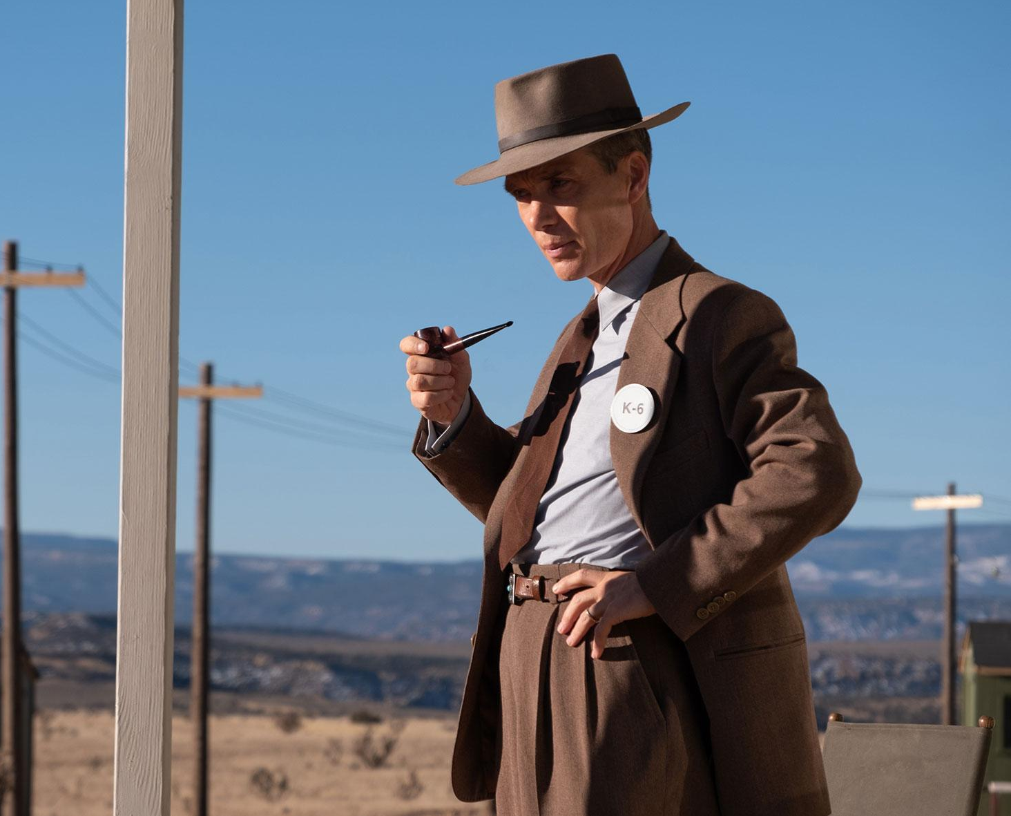
What is a text?
Part 3 - Images in Motion

Slide 2
Visual Texts - Movies
A visual text is in others words a visual medium, the way you channel information. You see something - your brain parse that information - you get a response. Visual texts tickle different parts of your brain functions than literal text does.
Movies are no different: in many ways, they are THE visual text. They are the visual text that has completely changed the world since their invention in the 1890s, and have come to define the idea of the ‘moving image’.

Slide 3
How to read a video/moving image?
What should we be looking for…
Sound
Colours
Acting
Dialogue
Tone (What is the feel)
Impact (What draws your attention)
Is it actually good/effective?
A visual text, as you know, is about decoding context/circumstances, the language of colours, symbols, etc. This remains true for videos.
However, when looking at movies/cartoons/etc, we must also take on the fluidity of what we are seeing on screen. What audio is there? How are things moving? What are you meant to be looking at?

Slide 4
This is not the same as film analysis!
‘Film analysis’, something we typically start doing in Year 9, is about really digging into a specific film and analysing its messages and intent on a level we are not doing right now.
Colour coding, cinematography, viewing ratio, editing, soundtracks, etc. Good to keep an eye out for, but not essential right now.
We will be focusing on film analysis at a later time.

Slide 5
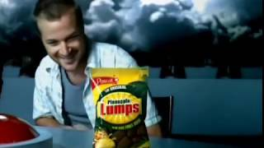
How to read a video?
Context: When was this video created? What purpose does it serve? Where might you see this video - what time of day, on tv, in a theatre, etc?
Audience: Who is the target audience?
Imagery/Colours: What are the visuals here?
Tone: Is the video serious? Professional? Comedic? What ‘atmosphere’ does it have?
Message: What is the intended message of this sign? What do you need to know?
Example: What is being communicated here?

Slide 6
How to read a video text?
Context: Classic ‘00s TV advertisement, meant to be seen on a television.
Audience: Consumers of all ages, but particularly Kiwi ‘blokes’. Note that the ‘regular white guy’ is considered the representative of NZ on the world stage.
Imagery/Colours: White heavenly clouds, red buzzers, easily identifiable product.
Tone: Comedic, meant to stick with you through well-known stock sounds and quotable dialogue.
Message: Pineapple Lumps - so good that even God considers them above gold, diamonds, oil. Buy them now!
A visual text does not have to be immediately clear. But this needs to be.

Slide 7
Do now
On your own, you will now decipher some additional videos & write some answers that test your knowledge of video texts.
I expect full sentences - make your text smaller if you want it to fit on the page, I’d rather the information be there than not readable. At least one full sentence per answer!

Slide 8
Visual Text 1: Game Boy Advertising
https://www.youtube.com/watch?v=D8PI2dZVoO4

Slide 9
Video Text 1 - Game Boy Colour
Watch about 4-5 minutes of the video. What is the purpose of this video? What is it trying to get you to do?
Answer:
What do these advertisements make you feel? What ‘vibe’ or feeling are they going for?
Answer:
Who is the target audience for these advertisements? How do they try appeal to this audience?
Answer:

Slide 10
Video Text 2
Public Safety Announcements
https://www.youtube.com/watch?v=BYlqSNjbhNc
1. This is Your Brain on Drugs
https://www.youtube.com/watch?v=f_Auh61aN9Y
2. Secondhand Smoke
https://www.youtube.com/watch?v=0FGc1QZ5QuE
3. Speed of Fire

Slide 11
Visual Text 2: ‘This is Your Brain on Drugs’
What is the message/goal of this video? What is a Public Service Announcement?
Answer:
What were some stylistic choices in this video? (How did it grab your attention)
Answer:
When was this video made? Do you think this video was effective at the time? If yes, why?
Answer:

Slide 12
Visual Text 2: ‘Secondhand Smoking’
What is the change in tone in this video compared to the cigarette smoking poster we saw in the last slideshow?
Answer:
What is the ‘punchline’ of this PSA?
Answer:
What are some choices the video made in order to try stick with you?
Answer:

Slide 13
Visual Text 2: ‘Speed of Fire”
Who made this video, and why?
Answer:
What is the emotion they’re trying to get you to feel? How do they do so?
Answer:
What strong colours are present in the video?
Answer:

Slide 14
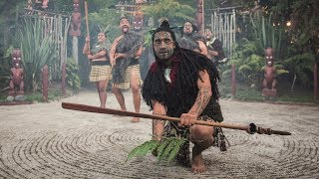
Visual Text 3 - Māori Hangi/Reception

Slide 15
Visual Text 3
Look at the channel, the woman centred in the video. Who is she speaking to? Who is the target audience for this video?
Answer:
What is the video showing? What is taking place? Where is it taking place?
Answer:
What is the style of video? Is it a regular movie, an interview, a documentary? Explain your choice.
Answer:

Slide 16
Video Text 4:
Pick one of the Public Safety Announcements to answer in more detail on the next slide

Slide 17
Video Text 4 - Answer using the list from before
Context: Where would you see this video?
Audience: Who is the target audience?
Imagery/Symbols: What being depicted on the video? Any easily identifiable symbols or interesting imagery/interesting choices made by the director?
Colours: What stands out?
Message: What is the intended message of this video? What do you need to know?

Slide 18
Visual Text 4 - Answer here
Context:
Audience:
Imagery/Symbols:
Colours:
Message:

Slide 19
Early Finishers
Google ‘2000s movie posters’, such as the green Zoolander poster, and pick one that you like, hopefully a movie you have seen. Describe it in detail - what does the poster suggest about the movie? What colours and symbols does it use? Does the poster accurately suggest the genre of the movie, or does it try trick you? Answer on the next slide.
Additional extra work - Read your silent reading book - Wordle - Continue watching the previous assignment’s videos

Slide 20
Early Finishers - Answer Here
Answer here:
Copy image here

