Slide 1
Strategic Reading
Using
Non-fiction Strategies Effectively
Notes:
A holistic overview of using reading strategies before, during and after reading to make meaning out of non-fiction texts

Slide 2
Before You Read
This is the preparation stage
Time and care taken before reading will make the actual reading experience easier
Notes:
Effective reading comprehension actually takes place in three stages: before, during and after. Setting the stage for reading before actually tackling the text helps the brain get ready to understand. This important stage is often neglected by struggling readers. Teach students to pause briefly before they begin reading the body text and think about what they are going to be reading. In the beginning stages of learning to read strategically, students need to be particularly metacognitive (think about their own thinking) to make sure they understand the processes. Eventually these steps will become second nature, but it is important to teach students to go through the steps purposefully in the beginning.

Slide 3
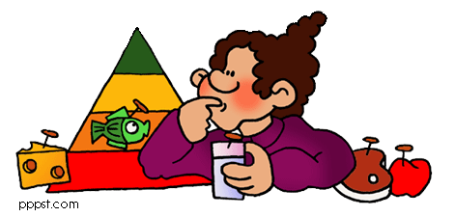
Set A Purpose
Decide why you are reading this information:
To make a decision?
To create something?
To help you?
To get information?
Notes:
You need to know WHY you are reading. Readers should begin by asking themselves what they hope to accomplish by reading a particular selection.

Slide 4
Preview
Read headlines and subtitles
Look at pictures and other graphics; read captions
Skim side bars
Read section outline in textbooks and articles
Notes:
Be purposeful. Intentionally pay attention to the information gained by previewing.

Slide 5
Activate Prior Knowledge
Consider what you already know about the subject
Think about connections to other knowledge you possess
Notes:
Be metacognitive. Stop and think about prior connections. As strategic reading skill improves, this step will become automatic, but for right now it will take some conscious effort.

Slide 6
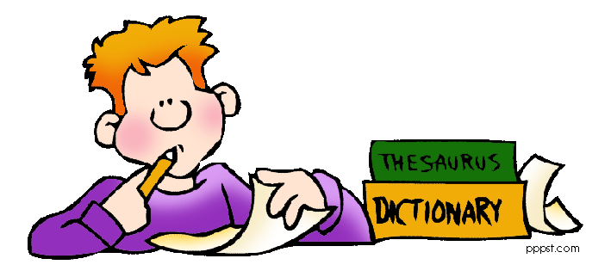
Wonder
Make predictions about information you expect to find
Write down things you wondered while previewing
Create questions you think might be answered by the text
Notes:
Pause and take a moment to wonder about the contents of the material.

Slide 7
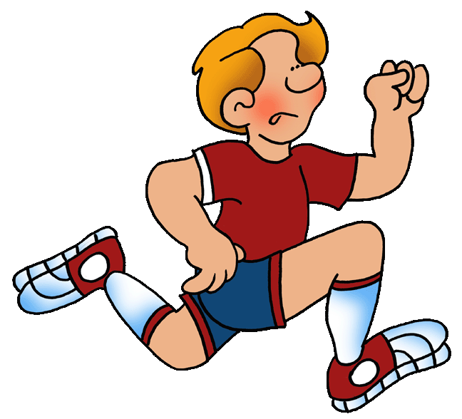
Set a Reading Speed
Good readers adjust their reading rate to fit the text and purpose
Think about WHY you are reading and WHAT you are reading
Then pick a speed
Notes:
Not all reading should be done at the same rate. Sometimes a reader only needs to scan a text to get information. At other times the reader might need to re-read several times, slowly and carefully to achieve the appropriate depth of meaning. Selecting the appropriate reading rate to meet a particular purpose is an important skill. Would you read a telephone book the same way you would read a novel? Would you read a text from your friend at the same rate you would flight information?

Slide 8
First Gear
Slow, thoughtful reading
Use when the text is complex or difficult
Use when you are reading to remember important information
Use when you are going to take action
Notes:
Reading rate #1. Use the analogy of driving a car. Examples of text that should be read in first gear: legal documents or contracts, instructions, learning materials, poetry or literature analysis, text that requires reflection like essays, editorials, or wisdom/spiritual materials.

Slide 9
Second Gear
Relaxed reading
Use when reading for pleasure
Use when the text is fairly simple for you
Example: reading a novel or magazine
Notes:
Reading rate #2. Use when reading casual and enjoyable materials such as novels, magazines, or e-mail messages from friends.

Slide 10
Third Gear
Skimming the text
Use when you need basic answers or information quickly
You don’t have to read every word until you locate the information you need
Notes:
Reading rate #3. Students often use this speed when they have been assigned to find answers in a text. Useful when searching the internet, particularly hit lists generated by search engines, and for reviewing subheadings or outlines in educational material. This is the speed needed for reading signs while driving.

Slide 11
Fourth Gear
Scanning the text rapidly
Use when looking for a particular word or concept
Your eyes move quickly over the page until you find what you are looking for
Notes:
Reading rate #4. Useful when searching for a particular bit of information like using a directory, perusing news headlines, or checking over a list.

Slide 12
Before Reading
Preview and set a purpose
Activate prior knowledge
Wonder
Set a speed
Notes:
The before reading skills can be summarized in to the acronym PAWS. Easy to remember since it is a play on the word “pause” before reading.

Slide 13
During Reading
Now that you have prepared your brain, you are ready to read
Remember: “READING IS THINKING”
Use effective strategies to help you make sense of what you are reading
Notes:
The metacognitive process continues during reading.

Slide 14
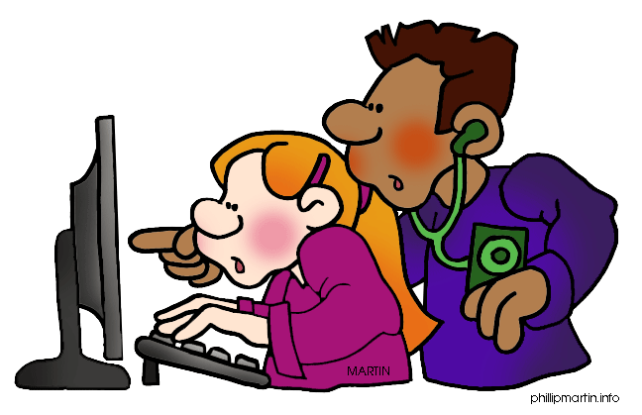
1. Monitor/Clarify
Pause to think about what you are reading
Ask yourself, “Do I understand this?”
If something is confusing re-read or use context clues
Look at graphics
Notes:
Good readers are constantly checking their own understanding. This is called self-monitoring. If things are not making sense, good readers use “fix-it” strategies like re-reading, using context clues or other resources to figure out difficult words, or break sentences or paragraphs into smaller chunks. Proficient readers also use the pictures, charts and diagrams to help them make sense of the text.

Slide 15
2. Visualize
Use illustrations to help you create mental pictures
Add in images from your own experiences so that you create a “Mental Movie”
Notes:
This may take some practice, but proficient readers are actually imagining what is going on in the text as they read. At first readers may need to pause occasionally to form the mental images, but eventually this skill will happen automatically.

Slide 16
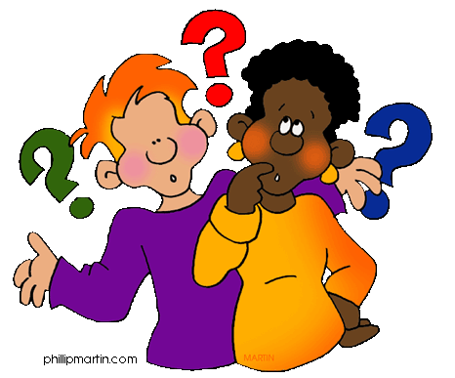
3. Question
Create readers’ questions you hope will be answered as you are reading
Think about the things the
author is not telling you
What more would you
like to know?
Notes:
Research shows that students who are able to generate questions while they are reading outperform those who do not. Help students understand the difference between self-generated readers’ questions and the kind they are typically asked after reading a text. Questioning while reading is more like wondering. Examples: I wonder why Julie spoke like that to Ted. What makes the cheetah able to run so fast? Why is the part about voting procedures included in this section about immigration?
Use questions to focus on what is most important in the text.

Slide 17
4. Connect
Text to text
Text to world
Text to self
Notes:
Proficient readers purposefully make connections between what they are reading and what they already know. Information is learned, remembered and applied because it is linked to other information.

Slide 18
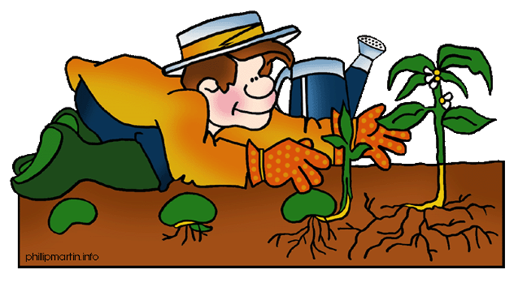
5. Infer
Use the author’s clues and your own knowledge to draw conclusions
Make reasonable predictions about what the text will tell next
Revise your inferences as
you read more
Notes:
When proficient readers infer, they are more able to: remember and reapply what they have read; create new knowledge and revise prior knowledge; analyze text; and reflect critically on what they have read. Inferring may cause the reader to slow down or pause to consider several possibilities. Inferences are often revised based on further reading or discussions with others about the text.

Slide 19
After Reading
Reflect on what the text was mainly about through talking, writing or drawing
Summarize the most important points
Reread for clarifications
Evaluate
Notes:
The reading experience doesn’t actually end after the text is finished. Proficient readers stop and reflect on what they have read making further connections, adjusting inferences, and evaluating the quality, usability, and reliability of the text. It may be necessary to go back and reread sections, or consult another source to get the most out of what has been read.

Slide 20
Review
Proficient readers use effective strategies before, during and after reading
PAWS before you read
Monitor, Visualize, Question, Connect and Infer while reading
Reflect after reading

Slide 21
Remember
READING IS THINKING!

Slide 22
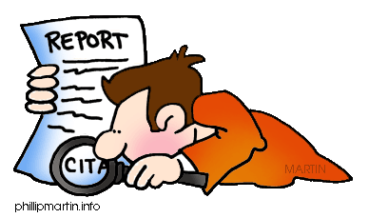
Resources
Comprehension Strategies by Keene, Ellin Oliver, 2002.
When Kids Can’t Read by Kylene Beers, 1998
Graphics
Phillip Martin Clip Art http://www.phillipmartin.info/clipart/homepage.htm
A ProTeacher Presentation
Barbara Yardley, M.Ed.
http://www.teacherspayteachers.com/Store/Barbara-Yardley/

