Slide 1
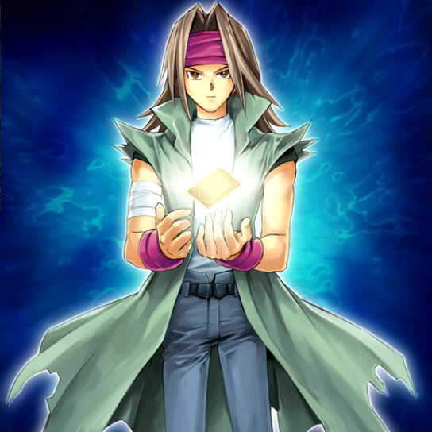
Poetry Articles Slideshow
L.I: We are EXPLORING articles by recognising texts that have multiples purposes and knowing the context of the creator helps us understand the purpose.

Slide 2
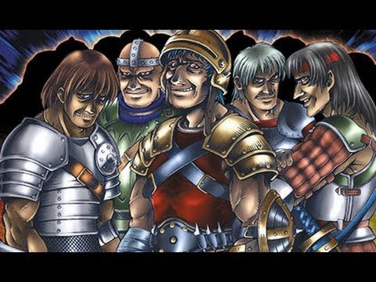
Power To Inspire
Read this article about how poetry has a power to inspire change like no other art.

Slide 3
Answer these questions in your English book:
1. Why might some people be afraid of poetry?
A) They think it's too hard and like math with secret codes.
B) They think it's only for adults.
C) They think it's boring.
D) They think it's only about nature.
2. What is a good reason to read poetry?
A) To learn about different kinds of animals.
B) To learn about famous people.
C) To help you understand your feelings.
D) To learn about different countries.
3. What is a good example of how poetry can help us remember important times?
A) Poems about birthdays.
B) Poems about weddings.
C) Poems about wars.
D) Poems about nature.

Slide 4
Answer these questions in your English book:
1. What are two ways that poetry can help us think about the future?
2. How are poems written by poets like Robert Lowell, Anne Sexton, and Sylvia Plath different from poems written by poets like Tony Walsh?
3. How does the author describe the best poems?

Slide 5
Answer these questions in your English book:
1. Think about a time when you felt scared or nervous about something new. How did you overcome your fear? How can poetry help people feel less scared?
2. The text says that poetry can help us remember important times. What are some important times in your life that you might want to remember? How could you use poetry to remember these times?
3. The text mentions that poetry can help us think about the future. What are some things you are hoping for in the future? How could poetry help you express your hopes and dreams?

Slide 6
Answer this question in your English book:
3. The text mentions that poetry can help us think about the future. What are some things you are hoping for in the future? How could poetry help you express your hopes and dreams?

Slide 7
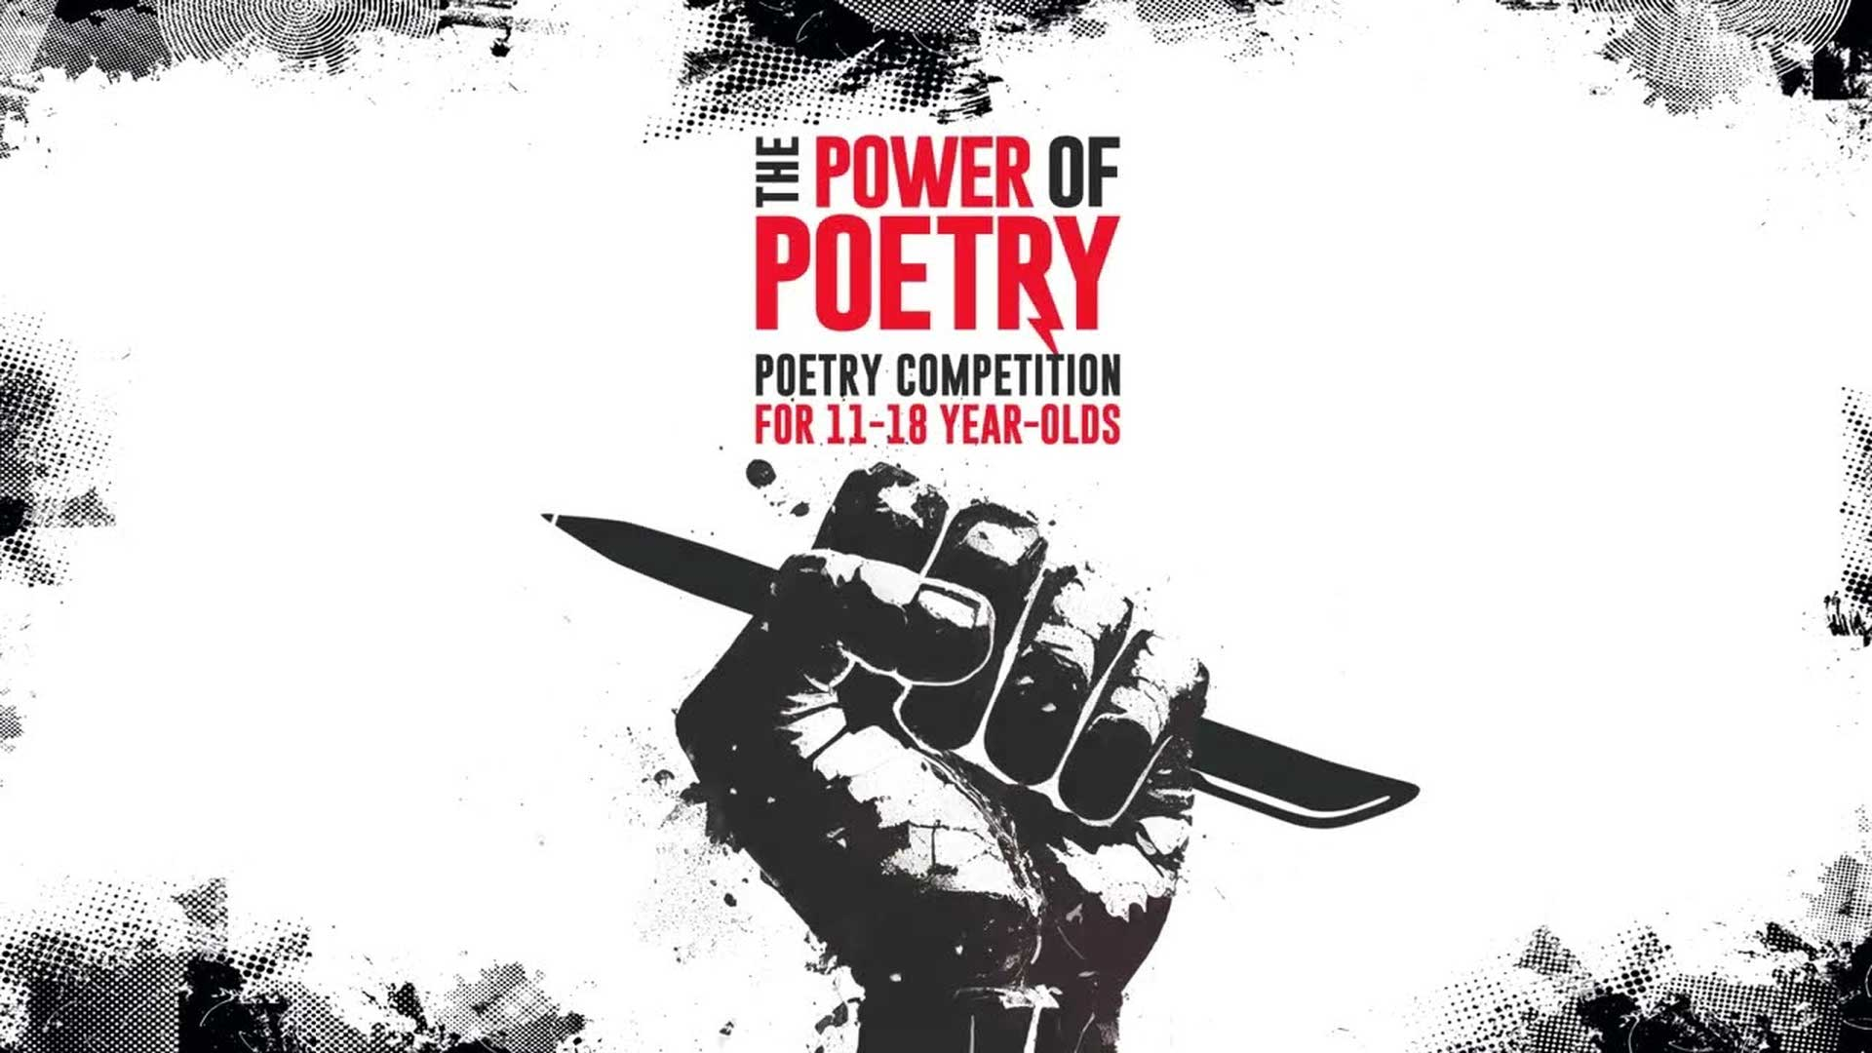
Answer this question in your English book:
Instructions: Look at the image below and write 2-3 things you notice (key details, main ideas, themes) and then write down 2-3 things you wonder (questions you have because of the image, things you are curious about when you look at the image).
What do you notice?
What do you wonder?

Slide 8
Answer this question in your English book:
Instructions: The center of the bubble map has an image that represents the reading to help get you started. Fill in the connecting bubbles with concepts, ideas, questions, and details that connect the image to the reading. Example: “This image connects to the reading because_____”
Poetry is a way to express feelings and ideas in a creative way.
Poems can help us understand big ideas, like death, change, and hope.
Poetry is everywhere, from books to websites, and can be enjoyed by everyone.

