Slide 1
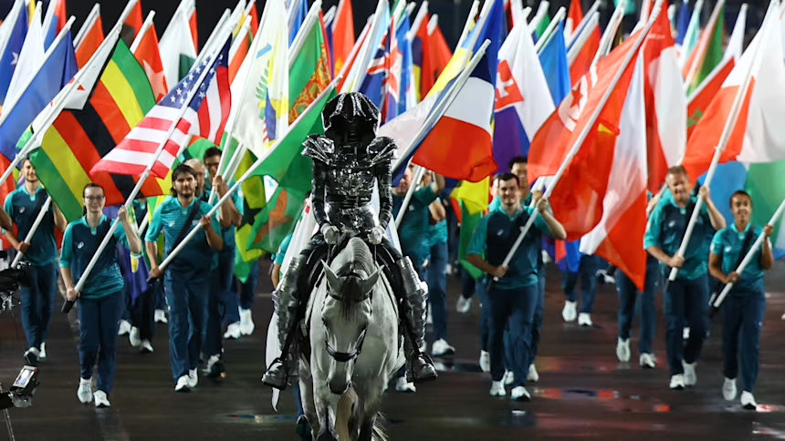
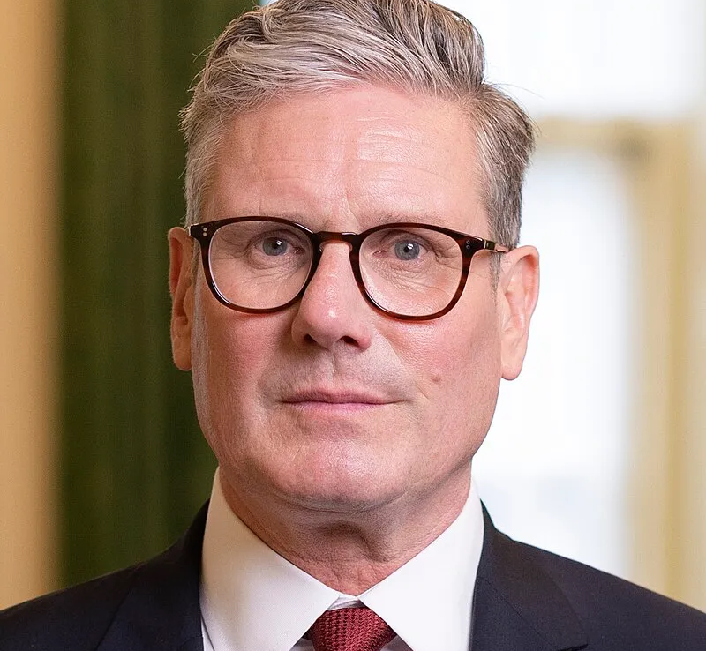
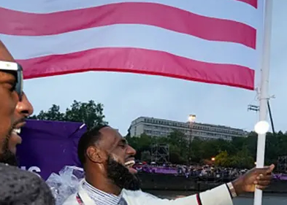
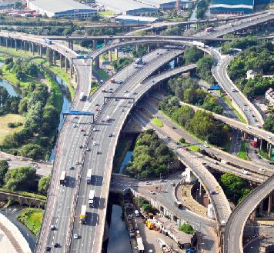
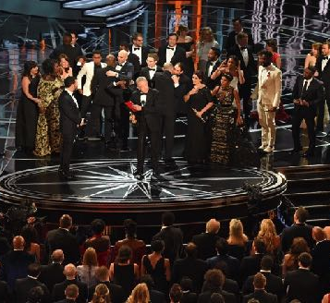
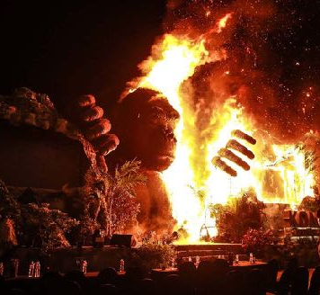
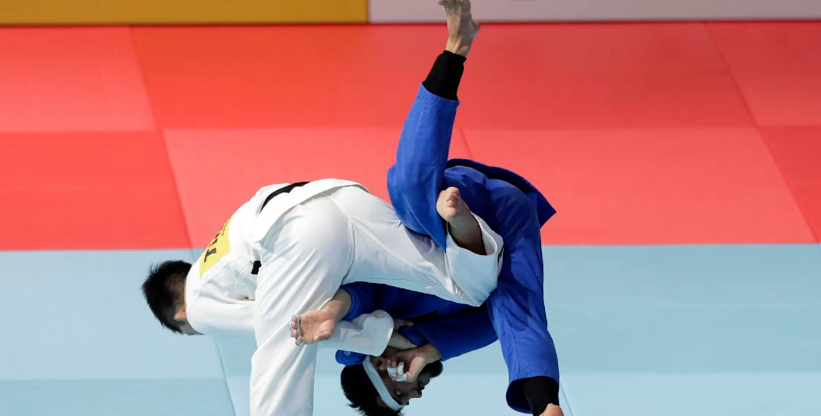
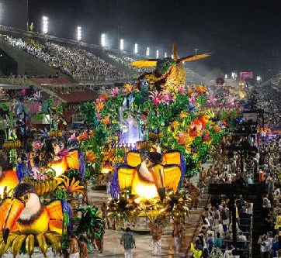
Weekly Quiz Current Events
29 July 2024
06/03/17

Slide 2
Donald Trump survived an assassination attempt recently. How many sitting US presidents have been assassinated throughout history?
1
a. Two b. Four c. Eight

Slide 3
France’s sports minister took a dip in the river that runs through Paris to ease concerns about water quality before the start of the Olympics. What is the name of the river?
2
a. The Seine b. The Rhine c. The Thames

Slide 4
It has been revealed that the Department of Conservation spent $270,000 since the beginning of 2023 on …?
3
a. Getting rid of bed bugs in huts b. Maintenance of long drops and toilets on DOC land c. Burying whales that have died in stranding events

Slide 5
What is the last name of this famous sportsman?
4

Slide 6
What is CrowdStrike and why has it been in the news?
5
a. It is a climate change activist group which held a protest shutting down the Auckland harbour bridge b. It is a cyber security company that has been held responsible for a recent global IT outage c. It is a printing company that has spelt New Zealand wrong on some of the Olympic Team uniforms

Slide 7
Jo Aleh and Aaron Gate were New Zealand’s flag bearers for the Paris Olympics opening ceremony. What sports do they compete in?
6
a. Sailing and cycling b. Javelin and swimming c. Lawn bowls and long Jump

Slide 8
Joe Biden is standing down from the presidential race. How much warning did he give his presidential campaign staff before he announced his decision to the public?
7
a. One minute b. One hour c. One day

Slide 9
Which Olympic sport is shown here?
a. Karate b. Judo c. Taekwondo
8

Slide 10
Why has a British three-time Olympic equestrian champion been ruled out of the Paris Olympics?
9
a. She has been caught doping horses b. She has been filmed using aggressive horse training techniques c. She was caught tampering with other riders equipment

Slide 11
A Canadian coach, assistant coach and team analyst was sent home from the Paris Olympics after using a drone to spy on which team?
10
a. The South African men’s sevens team b. The US men’s hockey team c. New Zealand’s women’s football team

Slide 12
Prime Minister Christopher Luxon has sacked the entire board of …?
11
a. Health NZ b. Oranga Tamariki c. Housing New Zealand Corporation

Slide 13
In which city was this photo taken at the weekend?
12

Slide 14
Ship assessors have found the Interislander ferries will …?
13
a. Need to be replaced within a year b. Be fine to sail for five more years c. Be fine to sail for fifteen more years

Slide 15
Former Olympic rowing champion Mahé Drysdale has just become the mayor of …?
14
a. Tauranga b. Nelson c. Taupō

Slide 16
What actions taken by protestors against tourism in Barcelona, have resulted in the Spanish tourism minister making a public apology?
15
a. They threw paint bombs at tourist buses b. They squirted tourists with water pistols c. They flew giant balloons over the city with anti-tourist slogans written on them

Slide 17
Which country has this flag?
16

Slide 18
The Ministry for Primary Industries has said it will conduct more regular checks on Orana Wildlife Park after recent animal welfare allegations. Where is Orana Park located?
17
a. Auckland b. Hamilton c. Christchurch

Slide 19
When was the last time Paris held the Olympic Games?
18
a. 30 years b. 50 years c. 100 years

Slide 20
Why has the Department of Conservation given a written warning to the producers of Race to Survive: New Zealand?
19
a. Contestants lit fires when there was a fire ban in place b. Contestants caught trout without a fishing license c. Contestants ate a protected bird

Slide 21
In which country has this man just become Prime Minister? a. Australia b. Canada c. United Kingdom
20

Slide 22
Answers

Slide 23
Donald Trump survived an assassination attempt recently. How many sitting US presidents have been assassinated throughout history? a. Two b. Four c. Eight
1
b. Four - On January 30, 1835, Andrew Jackson was the first president to experience an assassination attempt - since then Abraham Lincoln, James Garfield, William McKinley and John F. Kennedy have been assassinated. Ronald Reagan survived an attempt in 1981.

Slide 24
France’s sports minister took a dip in the river that runs through Paris to ease concerns about water quality before the start of the Olympics. What is the name of the river? a. The Seine b. The Rhine c. The Thames
2
a. The Seine - Swimming in the Seine was banned in 1923 due to pollution levels but $1.5 billion has been invested in cleaning up the Seine since 2015. Several open water swimming events will be held in the river during the Olympics including marathon swimming.

Slide 25
It has been revealed that the Department of Conservation spent $270,000 since the beginning of 2023 on …? a. Getting rid of bed bugs in huts b. Maintenance of long drops and toilets on DOC land c. Burying whales that have died in stranding events
3
c. Burying whales that have died in stranding events - Figures released under the Official Information Act show the agency spent $271,491 on an estimated 59 events, involving 63 animals. New Zealand is a hotspot for strandings, with more than 5000 recorded since 1840.

Slide 26
What is the last name of this famous sportsman?
4
James - Basketballer LeBron James and Tennis player Coco Gauff were the flag bearers for the largest team at the Olympics - the United States.

Slide 27
What is CrowdStrike and why has it been in the news? a. It is a climate change activist group which held a protest shutting down the Auckland harbour bridge b. It is a cyber security company that has been held responsible for a recent global IT outage c. It is a printing company that has spelt New Zealand wrong on some of the Olympic Team uniforms
5
b. It is a cyber security company that has been held responsible for a recent global IT outage - The unprecedented outage affected a raft of major institutions in New Zealand, Australia and internationally, including emergency services, government agencies, banks and airlines.

Slide 28
Jo Aleh and Aaron Gate were New Zealand’s flag bearers for the Paris Olympics opening ceremony. What sports do they compete in? a. Sailing and cycling b. Javelin and swimming c. Lawn bowls and long Jump
6
a. Sailing and cycling - Aleh is a two-time Olympic medallist, winning gold at London 2012 and silver at Rio 2016 alongside crew mate Polly Powrie. Gate won bronze at London 2012 and will be contesting his fourth Olympics in Paris. The track cyclist also won a staggering four gold medals at the Commonwealth Games in Birmingham in 2022.

Slide 29
Joe Biden is standing down from the presidential race. How much warning did he give his presidential campaign staff before he announced his decision to the public? a. One minute b. One hour c. One day
7
a. One minute - Biden had been recovering from Covid at his beach house on the eastern shores of Delaware, insisting that he was still running - but when faced with poor polling data and pressure from some important Democrats to stand aside - he made the decision to exit the race.

Slide 30
Which Olympic sport is shown here?
a. Karate b. Judo c. Taekwondo
8
b. Judo - All three martial arts are Olympic sports, however, Judo emphasises grappling, throws, and submissions, relying on leverage and balance to control or subdue opponents. Taekwondo and Karate are more focused on striking the opponent.

Slide 31
Why has a British three-time Olympic equestrian champion been ruled out of the Paris Olympics? a. She has been caught doping horses b. She has been filmed using aggressive horse training techniques c. She was caught tampering with other riders equipment
9
b. She has been filmed using aggressive horse training techniques - Footage has come to light showing six-time Olympic medalist Charlotte Dujardin, aggressively striking a horse being ridden by another woman despite the horse being obviously uncomfortable.

Slide 32
A Canadian coach, assistant coach and team analyst was sent home from the Paris Olympics after using a drone to spy on which team? a. The South African men’s sevens team b. The US men’s hockey team c. New Zealand’s women’s football team
10
c. New Zealand’s women’s football team - A drone was used to film the Football Ferns at training on at least two occasions. Canada won against New Zealand 2-1.

Slide 33
Prime Minister Christopher Luxon has sacked the entire board of …? a. Health NZ b. Oranga Tamariki c. Housing New Zealand Corporation
11
a. Health NZ - The health agency was formed in 2022 by the previous Labour government, which merged the country’s 20 district health boards. Health NZ was responsible for running all public hospitals and health services. Before being sacked Health NZ was going over its budget by $130 million per month.

Slide 34
In which city was this photo taken at the weekend?
12
Paris - As part of the Opening Ceremony to the 2024 Paris Olympic Games, a horsewoman carried the Olympic Flag on the River Seine and to the ceremonial stage where she was followed by the flag bearers for each country.

Slide 35
Ship assessors have found the Interislander ferries will …? a. Need to be replaced within a year b. Be fine to sail for five more years c. Be fine to sail for fifteen more years
13
b. Be fine to sail for five more years - The assessors concluded it was possible to keep the three ships running until at least 2029. To do so, however, KiwiRail said it would need to spend more on maintenance each year than it does currently. In response Maritime Union of New Zealand has raised concerns about health and safety in keeping the ferries running.

Slide 36
Former Olympic rowing champion Mahé Drysdale has just become the mayor of …? a. Tauranga b. Nelson c. Taupō
14
a. Tauranga - The two-time Olympic rowing gold medallist grew up in Tauranga and lives in Cambridge. Since 2021 Tauranga has been run by a four-person commission after the council was sacked for poor behaviour, infighting, leaks of confidential information and the inability to set rates at a realistic level.

Slide 37
What actions taken by protestors against tourism in Barcelona, have resulted in the Spanish tourism minister making a public apology? a. They threw paint bombs at tourist buses b. They squirted tourists with water pistols c. They flew giant balloons over the city with anti-tourist slogans written on them
15
b. They squirted tourists with water pistols - Spain is just several million behind top-ranked France’s 100 million tourist arrivals for 2023. Increased tourist numbers have been pricing locals out of the rental housing market. Barcelona has responded to the issue by announcing a plan to rid the city of its roughly 10,000 tourist flat licences by 2028.

Slide 38
Which country has this flag?
16
Nepal - Nepal is the country with the only non-rectangular flag.

Slide 39
The Ministry for Primary Industries has said it will conduct more regular checks on Orana Wildlife Park after recent animal welfare allegations. Where is Orana Park located? a. Auckland b. Hamilton c. Christchurch
17
c. Christchurch - A reporter for 1News said that more than 20 serving and former staff members have detailed animal welfare issues, including several animal deaths. MPI visited Orana Wildlife Park after the investigation aired and found no evidence of any major problems apart from a tiger that looked a little underweight. The park is run by a board as a charitable trust. Over the years it has struggled financially and has little to put into new facilities or building maintenance.

Slide 40
When was the last time Paris held the Olympic Games? a. 30 years b. 50 years c. 100 years
18
Paris has now hosted the games three times - 1900, 1924 and 2024.

Slide 41
Why has the Department of Conservation given a written warning to the producers of Race to Survive: New Zealand? a. Contestants lit fires when there was a fire ban in place b. Contestants caught trout without a fishing license c. Contestants ate a protected bird
19
c. Contestants ate a protected bird - The reality contestants caught and ate a weka despite the Department of Conservation being clear with the production company that protected species could not be harvested or consumed. The pair were disqualified from the competition.

Slide 42
In which country has this man just become Prime Minister? a. Australia b. Canada
c. United Kingdom
20
c. United Kingdom - Keir Starmer and his Labour Party defeated Rishi Sunak and the Conservatives at the recent UK General Election.

Slide 43
The End

