Slide 1
Plot & Structure
Learning Outcome: We are learning to understand what plot is, and how to identify the key parts of the plot in your novel

Slide 2
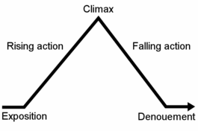
What is plot? The plot is simply, what happens in your novel, and how it happens. Although there are parts that make up the plot.

Slide 3
Plot Structure:
Exposition - introduces the reader to the setting and characters.
Rising Action - this event creates the central conflict or struggle.
The climax - the high point of interest and suspense in the story.
Falling Action - point at which the conflict is ended, or resolved.
Conclusion - the final outcome of the main dramatic complication in a literary work In the denouement
Notes:
https://www.youtube.com/watch?v=PL0OBybFu2I&ab_channel=HelpTeaching

Slide 4
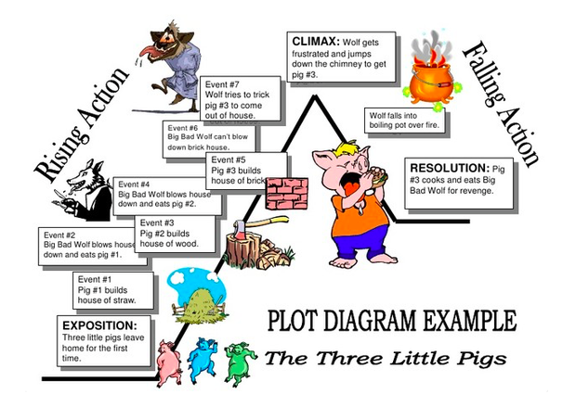
Plot Example: The Three Little Pigs
Notes:
https://study.com/academy/lesson/plot-analysis-example-lesson-quiz.html

Slide 5
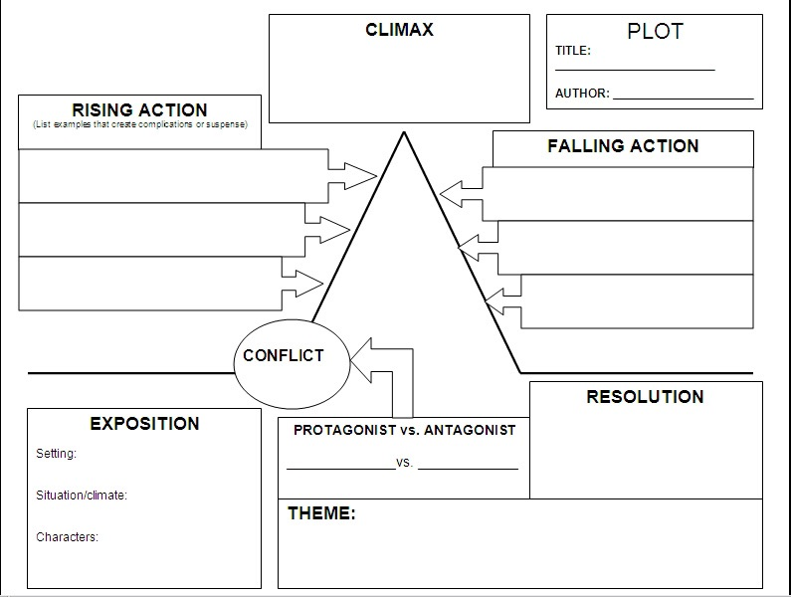
Plot analysis activity
Notes:
Fill out the plot analysis worksheet, analysing your novel plot.

