Slide 1
Poetic
Techniques
Year 8 English

Slide 2
Learning Objectives
To show increased understanding of how language features are used for effect within texts by learning, recognizing, and utilizing poetic devices.

Slide 3
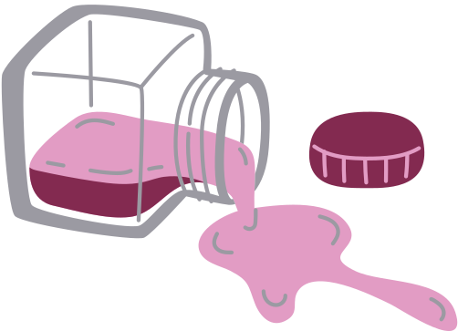
Imagery
Language that describes something using the 5 senses (sight, smell, taste, touch, hearing)
The rock had been polished by the constant current. It was perfectly smooth and cool to the touch as I ran my thumb across it. The sun glistened off of its still wet surface as I held it up to the light, making it shine with a brilliant shade of green.

Slide 4
Onomatopoeia
Words that imitate the sound they describe
My friend tapped on my window
There was a loud bang as she dropped her water bottle
I could hear pots and pans clanging together the kitchen

Slide 5
Simile
A comparison that uses the words “like” or “as”
She was as free as a bird
When she was angry, she was like a storm
They were as destructive as a fire

Slide 6
Metaphor
A comparison that does not the words “like” or “as”
Life is a highway
She eyes were a pair of diamonds
He was a raging river

Slide 7
Personification
Giving human characteristics to something that’s not human (an inanimate object, idea, etc.).
A lonely cloud drifted toward the horizon
The wind played with her hair
The light danced along the surface of the water

Slide 8
Alliteration
Repeating sounds or letters at the beginning of words placed next to or near each other
The swallows soar in the sky
Cuckoos and cowbirds swarmed the camp
The dog was drinking dirty water from a puddle

Slide 9
Assonance
Repeated vowel sounds in words placed near each other, usually in the same line
The heir bears the weight of his father’s decisions
Too cool for school
I could see it between the trees.

Slide 10
Consonance
Repeated consonant sounds in words placed near each other or in the same line
She smiled and laughed, but I felt bad
The clock struck and I was shocked
Traffic will be rough this weekend

