Slide 1
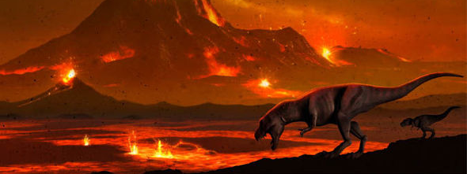
Earth – Where do Volcanoes Come From?
Lesson Aim: TBAT describe Earth’s age and history and explain the structure of the Earth.

Slide 2
Instructions
Slide 4 - Click title and watch video and make notes about the history of Earth.
Slide 5 - click title and watch video, make notes and follow instructions on slide.
Slide 6 - click title and watch video, make a sketch in your book using colours.
Slide 10 - rewrite passage and insert correct words in spaces.

Slide 3
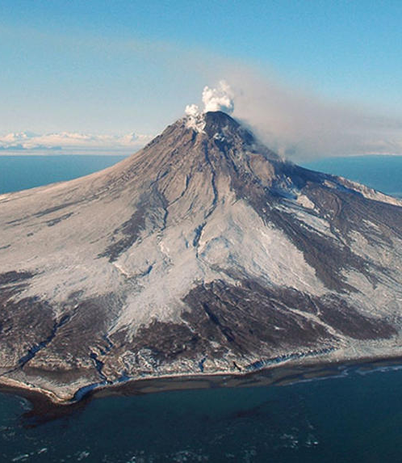
What do you know about Earth and volcanoes?
Task:
Mind map what your table knows about the Earth and volcanoes – do this on the A3 paper provided.
Move to a different table in the room and each take note of something different on that groups mind map.
Come back to your table and add what you have found out.
Be prepared to share your mind map with the rest of the class.
Lesson Aim: TBAT describe Earth’s age and history and explain the structure of the Earth.

Slide 4
The History of the Earth…
4.5billion years ago – Earth was formed (The Big Bang)
65 million years ago – dinosaurs disappeared
4 million years ago – apes appeared
100,000 years ago to present day – Homo Sapiens (modern human)
10,000 years ago – starting point of modern recorded History
Lesson Aim: TBAT describe Earth’s age and history and explain the structure of the Earth.

Slide 5
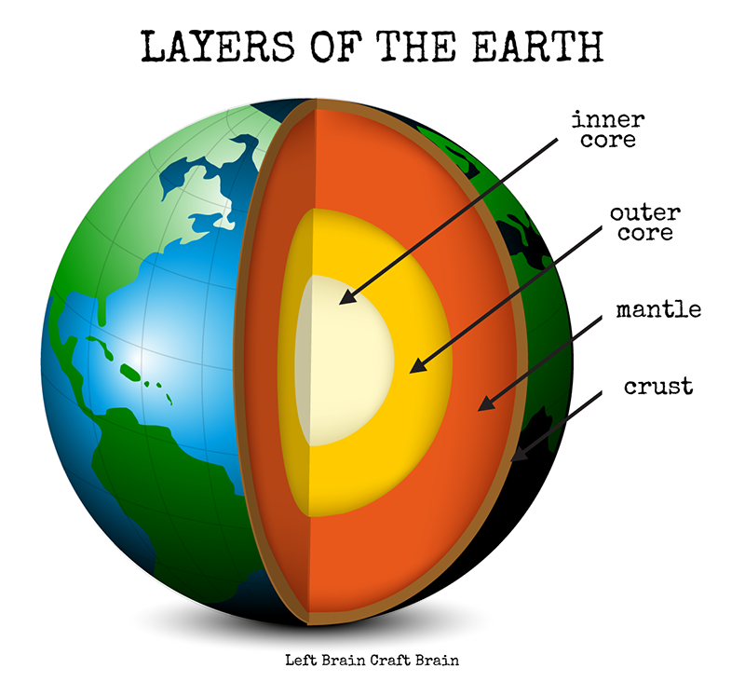
The Structure of the Earth…
Task:
On a full page make a sketch of the diagram on the board.
Listen and watch the video clip and add some notes to each section of the earth.
Lesson Aim: TBAT describe Earth’s age and history and explain the structure of the Earth.

Slide 6
The Earth’s Four Layers…
The Inner Core
Solid
5,150-6,360km below the Earths surface
Iron and some nickel
The Outer Core
Liquid
2,890-5,150km below the Earths surface
Iron and nickel
Lesson Aim: TBAT describe Earth’s age and history and explain the structure of the Earth.
Notes:
Use these to add more notes to diagrams

Slide 7
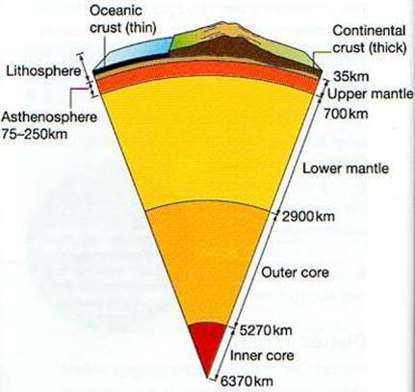
The Mantle…
Thickest layer of earth
35-2,890km below the surface of the Earth
Solid
Molten hot rock known as magma
Tectonic plate movement
Lesson Aim: TBAT describe Earth’s age and history and explain the structure of the Earth.

Slide 8
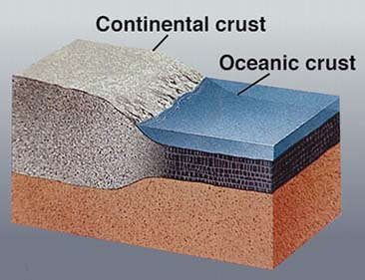
The Crust…
Thinnest layer of the Earth
Two types of crust: oceanic and continental
0-35km thick
Solid
Oceanic:
Basalt
Under the sea
Young
Thinner
denser
Continental:
Granite
Under the continents
Old
Thicker
Less dense
Lesson Aim: TBAT describe Earth’s age and history and explain the structure of the Earth.

Slide 9
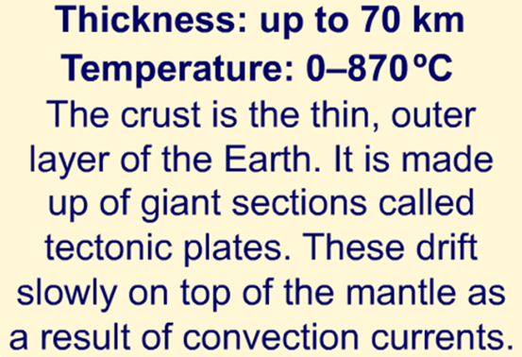
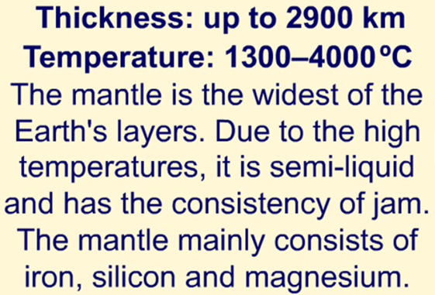
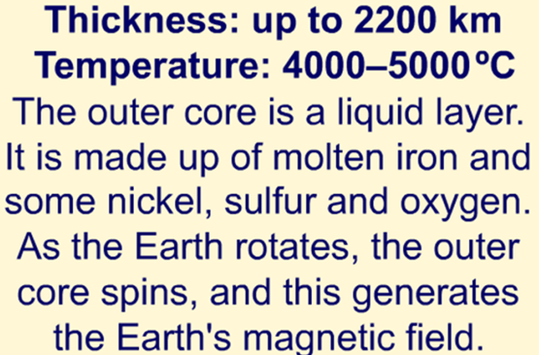
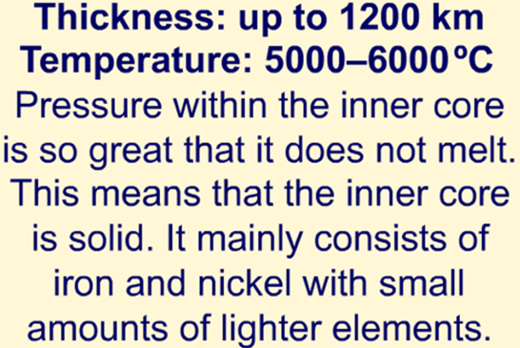
Crust
Mantle
Outer Core
Inner Core
Lesson Aim: TBAT describe Earth’s age and history and explain the structure of the Earth.

Slide 10
Lesson Aim: TBAT describe Earth’s age and history and explain the structure of the Earth.
Notes:
Plenary

Slide 11
crust
lightest
thin
apple
mantle
thick
Outer core
iron
liquid
Inner core
dense
Lesson Aim: TBAT describe Earth’s age and history and explain the structure of the Earth.

