Slide 1
Visual Literacy
Year 10 English

Slide 2
Film has its own language that has been developed from certain codes and conventions that combine to create meaning, to convey emotions, share experiences and ultimately "tell a story".​

Slide 3
Content
This unit is designed to be a personal and creative journey for you to reflect, analyse and create.
Identity and self
Representations – community and institutional context.
Stereotypes – culture dependant and country dependant.
Social beliefs and values reflected in film (film examples from New Zealand, Australia, America and Britain).
Technical and symbolic elements: camera techniques, editing , sound , music, mise-en-scene - techniques that shape or manipulate teen representations in film including genre conventions.
Ethical responsibilities in filmmaking and representations of teen characters in film.
Story structures (including themes) – prior knowledge
Genre conventions of films – prior knowledge
Ethical responsibilities in filmmaking and representations

Slide 4
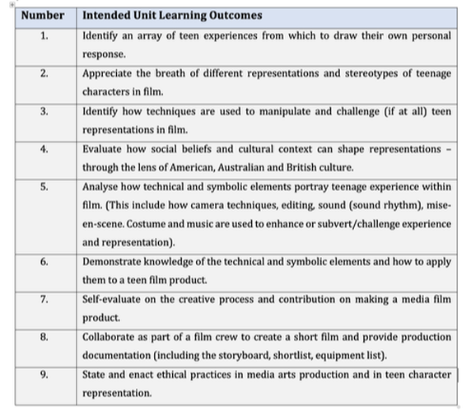

Slide 5
Lesson 1
Representation, Stereotypes, Identity and Self

Slide 6
Learning Intentions
Explore and reflect on personal experiences; who are they? Themes: self-Image, Identity, belonging.
Explore representation and stereotypes of teens in the media.
Examine how social beliefs and cultural context can shape representations.
Identify the difference between personal and social representations.
Understand the task expectations.

Slide 7
Representing Teens
As you watch, make notes of
the different types of teens
represented in this video.

Slide 8
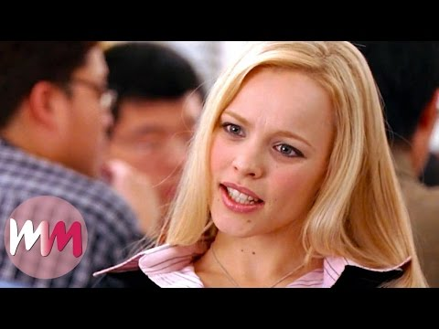
Teenage Sterotypes in Movies
As you watch, make notes of
the 10 different stereotypes.
Think about how you fit into
these stereotypes.

Slide 9
Culture and Context
Social Values, beliefs and representation.
The word 'culture' is used to refer to whatever is distinctive about the 'way of life' of a person, group of people, community, nation or social group. Culture can be used to describe the 'shared values' of a group or of society which is in part social beliefs. (Hall 1997, p. 2)
Language is one of the ‘mediums’ through which thoughts, ideas and feelings are represented in a culture. Representation is central to the processes by which meaning is produced.
That is why images have meaning and why we call Film a Language. In a film the signs, symbols, technical elements work together to make meaning. How images and film create meaning and represent the world is part of a cycle.

Slide 10
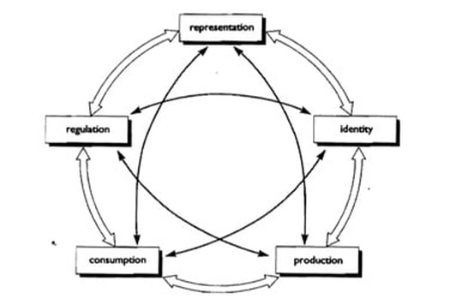
Cycle of Culture
Stuart Hall has created this cycle of culture that relates the connection of identity, representation, productions, regulation and consumption.
Define each of the titles in the chart.
Representation
Regulation
Identity
Consumption
Production

Slide 11
Representation and Media Production
Dependant on these factors:
Production – who produced it and why?
Reception – the audience response. E.g self deprecating crude comedies stereotype however the purpose matches with the intended audience.
Media – the trends and framework in current media.
Social and Political context – social values and beliefs.

Slide 12
Symbolic Codes
Meaning culture and context – meaning is also attached to images through culture and society.
Visual codes are technical and symbolic elements in images, and in action:
Meaning=image/word connotation=object denotation

