Slide 1
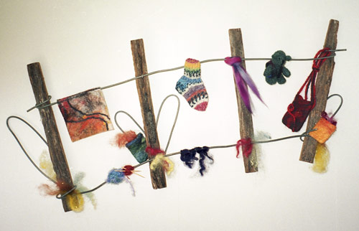

Slide 2
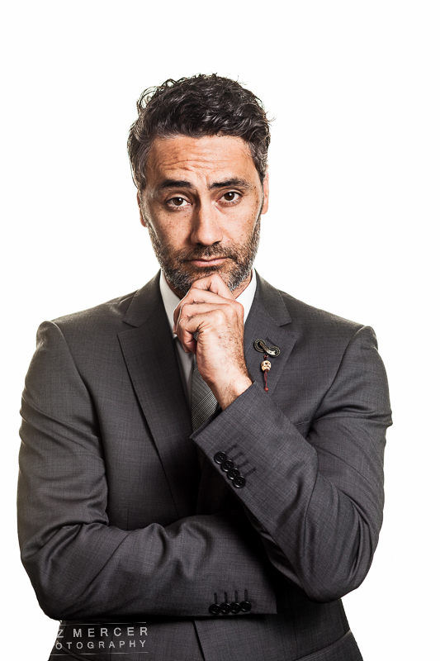
No.8 Wire - Kiwi Ingenuity
Taika Waititi
The Auteur

Slide 3
Auteur
What Is an Auteur?
The French word auteur literally translates to the English, “author.” Within the context of cinema, the word auteur is used to describe a director who exerts a high level of control across all aspects of a film. Auteur directors generally have a distinctive style from film-to-film and often fill other roles besides directing including: writing, editing, and sometimes acting in their own films.

Slide 4
The 3 Components of Auteur Theory
Technical competence: Auteurs must be at the top of their craft in terms of technical filmmaking abilities. Auteurs always have a hand in multiple components of filmmaking and should be operating at a high level across the board.
Distinguishable personality: What separates auteurs from other technically gifted directors is their unmistakable personality and style. When looking at an auteur’s collected works, you can generally see shared filming techniques and consistent themes being explored. One of the primary tenets of auteur theory is that auteurs make movies that are unmistakably theirs. This is in sharp contrast with the standard studio directors of the era who were simply translating script to screen with little interrogation of the source material or editorial input.
Interior meaning: Auteurs make films that have layers of meaning and have more to say about the human condition. Films made by auteurs go beyond the pure entertainment-oriented spectacles produced by large studios, to instead reveal the filmmakers unique perspectives and ruminations on life.

Slide 5
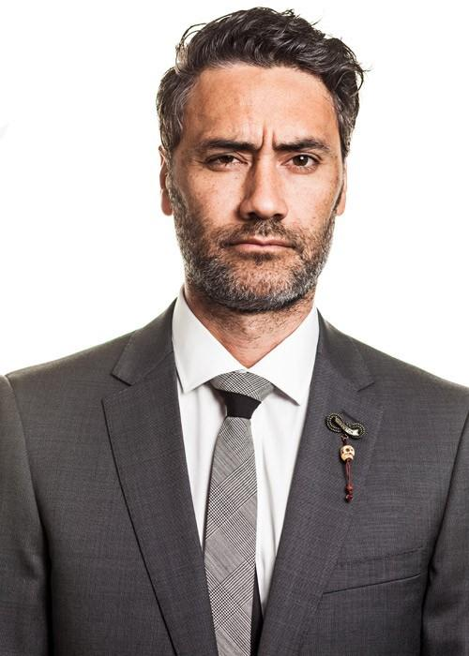
Autobiography
Taika Waititi is a New Zealand comedian, actor, and movie director with a growing repertoire.
Task 1 - Draw a timeline of Taika Waititi films ✅
Task 2 - Create a profile of Waititi that includes his upbringing and background ✅

Slide 6
DRAMEDY
His films fall into a category of comedy-drama or dramedy. Dramedies combine elements of drama and comedy in a way that can provide lightness without mockery and understanding without sentimentalism. Waititi specifically focuses on people on the margins of society and uses father-son relationships to balance the delicate nature of the genre, the success of which has proven his status as a new auteur in this golden age of dramedy.
Dramedies combine elements of drama and comedy in a way that can provide lightness without mockery and understanding without sentimentalism. Waititi specifically focuses on people on the margins of society and uses father-son relationships to balance the delicate nature of the genre, the success of which has proven his status as a new auteur in this golden age of dramedy.

Slide 7
Dramedy is a relatively new genre, and with the exception of a few outliers, most of the films have been made in the last 20 years. Topics like war, relationships, ethical dilemmas, mental illness etc. can all be covered giving the genre a wide range of topics.
Underlying in them all is a lens of humour in the midst of the situation. If it’s too comedic, the effect is lost and the issue becomes whimsical or subsidiary to the humour. Dramedies work best when at least one of three things takes place: a traditionally comedic actor playing the main role (Truman Show), when the main character has some type of comedic trait about them (Forrest Gump), or the protagonists find themselves in humorous situations a result of the darker situation around them.

Slide 8
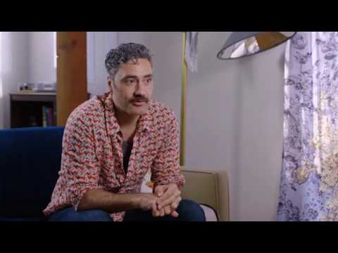

Slide 9
In describing his most recent film, Hunt for the Wilderpeople, Waititi states the film, “was about people who were on the margins and people who don’t feel like they’re a part of society.” This takes the front seat in Boy and Hunt for the Wilderpeople. In the realm of dramedy, Waititi focuses his films on social rejects, letting the audience step into the shoes of the individuals of the films, not only for empathy, but for examining their own biases towards people like this.
Waititi has also stated, “One of the things I strive for in my work is to… take a little snapshot of the human condition or human nature, just to say, ‘This is what life is like.’” Focusing on people in the margins of society is how he does so. Specifically, in Boy and Hunt for the Wilder people, Waititi chooses a dysfunctional father-son relationship as a more specific lens through which to approach the marginal characters. In looking at both films as a case study, key aspects of dramedies come out. Boy makes use of all three key aspects. Waititi casts himself as the father, fulfilling the need for a traditionally comedic actor in the film. He also has several quirks that allow for comedic treatment. Lastly, he and his son find themselves in a multitude of humorous situation. Boy uses dry comedy and a bizarre story line.

Slide 10
Task 2
Watch the Trailer for Boy - https://www.youtube.com/watch?v=oP05fUP9xAo
What do you think the film is about?
Knowing about Waititi as an auteur what characteristics do you see?
What (if any) similarities are there between what you have seen in the trailer to Two Cars One Night/ Tama Tu

Slide 11
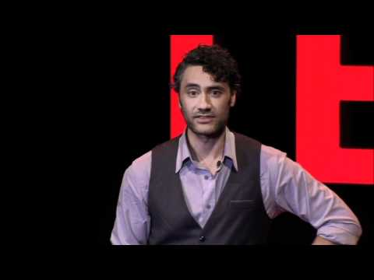
Task 3
Boy and Taika Waititi
Similarities between Boy trailer
and Waititi’s own life

Slide 12
Hunt for the Wilderpeople also uses a father-son type relationship to narrate the struggles on the margins of the society. With regard to the three aspects of dramedy, the film does not have a traditionally humorous character as the main character. Sam Neill, traditionally the Wildman in films, plays Hector, the father figure. The son figure, played by Jullian Dennsion, is a comedic young actor, although he is relatively new to New Zealand film, thus not satisfying the requirement. Neither character has any outstanding characteristics that are inherently funny. The film’s dramedy comes from the last key aspect, that the two protagonists find themselves in amusing situations. This movie follows a more Hollywood-style plot with more common archetypes than Boy. In both films, this sort of father-son relationship takes the spotlight for the serious issues. Waititi does this for several reasons. Having a male relationship at the center opens up the opportunity for more comedy because that’s what father-son relationships are like. They are a little chaotic and lots of crazy things happen, though at the heart of them are deep seeded human needs and emotions.

Slide 13
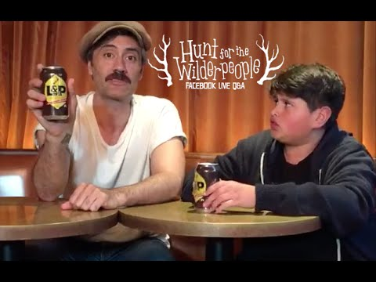

Slide 14
Waititi’s success and ability to draw upon marginal characters, and specifically these patriarchal relationships are enough to call him an auteur in the field of dramedy. He is a director whose, “film(s) is more than likely to be the expression of his individual personality; and that this personality can be traced in a thematic and/or stylistic consistency overall (or almost all) the director’s films”. His films balance humor with serious content, the balance of which should prove to be a standard for dramedies and provide case studies of how to approach the genre.

Slide 15
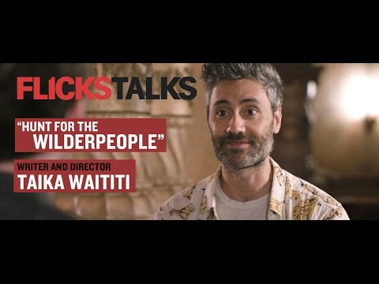

Slide 16
The effect is amplified by the films’ scores and soundtracks, which frequently incorporate traditional Maori music and tracks from New Zealand musicians. Above all, Waititi’s efforts to highlight and embrace all things local can be seen through his authentic casting choices; Boy features many promising Maori actors and Waititi always makes an effort to employ local cast and crew members. It’s hard to walk away from a Waititi film without some fascination with his homeland. Though Waititi’s films are primarily comedies, they all carry a surprising amount of emotional weight. For the most part, the films are linked by a common theme: some unfulfilled desire for an interpersonal relationship

Slide 18
Perhaps the most charming thing about Waititi’s work is his way of celebrating awkwardness and innocence. Deep down, every character is a child, and it’s through each one’s inherent innocence that Waititi endears his characters to the viewer. Take, for example, Wilderpeople’s Ricky Baker, who the child services official assures us at the start of the film is a “bad egg.” At the onset of the film, Ricky’s silence and apparent indifference seems to confirm his bad egg status. Ricky may literally be a child, but he seems unapproachable and delinquent. He doesn’t really acts his age until his eventual birthday, when his foster mother Bella (Rima Te Wiata) sings a customized birthday song to him and he begins to sing along to it. It is a touching moment, an act that immediately exposes his innocent craving for affection. Waititi’s characters frequently engage in actions that initially appear sad and uncomfortable. But by showing how the characters are at home in their idiosyncrasies, Waititi invites the viewer to abandon any cynicism and empathize with the misfit.

Slide 19
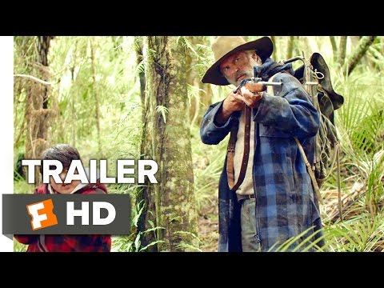
Task 4
Watch the Trailer
What is the film about?
What are the most striking film techniques used in the trailer?
Knowing about Waititi as an auteur what characteristics do you see?
What (if any) similarities are there between what you have seen in the trailer to Two Cars One Night/ Tama Tu

Slide 20
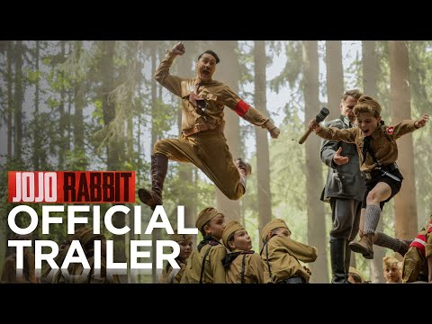
Task 5
This type of film is often referred

Slide 21
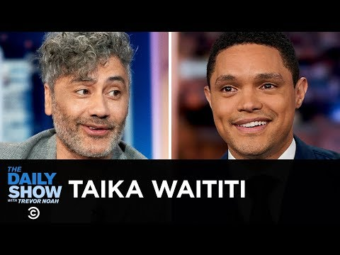
Task 5
Jo-Jo Rabbit

