Slide 1
Captain James Cook
Explorer to NZ

Slide 2
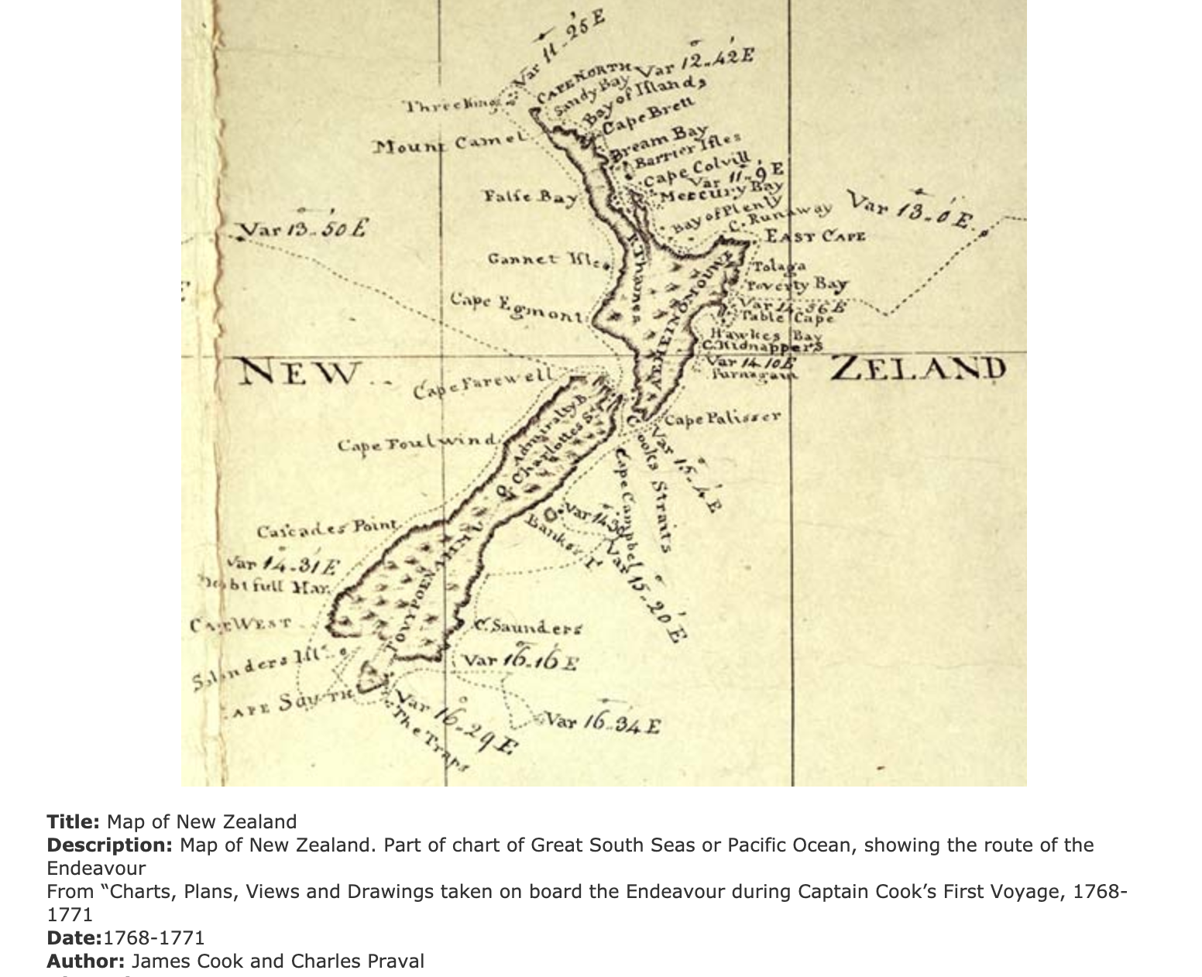
Open the following link and read through the information and looking at the videos to help find the answers.
Where did Captain Cook live and leave on his first voyage from?
What was the original intent of Cook’s first voyage to the Pacific?
What was the name of the ship he sailed to NZ?
Where did he land first in NZ?
How much of NZ did he sail around during his first voyage?
Who was Tupaia and why was he so important to Captain Cook?
https://nzhistory.govt.nz/culture/encounters/european-exploration

Slide 3
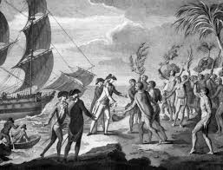
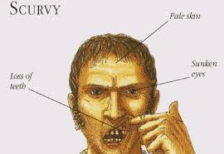
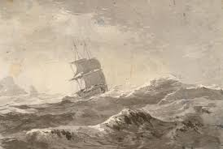
Navigate your way around the website link below and find the answers to the following questions.
European voyaging and discovery - Encounters
How old was James Cook when he was given the mission for his first voyage to the Pacific?
What were the names of the other important people he took on the voyage and what was their intention?
What was the other reason the British liked the idea of Captain Cook exploring the Pacific?
Watch the video about the voyage and describe the conditions the seamen had to face. What were the challenges they had? (Think about their health, the environment and meeting the Maori when you answer this)

