Slide 1
Creative Writing Articles Slideshow
L.I: We are EXPLORING articles by recognising texts that have multiple purposes and knowing the context of the creator helps us understand the purpose.

Slide 2
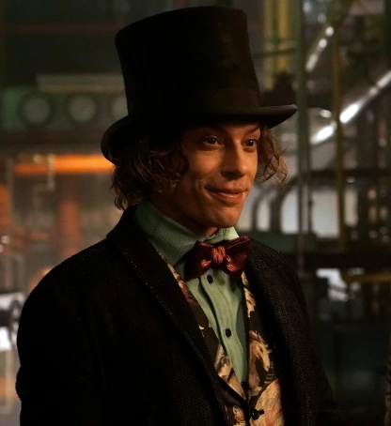
Health Of People
Read the following article about how creative writing can help improve the health of people.

Slide 3
Answer these questions in your English book:
1. What is the main goal of the Life Righting Collective's writing classes?
A) To help people write stories for money.
B) To help people improve their writing skills.
C) To help people feel better and make positive changes in their lives.
D) To help people become professional writers.
2. How do the writing classes help people feel like they are part of a community?
A) They have parties and social events.
B) They encourage people to share their stories and experiences.
C) They offer free food and drinks.
D) They have a lot of people in each class.
3. What is one way that the writing classes help people deal with difficult experiences?
A) They offer free therapy sessions.
B) They provide a safe space for people to share their stories.
C) They give people money to help them forget their problems.
D) They tell people to forget about their problems.

Slide 4
Answer these questions in your English book:
1. What is the main difference between the writing classes in South Africa and the research done in North America and Europe?
2. What are two examples of how the writing classes help people feel more confident?
3. What are two examples of difficult societal issues that people have written about in the Life Righting Collective?

Slide 5
Answer these questions in your English book:
1. The text discusses how writing can help people deal with difficult experiences. Think about a time when you faced a challenge. How could writing about it help you work through it?
2. The Life Righting Collective believes that everyone is creative. What are some ways you express your creativity? How does being creative make you feel?
3. The text mentions that writing can help people feel more confident and empowered. Think about a time when you felt confident or empowered. What helped you feel that way?

Slide 6
Answer this question in your English book:
1. The Life Righting Collective believes that everyone has the power to be creative. What are some ways you use your creativity in your own life? How does being creative make you feel?

Slide 7
Answer this question in your English book:
Instructions: Look at the image below and write 2-3 things you notice (key details, main ideas, themes) and then write down 2-3 things you wonder (questions you have because of the image, things you are curious about when you look at the image).
What do you notice?
What do you wonder?

Slide 8
Answer this question in your English book:
Instructions: The center of the bubble map has an image that represents the reading to help get you started. Fill in the connecting bubbles with concepts, ideas, questions, and details that connect the image to the reading. Example: “This image connects to the reading because_____”
A group in South Africa studied how writing classes helped people feel better and improve their mental health.
The classes helped people share their stories, connect with others, and learn to be kind to themselves.
The researchers believe that writing classes should be offered in schools and other community groups to help people heal and improve their lives.

