Slide 1
Mix and Match
Heads
Tails
Decade
Century
AD
BC
Chronology
100 years
Anno Domini
10 years
Time
Before Christ
What do you think we are leaning about today?

Slide 2
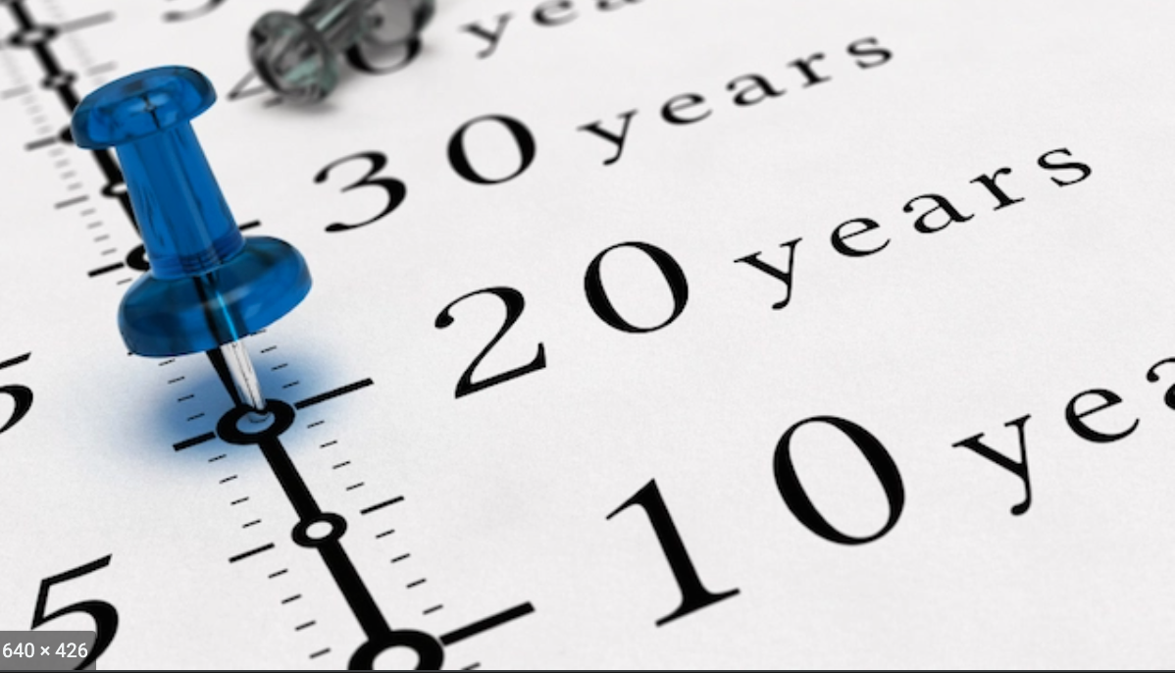
Week 4-Lesson 1
Chronology

Slide 3
Chronology
Lesson Objective
To be able to place key events in date order.
To add to your glossary of key words

Slide 4
Chronology
Success criteria
By the end of today’s lesson can you
Give a definition of the word chronology
Place events in chronological order
Begin to work out which century certain event occur in.

Slide 5
Task 1
In your glossary
Write the meaning of the word Chronology.

Slide 6
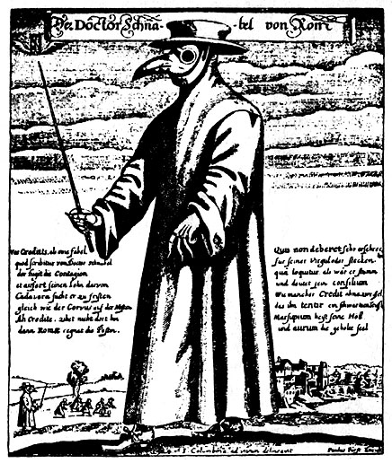
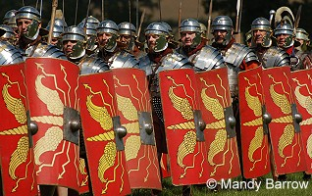
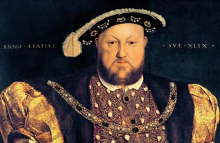
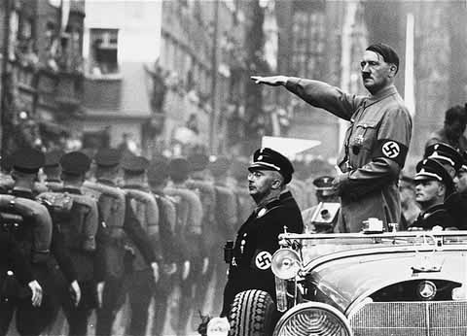
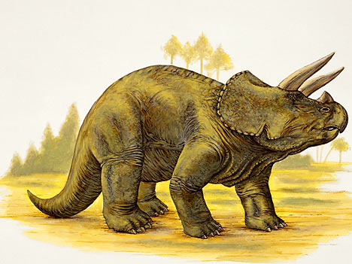
What is chronology? (write in your books)
Chronology is the study of time. To put things in chronological order means to put them in order from oldest to youngest or from oldest to most recent.

Slide 7
Put the following events in chronological order:
1552
567
250BC
500BC
2010
1215
500BC
250BC
567
1215
1552
2010

Slide 8
Now a better one!!!!

Slide 9
Put the following events in the correct CHRONOLOGICAL order
1896 CE Olympic Games revived in Athens, Greece
Aug 1947 Indian Independence –
1840: the Treaty of Waitangi is signed
1027 BCE In China, Chou dynasty began.
78 CE Origin of Saka Era in India
613 CE Muhammad preaching in Mecca
1945 CE Atomic bombing on Hiroshima and Nagasaki (Japan)
10000 BCE Middle East people domesticated goats and dogs
1833 Slavery was abolished in the British Empire
June 1914 Start of the I World War
1893: women receive the right to vote
800 CE Gunpowder was invented
1199 CE Europeans first used compasses
3000 BCE Early writing.

Slide 10
Centuries, AD and BC
A century is 100 years and is made up of 10 decades.
In history we measure periods of time in centuries. We are currently in the 21st century.
History is also split into 2 time periods.
AD – Anno Domini - meaning in the year of our lord.
BC – Before Christ - meaning before Christ.

Slide 11
Centuries
Centuries seem confusing at first but are easy to work out once you know how.
To figure out what century a date is from, look at the first number (if it’s in the 100s) or the first two numbers (if it’s in the 1000s) and add one.
So the year 784 would be in the 8th century (7+1=8)
The year 1542 would be in the 16th century (15+1=16)
Look at the dates on your sheet and use the formula above to work out which century each date belongs to.

Slide 12
How do I work out the century?
Finding out which year is in which century can be tricky business. The easiest way to decide is to cover the last two numbers up and add one. For example; 1459 is in the Fifteenth Century
In your books answer the following:
The year 1584 is in the ______________ Century.
Do the same for the years 1275, 2010, 1899 and 654.

Slide 13
Feedback
The year 1584 is in the Sixteenth Century.
The year 1275 is in the Thirteenth Century.
The year 2010 is in the Twenty-first Century.
The year 1899 is in the Nineteenth Century.
The year 654 is in the Seventh Century.

Slide 14
What do the following words mean? You have 2 minutes!
Decade =
Year=
Am =
Pm=
AD=
BC=
Century=
Millennium=
Compare with a partner and feedback!

Slide 15
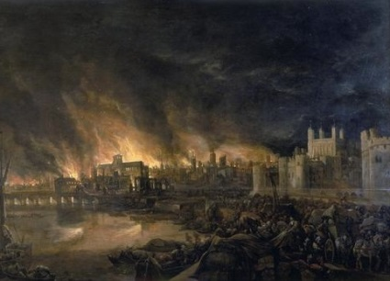
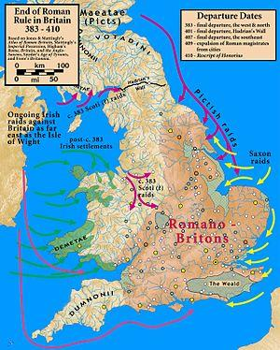
Before Christ (BC)
Z
E
R
O
Anno Domini (AD)
Events that happen before Christ are followed by the letters BC.
The bigger the number the further back in time that event happened.
So the Greek empire started in 800BC.
Dinosaurs roamed the earth in
240 million BC
Events that happen after Christ are known as Anno Domini (AD) meaning the year of our lord.
The lower the number the closer to the year 0 the event happened.
So the Romans left Britain in 410AD
The great fire of London was in 1666AD
You started Mortimer in 2013AD

Slide 16
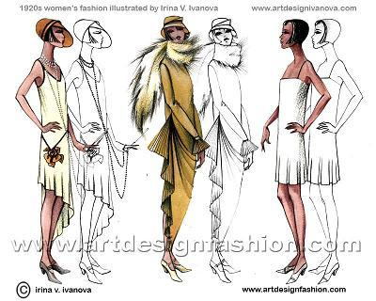
When people refer to a decade in time they don’t say the say the second decade they say the 20’s.

Slide 17
Plenary HA
Put the following events into the correct chronological order and then draw a timeline using one whole page in your exercise book and plot the following events accurately on it.
-> 1066AD Edward the Confessor died;
-> 55BC Julius Caesar invaded Britain;
-> 753BC Rome was founded by Romulus;
-> 260AD plague spreads through the Roman empire;
-> 43AD Roman conquest of Britain by Emperor Claudius;
-> 1042AD King Harthacnut of England and Denmark died;
-> 2560BC pyramid of Giza was completed
-> 802AD Egbert became first king of England
Notes:
Pyramid of Giza took 20 years to build

Slide 18
Centuries
Centuries seem confusing at first but are easy to work out once you know how.
To figure out what century a date is from, look at the first number (if it’s in the 100s) or the first two numbers (if it’s in the 1000s) and add one.
So the year 784 would be in the 8th century (7+1=8)
The year 1542 would be in the 16th century (15+1=16)
Look at the dates on your sheet and use the formula above to work out which century each date belongs to.

Slide 19
Timelines
When Historians put dates in order they use a timeline.
3000 BC
2000 BC
1000 BC
0
1000 AD
2000 AD
3000 AD
BC dates start with higher numbers first.
AD dates start with lower numbers.
Turn your book sideways.
Use a whole page to draw the timeline above.
Plot the dates on your sheet on the timeline.

Slide 20
Where this lesson fits in
Last lesson you were introduced to history.
This lesson we looked at chronology and time lines.
Next lesson we will look at anachronisms and how they are used by historians.

Slide 21
Your Chronology
Using what we’ve looked at today, create a timeline of your life.
It needs to start with the year you were born, and end with 2022.
Add dates that are important to you e.g. when you learned to ride a bike, when your little brother/sister was born, when you got a dog, etc.

Slide 22
Final one!
Worksheet in Google classroom

Slide 23
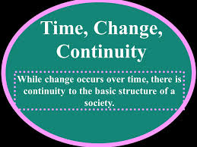
CHANGE AND CONTINUITY Learning Objective
How to explain change and continuity in History.

Slide 24
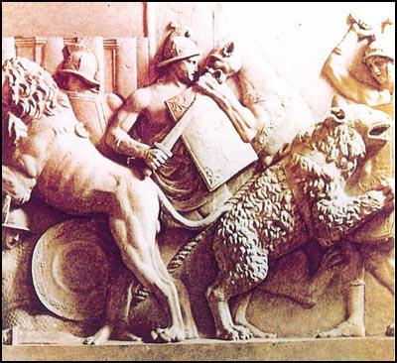
What is ‘change’ (different)?
Change refers to events or developments from the past that have been changed, modified, altered or transformed over time.
The change can be a decline or even progress.
The change can be gradual or even immediate.
changes are events or developments from the past that represent modifications, alterations and transformations

Slide 25
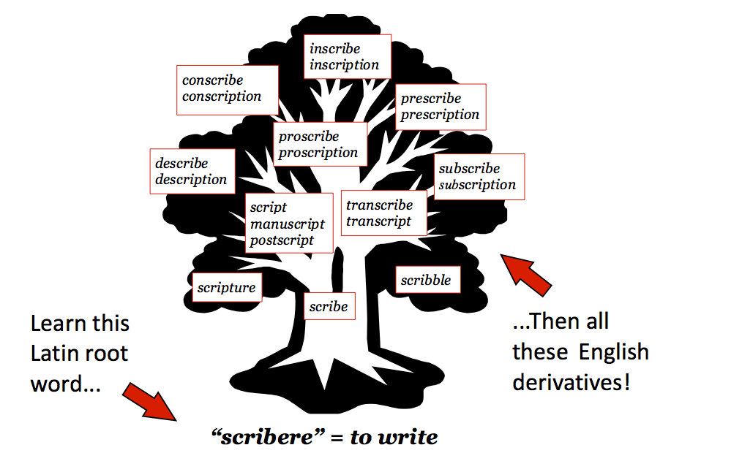
What is continuity (similar)?
Aspects of the past that have remained the same over of time.
This is generally without any sort of significant interruptions or drastic changes.
Common examples include certain rules, some religious beliefs and systems of government.

Slide 26
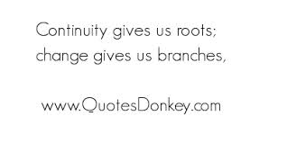
Change and Continuity
CHANGE (Differences) | CONTINUITY (Similarities)
In Ancient Rome people believed the different gods controlled different aspects of their lives. Today we worship one god and believe that we control the different aspects of our lives. | The Ancient Romans built roads which were higher in the middle and curved downwards towards drainage ditches on the sides. In Australia today roads are still designed in this way.

Slide 27
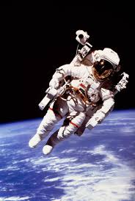
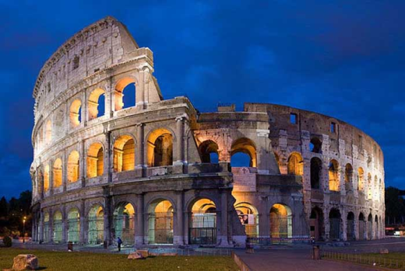
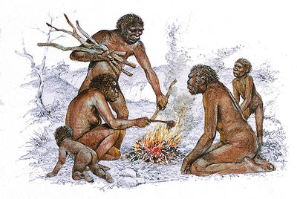
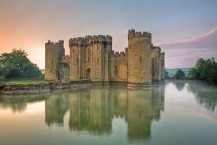
Eras of History

Slide 28
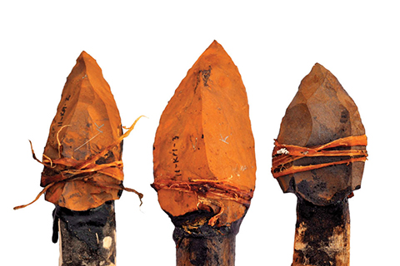
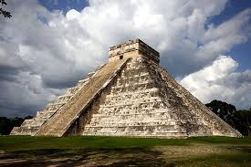
Four main periods in History
1. Prehistory
2 Ancient History
3. Middle Ages (Medieval times)
4. Modern History

Slide 29
ERAS IN HISTORY
Prehistory – 6 million years ago – 3600 BCE
Ancient History – 3600 BCE – 500 CE
Dark Ages – 500 CE – 1000 CE
Middle Ages – 1000 CE – 1500 CE
Modern History – 1500 CE –
https://www.biographyonline.net/different-periods-in-history/

Slide 30
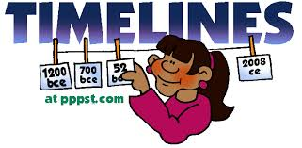
Activities
1. Draw the timeline in your workbook (draw the timeline down the page).
2. Include the dates, names of the eras and
three features or events for each era.
3. The timeline must have a title and be neat.

