Slide 1
A Guide to Creating Infographics
Tips. Ideas. Samples

Slide 2
What is an infographic?
Information graphic (infographic) is a visual representation of information or data, and has engaging visuals to communicate information quickly and clearly.
Infographics are around us everywhere. You’ve seen infographics with beautiful designs printed as posters or distributed through social media or email marketing, and by government agencies such as the COVID-19 infographics circulated to the public during the government’s campaign in response to the pandemic. You may have also seen them at school or in the library.

Slide 3
Why infographics?
Infographics help communicate complex information in a much simpler manner. They are useful to communicate processes and procedures.
Because they are usually attractive infographics are memorable and help people retain information.

Slide 4
Plan & Write Contents First!
Before designing an infographic you need to do the following:
Research your topic.
Jot down key ideas.
Form a topic and purpose.
Section your key points/ideas by creating headings and some bullet points to help you organise your thoughts.
Write the contents of your infographic in sequence so that your message/purpose is clear to the audience/reader.
Give your infographic a title that directly addresses the purpose!

Slide 5
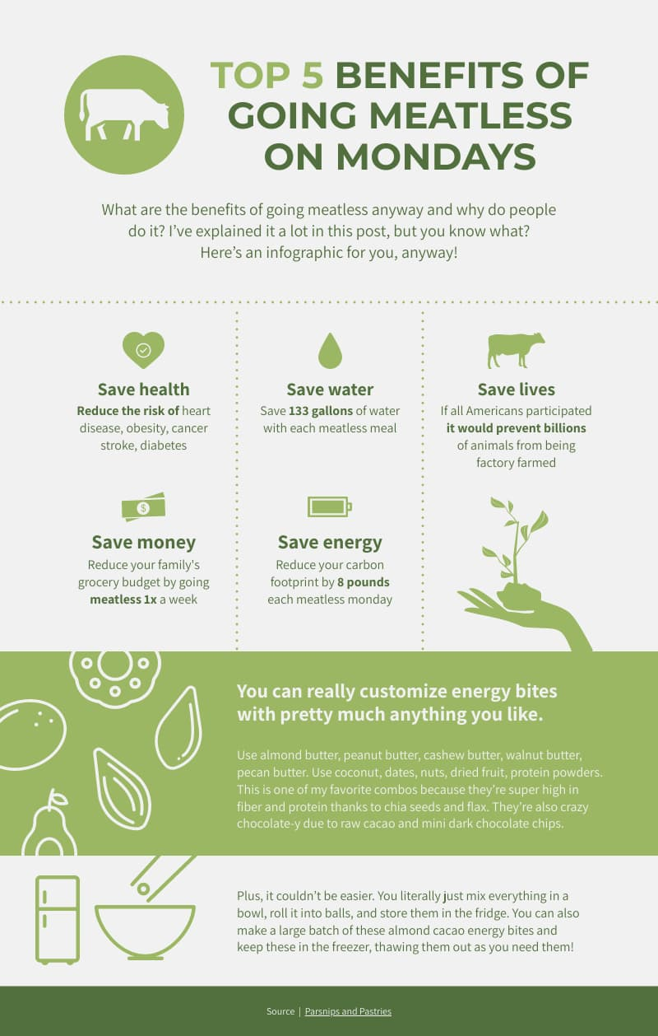
10 infographic poster ideas
1. Raise awareness about a specific issue
This infographic poster about the benefits of going meatless on Mondays is an excellent example of taking the visual route in creating persuasive informational content.

Slide 6
10 infographic poster ideas
2. Introduce a complex concept in a scannable and digestible way
The visual nature of infographic posters helps overcome the challenge of explaining a new complex idea or process.

Slide 7
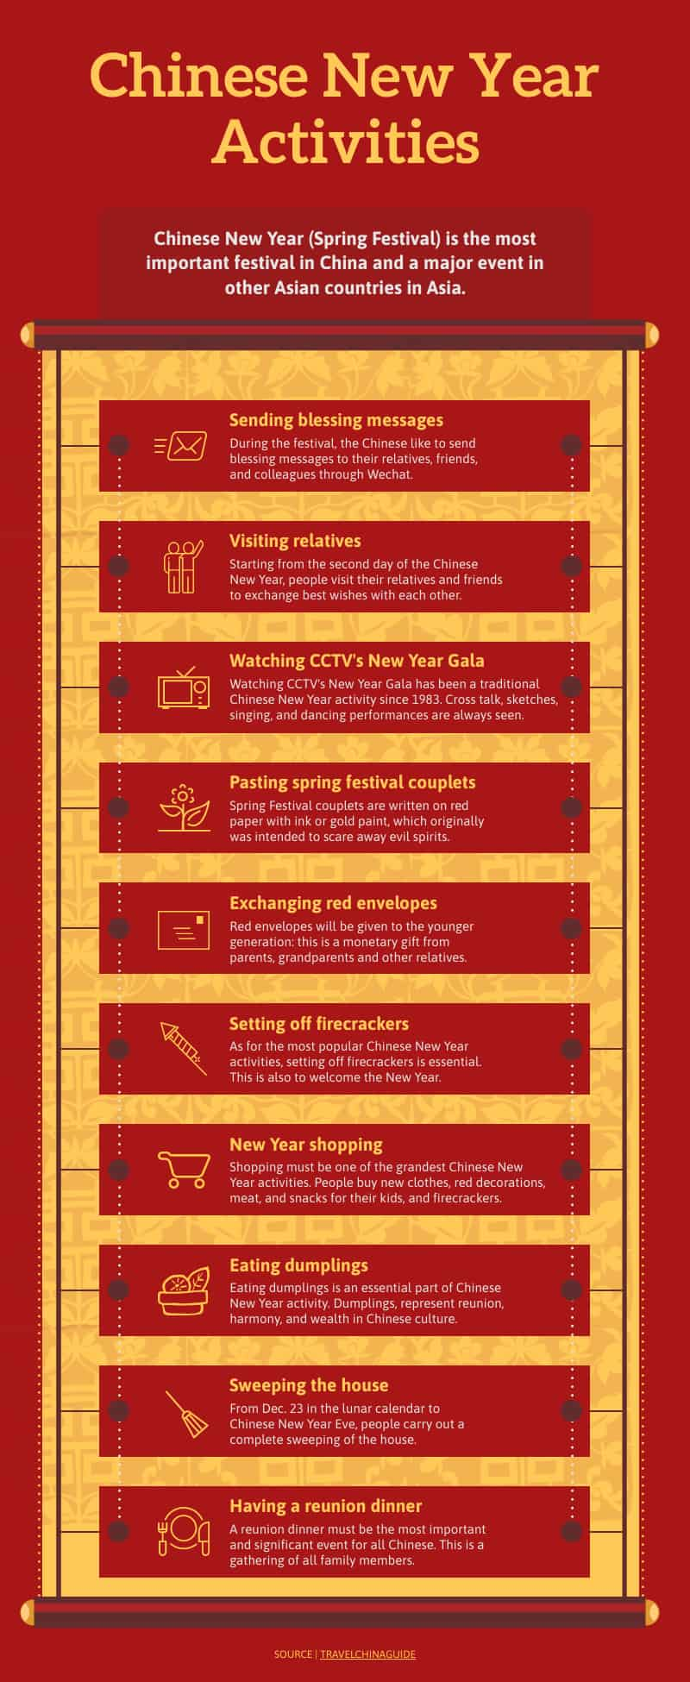
10 infographic poster ideas
3. Create a buzz for an upcoming event or activity
If you’re organising or hosting an event, use infographic posters to pique your attendees’ interest and build anticipation, just like this example.

Slide 8
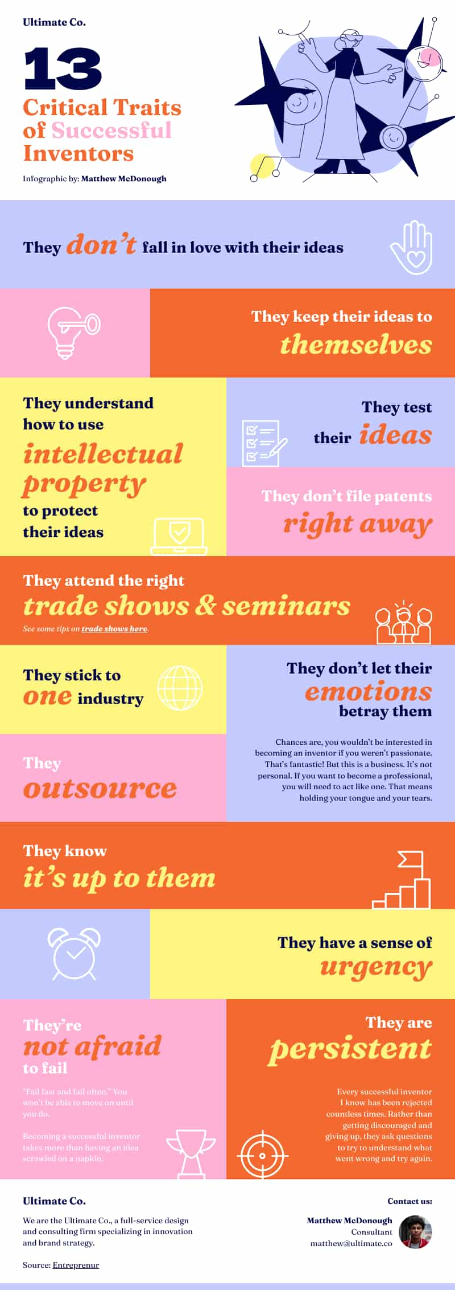
10 infographic poster ideas
4. Inspire your audience
There’s more to infographic posters than being informative. You can also use them to inspire your audience.

Slide 9
10 infographic poster ideas
5. Explain the steps of a process or workflow
Infographic posters can save you time and energy if you have to explain a process repeatedly. For example, HR teams often have to explain the onboarding process to new employees. Instead of scheduling an hour long onboarding discussion for every new hire, new employees can scan the infographic on their own and ask questions during a 30 minute meeting!

Slide 10
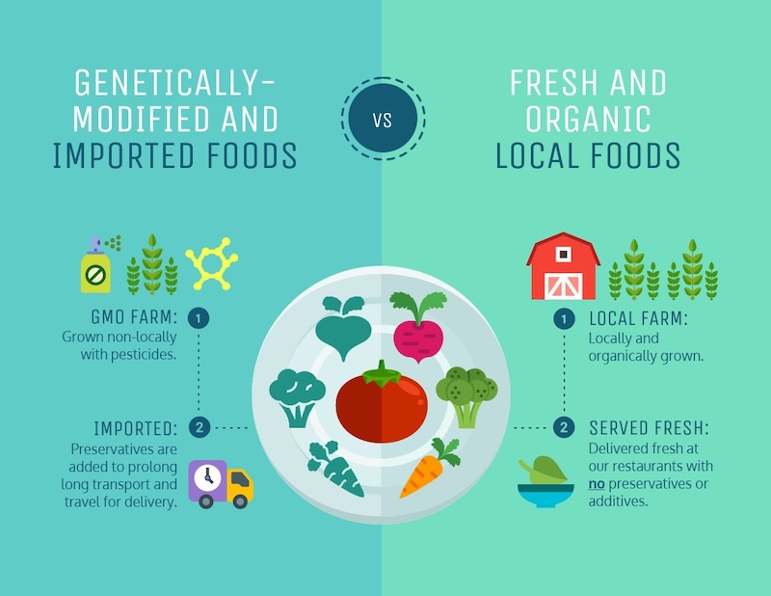
10 infographic poster ideas
6. Compare and contrast
Highlight the similarities and the differences between places, ideas, or objects with infographics.

Slide 11
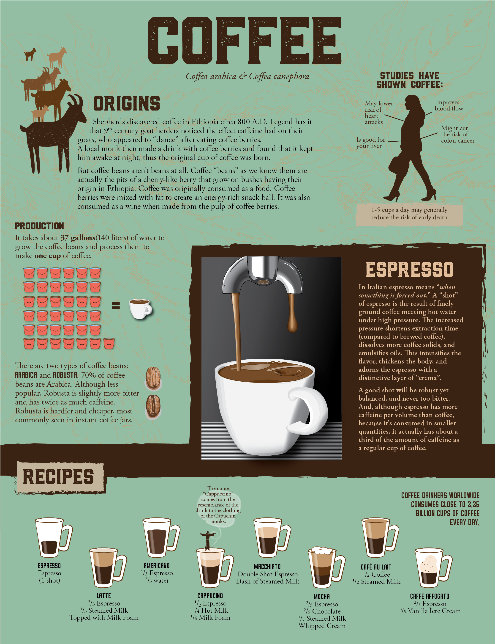
10 infographic poster ideas
7. Advertise a product, service, or event
Using traditional posters to advertise a product or service has been around forever! Infographic posters are no exception, especially when placed in strategic locations or where your target audience frequently hangs out. Bus stops, and checkout areas are some examples of effective infographic poster spots.

Slide 12
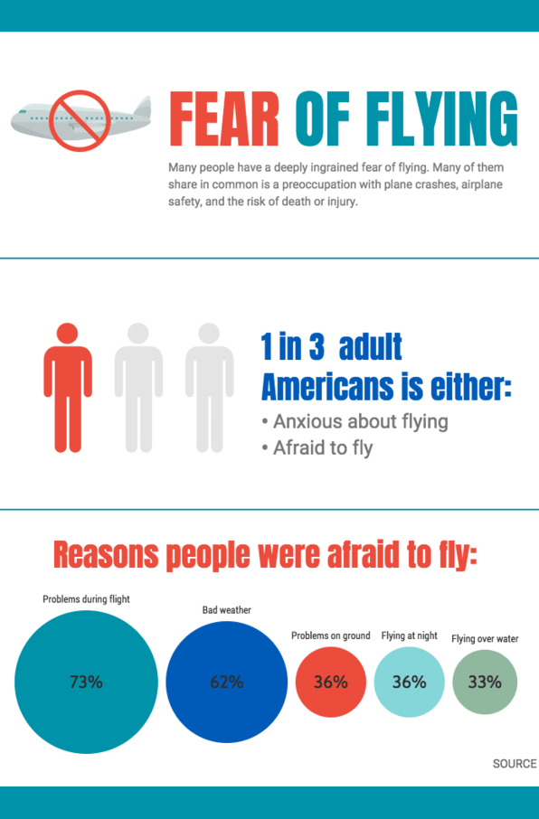
10 infographic poster ideas
8. Showcase survey results
Infographics are the best ways to present survey findings. You can even use them as handouts during your presentation.

Slide 13
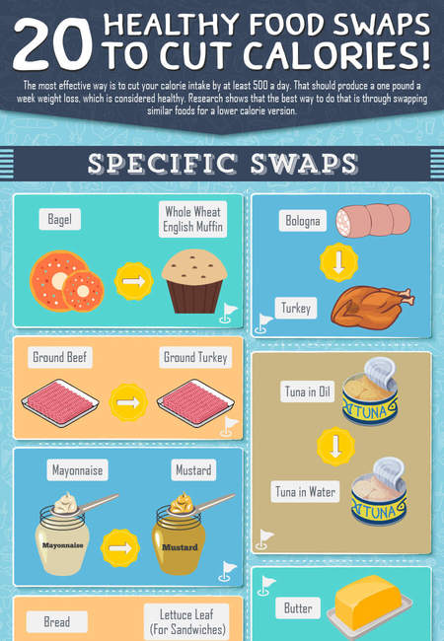
10 infographic poster ideas
9. Share tips and best practices
Another way to use infographic posters is to visualise best practices and tips. This example promotes healthy eating by sharing healthy ingredient swaps.

Slide 14
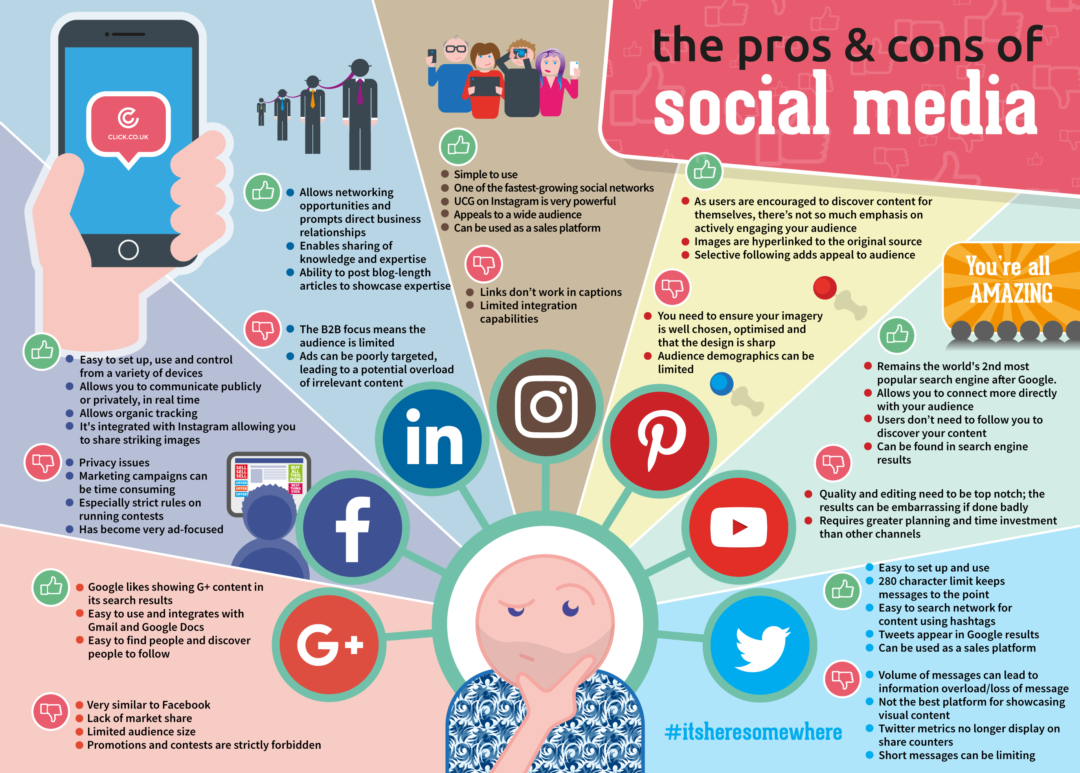
10 infographic poster ideas
1o. Make an argument
Making and building an argument isn’t not just limited to essay writing or public speaking. Infographic posters are also an ideal platform when you need to build your case.

Slide 15
Important things to remember when designing infographics
Simple
Be Simple. The point is to condense a lot of data and design a visual solution to interpret it. Your design should allow the viewer to easily navigate around the information without being confused. Less is more.
Universal
Be Universal. Use recognisable icons and images that will be understood by many. Infographics can take on a language of their own by delivering information in an accessible way.
Original
Be Original. Through the creative use of colour, proportion, fonts, images, and text, the design should be unique and grab the attention of viewers. Start with a mood board to capture the tone of the message or purpose.

Slide 16
Essential elements of an infographic
Descriptive title and subheadings
Informative statistics
Thematic colour scheme
Eye catching graphics
Clearly organised, sequential story
Specially formatted facts

