Slide 1
Blizzards Slideshow
L.I: We are EXPLORING articles by recognising texts that have multiples purposes and knowing the context of the creator helps us understand the purpose.

Slide 2
Winter Storms
You will watch the following video about what are winter storms?
Then read this article about how blizzards are inescapable.

Slide 3
1. According to the text, what is one reason why many people choose to drive during a blizzard despite the risks?
A) They are unaware of the potential dangers of driving in a blizzard.
B) They believe that authorities will close roads or impose driving bans if necessary.
C) They are pressured by economic factors to continue working or traveling.
D) They are confident in their driving skills and believe they can handle the conditions.
2. What is the primary reason why power outages are a major concern during snowstorms?
A) Power outages can lead to the failure of critical infrastructure systems.
B) Power outages can cause widespread damage to buildings and property.
C) Power outages can disrupt transportation and communication networks.
D) Power outages can result in the loss of heating and ventilation, leading to dangerous conditions.
3. What is the author's main argument about the role of building codes in preventing snow storm disasters?
A) Building codes are outdated and need to be updated to reflect current snow load data.
B) Building codes are ineffective in preventing roof collapses during heavy snowstorms.
C) Building codes are essential for ensuring the safety of new construction but have limited impact on older buildings.
D) Building codes are a crucial factor in mitigating snowstorm damage, but they are not a complete solution.

Slide 4
Short Answer Questions
1. What is the author's main argument about the role of human behavior in preventing snow storm disasters?
2. What are some examples of infrastructure failures that can occur during snowstorms, as discussed in the text?
3. What are some specific steps that homeowners and businesses can take to prepare for power outages during a snowstorm?

Slide 5
Open-ended Prompts
1. The text argues that many snowstorm-related disasters are preventable. Reflect on a time when you or someone you know experienced a natural disaster. What steps could have been taken to prevent or mitigate the damage? How does this experience inform your understanding of disaster preparedness?
2. The author emphasizes the importance of having a 'Plan B' for power outages. Consider how technology and infrastructure play a role in your daily life. What are some potential disruptions to your routine that could occur if you lost access to electricity? How could you prepare for such an event?
3. The text highlights the economic pressures that can lead people to take risks during snowstorms. Think about a time when you made a decision that involved weighing potential risks and rewards. What factors influenced your decision? How did your choice impact you or others? What lessons did you learn from this experience?

Slide 6
Answer the question in your English book:
1. The text discusses how human behavior can contribute to the severity of snowstorms. Reflect on a time when you or someone you know made a decision that could have potentially put them in danger during a weather event. What factors influenced that decision? What could have been done differently?

Slide 7
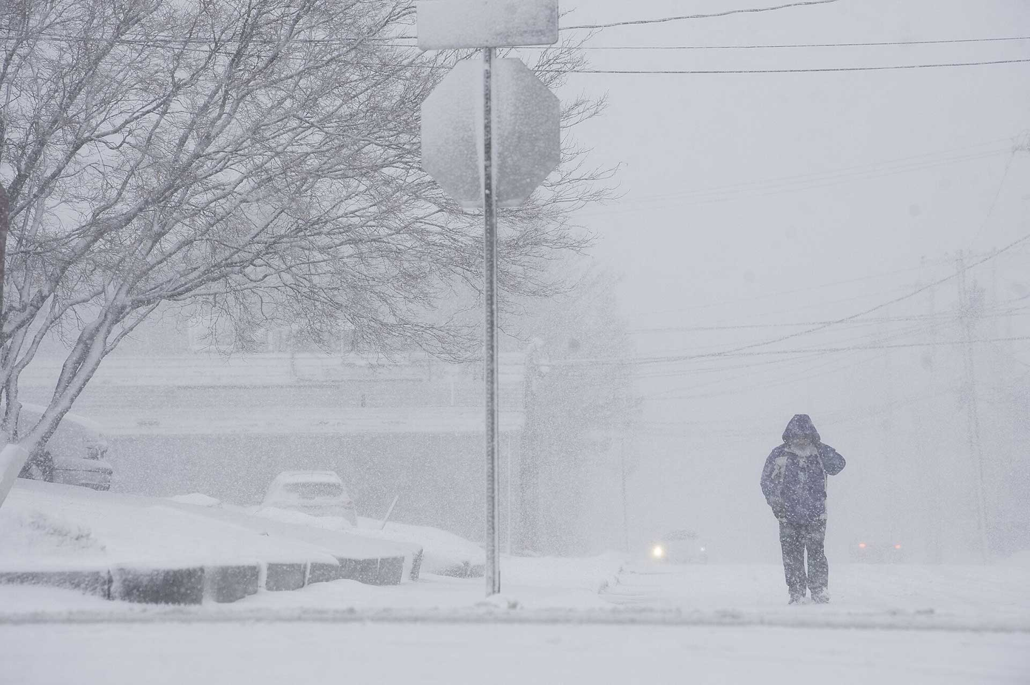
Answer this question in your English book:
Instructions: Look at the image below and write 2-3 things you notice (key details, main ideas, themes) and then write down 2-3 things you wonder (questions you have because of the image, things you are curious about when you look at the image).
What do you notice?
What do you wonder?

Slide 8
Answer the question in your E book:
Instructions: The center of the bubble map has an image that represents the reading to help get you started. Fill in the connecting bubbles with concepts, ideas, questions, and details that connect the image to the reading. Example: “This image connects to the reading because_____”
Snowstorms can be prevented from becoming disasters by taking precautions such as staying off the roads, ensuring roofs are strong enough to handle heavy snowfall, and preparing for potential power outages.
The text emphasizes the importance of building codes and their role in mitigating roof collapses, highlighting the need for updated codes and the risks associated with older structures.
The author stresses the significance of resilience in infrastructure, particularly in relation to power outages, advocating for backup plans and measures to minimize damage and disruption during extreme weather events.

