Slide 1
TREATIES AROUND THE WORLD
L.I: We are EXPLORING on analysing different types of treaties.

Slide 2
In this lesson you will learn...
What is a treaty?
What is in a treaty?
Why are they created?
Different types of treaties
Activity
Task

Slide 3
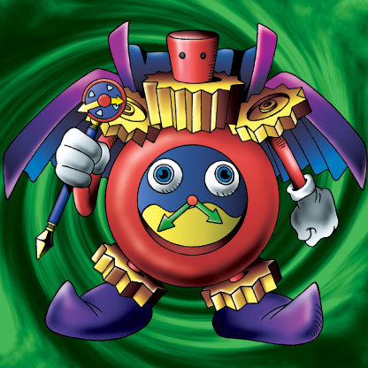
There will be time during this lesson...

Slide 4
What is a treaty?
A treaty is an agreement under international law entered into by actors in international law, namely sovereign states and international organizations. A treaty may also be known as an (international) agreement, protocol, covenant, convention, pact, or exchange of letters, among other terms. Regardless of terminology, all of these forms of agreements are, under international law, equally considered treaties and the rules are the same.

Slide 5
What is in a treaty?
It will have a title to state what the topic / issue is.
It will have a date around the bottom or top to establish the time period that it was created in and sorted.
A treaty will have paragraphs otherwise known as articles which state the information required from the parties and what the parties need to do.
It will have signatures from the necessary people who need to sign the treaty which confirms that it is agreed to.

Slide 6
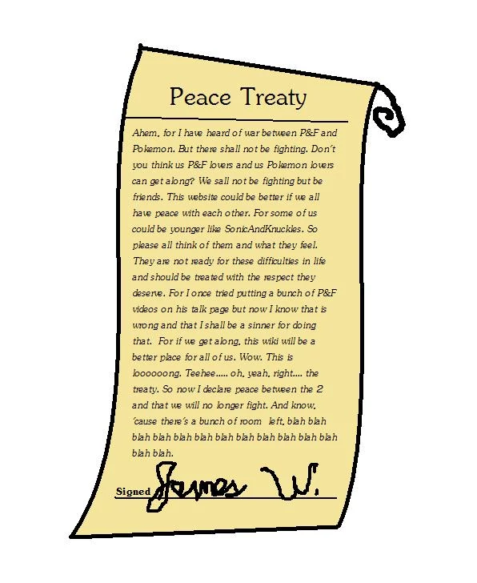
Treaty image

Slide 7
Why are treaties created?
Treaties form the basis of most parts of modern international law. They serve to satisfy a fundamental need of States to regulate by consent issues of common concern, and thus to bring stability into their mutual relations. They are written promises, like a contract, that are binding on the parties to the agreement. The Constitution grants the president the power to make treaties with other countries. Once executed, treaties become a part of international law.

Slide 8
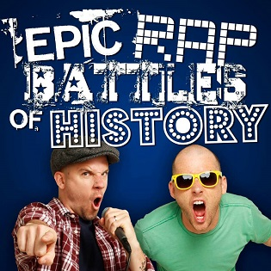
Historic treaties

Slide 9
What are they?
Historic treaties are those treaties signed by First Nations and the British and Canadian governments between 1701 and 1923. The British and Canadian governments wanted to sign treaties with First Nations in order to reduce the possibility of conflict and to support European immigration and land settlement, agriculture, natural resource use, trade, and other economic developments.

Slide 10
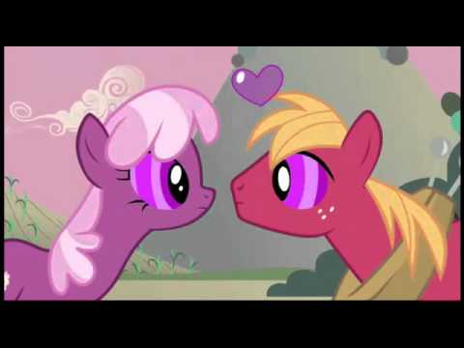
Peace and friendship treaties

Slide 11
What are they?
The Peace and Friendship Treaties, signed in the Maritimes in pre-Confederation Canada, were intended to end hostilities and encourage co-operation between the British and Mi’kmaq and Maliseet First Nations. Unlike later treaties signed in other parts of Canada, the Peace and Friendship Treaties did not involve First Nations surrendering rights to the lands and the resources they had traditionally used and occupied.

Slide 12
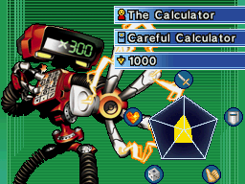
The Numbered treaties

Slide 13
What are they?
Eleven Numbered Treaties were signed by the First Nations in Canada and the reigning monarchs of Canada (Victoria, Edward VII, or George V) between 1871 and 1921. The treaties provided the government with large tracts of land in exchange for promises made to the First Nations of the area. The specific terms differed with each treaty.

Slide 14
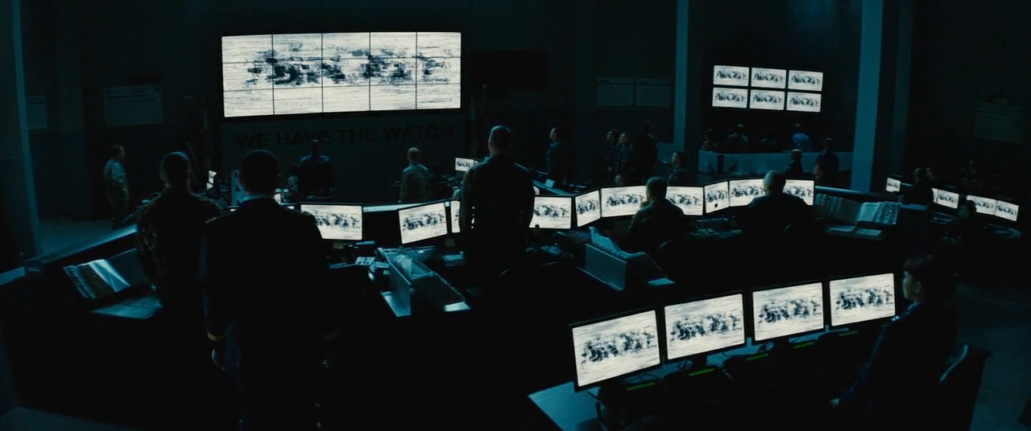
Modern treaties

Slide 15
What are they?
Many modern treaties are being negotiated today. The Government of Canada officially calls modern treaties Comprehensive Land Claims. As of May 2017, 65 First Nations in British Columbia were participating in the treaty process. Six First Nations have completed a treaty. These negotiations are “tripartite,” meaning that three levels of government are involved: the First Nation, the Government of Canada, and the Province of British Columbia.

Slide 16
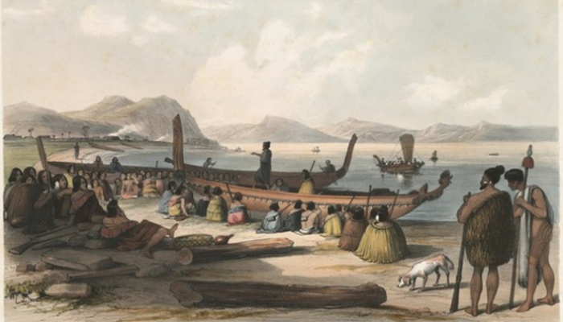
Often defined as ‘revenge’, utu has a broader meaning: the maintenance of balance and harmony within society. A wrong had to be put right, but how this was done could vary greatly.
Utu in the form of gift exchange established and maintained social bonds and obligations. If social relations were disturbed, balance could be restored through utu. One form of utu was muru, the taking of personal property as compensation for an offence against an individual, community or society. Once muru was performed, the matter was considered to be ended. The nature of muru was determined by factors that included the mana of the victim and the offender, the severity of the offence and the intent of the offending party.

Slide 17
Activity
Research 1 Treaty between 2 parties and discuss/ share back what it is about. Do you agree/ disagree.

Slide 18
Task
Make a treaty between you and your partner about anything you do together. Your treaty must include text, colour, images and a colourful border.

