Slide 1
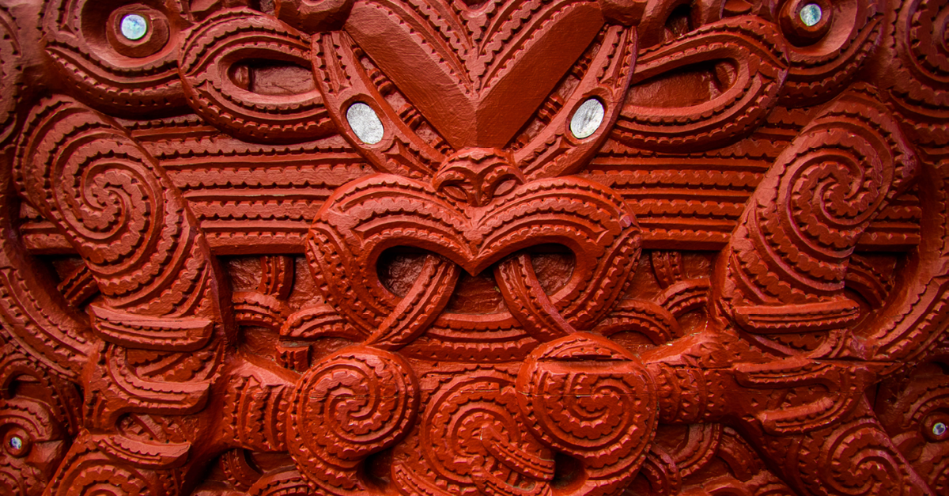
Historical Māori Innovative Inventions Slideshow

Slide 2
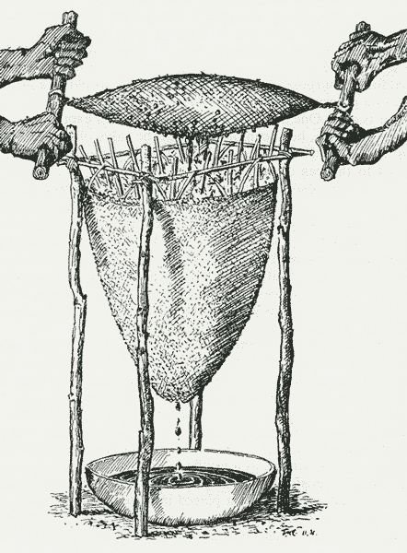
Historical Innovations: The Kopa
The kopa, also called a tāwiri, was an invention for squeezing the juice from tītoki berries. It was a flax bag in which the berries were placed, then pounded to release their juice. The kopa was squeezed by twisting it between two pairs of wooden handles. The juice was then filtered through another bag, and dripped into a container underneath.
Mark Derby, 'Inventions, patents and trademarks - The ‘no. 8 wire’ tradition', Te Ara - the Encyclopedia of New Zealand, http://www.TeAra.govt.nz/en/diagram/25385/early-maori-invention-the-kopa (accessed 17 May 2024)

Slide 3
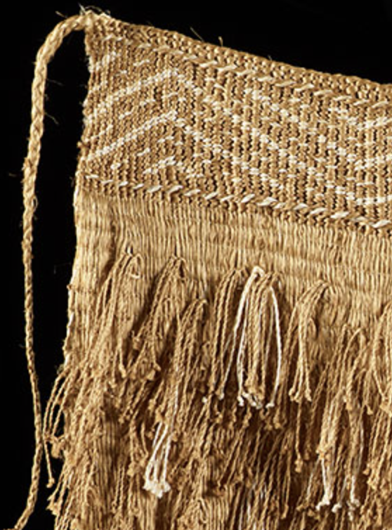
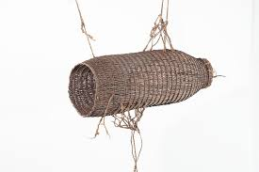
Historical Innovations: Flax and flax working (by Nancy Swarbrick)
In the late 1700s Māori showed European visitors how New Zealand flax could be prepared to make rope and other useful items. This led to a booming trade in flax fibre, and a local flax-stripping industry. Today, research is finding new uses for flax – from face-creams and animal feed to flower arrangements.
At first, Māori women used flax in the same way they had used the pandanus plant in Polynesia – weaving baskets, containers and mats from the leaves. They then learned to obtain the strong fibre (muka) from the leaves by scraping the green flesh away with a sharp shell. The muka was pounded until soft, then washed and sometimes dyed. Twisted, plaited and woven, it was used to create a wide range of items, such as fishing nets and traps, footwear, cords and ropes.
Flax became so crucial for Māori that when 19th-century missionary William Colenso told chiefs that it did not grow in England, they would reply ‘How is it possible to live there without it?’ and ‘I would not dwell in such a land as that’.
Flax was not just useful – it was a way of passing on culture. Through the patterns in woven articles, stories were told and beliefs affirmed. Although European clothing replaced flax garments, weaving as an art survived. After its revival in the later 20th century, less well-known flax types were grown once more.
hīnaki (fish/eel trap)

Slide 4
Historical Innovations: Hīnaki
hīnaki (fish/eel trap)
The hīnaki (eel pot) was a basket-like pot that was set in open water with bait, or used at pā tuna (weirs). Intricately woven, the best-made hīnaki were works of art.
Ordinary hīnaki (called hīnaki tukutuku) had one entrance. When they were set without a weir, the entrance faced downstream. The eels would smell the bait, and swim upstream to find it. The hīnaki was anchored with stones and tied to a stake, a tree, or a pole driven into the stream bed.
A large type of hīnaki, called hīnaki tarino, was used in the Waikato River and its tributaries. The hīnaki waharua had an entrance at each end – waharua means ‘two mouths’. The entrance to the hīnaki – called the akura – had a circle of sticks inside. These pointed inwards, touching in the centre, so the eel could push through to enter, but could not get back out. Other hīnaki stopped the eel escaping with a small bag-like net inside the akura.
Hīnaki were often made from stems of mangemange (Lygodium articulatum), which only grows in the north. Mangemange is strong and flexible, and if hīnaki were being carried far, they could be soaked in water, pressed flat, stacked and lashed to poles. When they were untied, they sprang back to their original shape. Around Ōtaki, north of Wellington, hīnaki were made from the aerial roots of kiekie and the stems of aka-tororaro, a climbing plant. Supplejack was also used, but it was a poor substitute. Temporary hīnaki were sometimes made from flax.

Slide 5
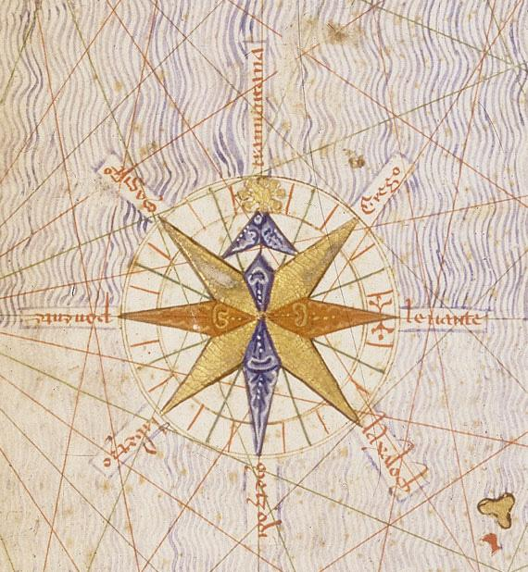
Historical Innovations: Way-finding - the Star Compass
Before the invention of the compass, sextant and clocks, or more recently, the Global Positioning System (GPS), Polynesians navigated their ocean voyages without instruments. Instead, clues about position, direction, and distance came from the stars, sun, and moon; from patterns in the ocean, including currents, ocean swells, and localized wave characteristics; from clouds, the wind, and even from wildlife. Navigators also kept a mental log of their progress, always maintaining a sense of the distance covered and the present location.
Traditional Polynesian navigators position themselves mainly by the stars, using what's called a star compass. The ability to read the night sky is a great skill. A star compass is used to help memorise the rising and setting points of the brightest and most distinctive stars and planets to set direction.
Navigators steer their waka toward a star on the horizon. When that star rises too high in the sky or sets beneath the horizon, another is chosen, and so on through the night. Seven to 12 stars are enough for one night's navigation, and the moon and bright planets such as Kōpō (Venus) and Pareārau (Jupiter) are also useful.
Of course, stars aren't visible all the time. That's when the sun and moon can help. At daybreak, navigators note the position of the waka in relation to the rising sun. As the sun gets higher in the sky, they look to where it will set in the evening. At night, if clouds or fog pass in front of your guiding stars, the moon may still be visible and a good bearing marker when it is near the horizon.
When skies are too overcast for navigators to use the sun, the moon, planets or stars, ocean swells can fill in as a rough guide to direction. An experienced navigator can sense the direction swells are coming from as they pass under the waka. If you note the direction from which the swells are coming at a time when the stars are visible, those same swells can guide you when the stars disappear.
https://www.learnz.org.nz/location192/bg-standard-f/polynesian-navigation

Slide 6
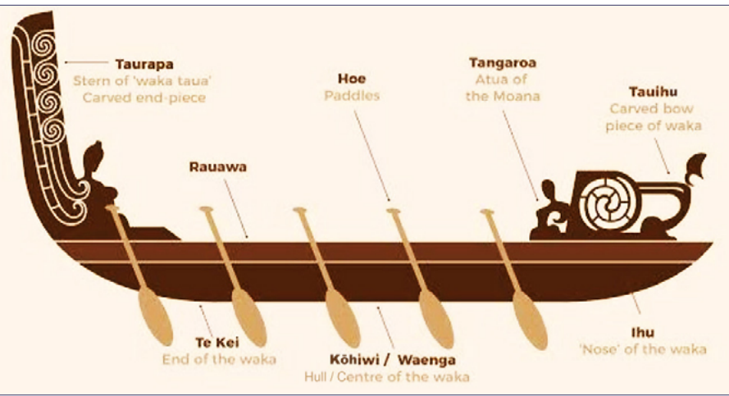
Historical Innovations: The role of carvings on waka
from https://nzase.org.nz/wp-content/uploads/2022/08/2022-08-Waka-physics-NZASE-resource-1.pdf
The tauihu and taurapa are the principle elements added to the main body of a canoe to complete its construction. Their addition completes a waka by both enabling an intended pattern of motion and by giving form to understanding of spiritual / temporal relationships.
….
The spiral carving of tauihu and taurapa also works in several ways. It allows the wind to move through the carvings reducing windage and the heeling over that this may cause. However to a certain extent this is used to advantage in that it does provide some stability in the same way as a small staysail was used on traditional fishing trawlers with the pressure of the wind on the sail helping to control roll. The functional aspects of tauihu and taurapa are a distinctive component of Māori waka and the recognition of this technology completes a deeper understanding of their evolution. This also holds exciting possibilities for contemporary waka design and revives knowledge pathways for carvers giving new direction for their contribution to contemporary waka development and practice.
from Roake, Q. (2014). University of Otago https://ourarchive.otago.ac.nz/bitstream/handle/10523/5032/RoakeQuentin2014MIndS.pdf?sequence=6&isAllowed=y

