Slide 1
Paragraph Writing
Mr. Mitchell

Slide 2
Learning Goal
To write a strong paragraph and get to know you better!

Slide 3
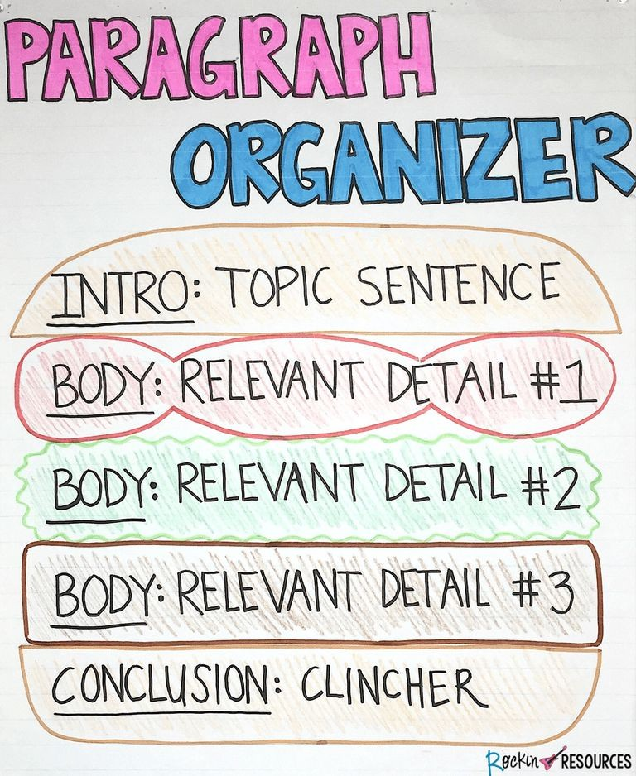

Slide 4
THE TOPIC SENTENCE
What makes a good topic sentence?
It includes the main idea or topic of the paragraph: TEXAS is about scaffolding, this is the base of the frame
It grabs the reader’s attention (snappy, powerful, bold)

Slide 5
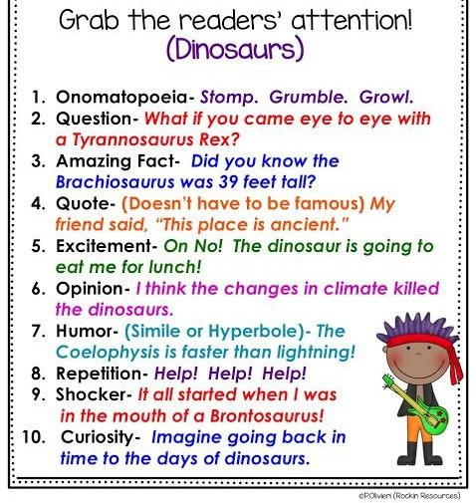

Slide 6
Example
You may know my name is Mr. Mitchell but here are some other things that I think you should know about me.

Slide 7
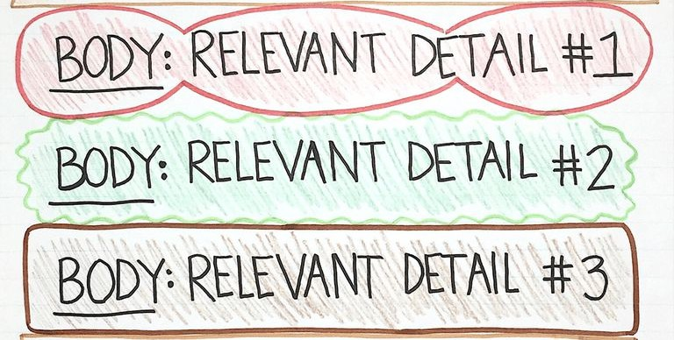
The body/ relevant details
Key Reminders:
Within a paragraph you need to stick to the topic
Every sentence is RELATED to the topic sentence - flow, flow flow, remind the structure
Every sentence communicates details, examples, or a clear picture in the reader’s mind of what your topic is

Slide 8
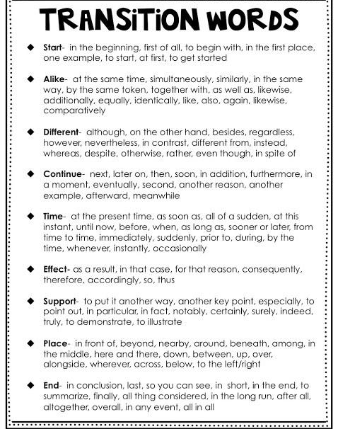

Slide 9
Example
Sentence 1:
Start -
First of all, you should know that I am passionate about watching movies and reading film history.
Sentence 2:
Continue - Secondly, you should know that I am terrified of rats.
Sentence 3:
End -
Finally, I think that you should know that I love to play any type of sport.

Slide 10
The Conclusion
How do you end off your paragraph?
Summarize the main ideas/ topic of your paragraph. Try to not repeat yourself exactly: this is considered lazy, and an even more damning crime, boring.
Like the topic sentence, be creative! Think about how you can snap the reader back to focus and make them wonder about your words.

Slide 11
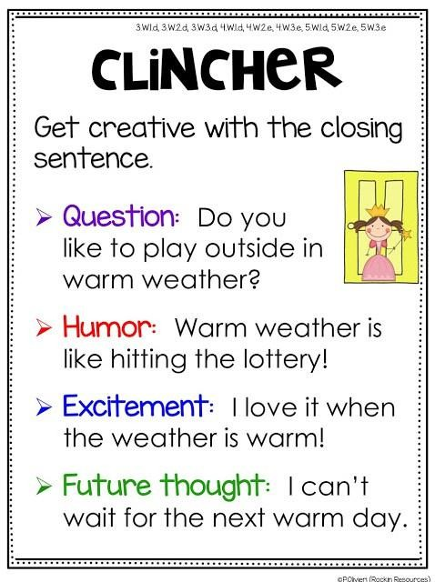

Slide 12
Example
Those are a couple of things that I think you should know about me, what should I know about you?

Slide 13
Mr. Mitchell’s PARAGRAPH
You may know my name is Mr. Mitchell, but here are some other things that I think you should know about me. First of all, you should know that I love the movies and how they are made. Secondly, you should know that I am terrified of rats. Finally, I think that you should know that my background is Scottish and French. These are a couple of things that I think you should know about me, what should I know about you?
What do you notice about the appearance of my paragraph?

Slide 14
Summary: What goes into a paragraph?
A paragraph is a summary of an idea, a complete thought. It is an idea seen through to an end.
Although it may be one part of a wider piece, a paragraph must be readable and understandable on its own. A building block must still be functional as a block. When writing a paragraph, you must keep in mind the flow of your sentences. Are they clear? Do they flow? What is your style?
Do. You. Write. Short. Sentences. Like. This?
Or do you make the unnecessary mistake of long, flowy sentences that just drag on, really just seeming to go on and on without end, completely distracting and well beyond the point that you were making and completely losing the reader?

Slide 15
Resources
http://rockinresources.com/2014/11/writing-mini-lesson-7-clo sing-sentences.html
http://rockinresources.com/2018/01/series-step-step-writing- mini-lessons.html
http://rockinresources.com/2014/11/writing-mini-lesson-6-rel evant-details.html

