Slide 1
Karakia Timatanga - Beginning Prayer
Me karakia tātou
Whakataka te hau ki te uru
Whakataka te hau ki te tonga
Kia mākinakina ki uta
Kia mātaratara ki tai
E hī ake ane te atakura
He Tio, he huka, he hau hū
Tihei mauri ora!

Slide 2
This week we are EXPLORING the Tupu-ā-nuku and Tupu-ā-rangi by observing how they connect Māori to te taiao
By the end of today’s lesson you should be able to:
Describe (explain) the tikanga when harvesting rongoā rākau (plants)
State (describe) at least 1 (or at least 2-3) connections between rongoā Māori and te taiao and Tupu-ā-nuku and Tupu-ā-rangi

Slide 3
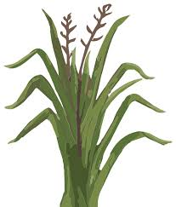
There is tikanga around harvesting (cutting / taking)
plants from the native bush and in your garden.
Why do you think there is tikanga involved?
When harvesting (cutting / taking) plants you should say a karakia (prayer) to outline your intention and honour some of the Māori atua (Gods).
Which atua (Gods) do you think we should honour?
Karakia is a time to let go of stress / problems you are holding on to and a time to focus on and tune into the plants.
Tikanga

Slide 4
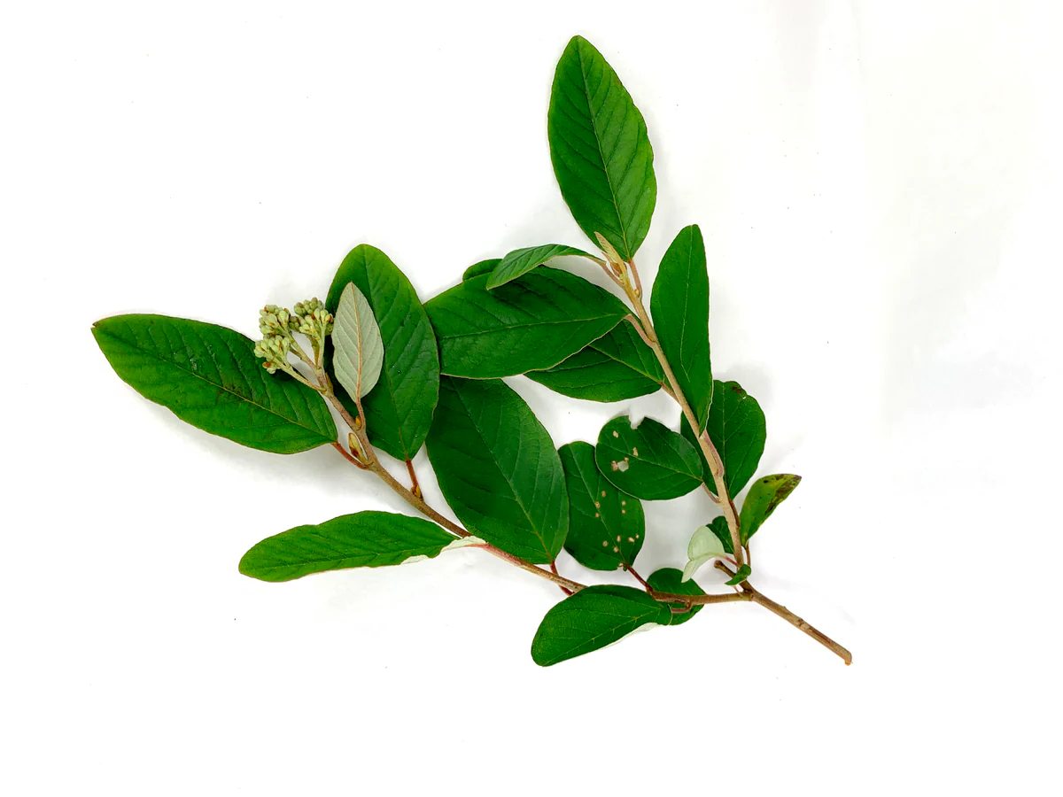
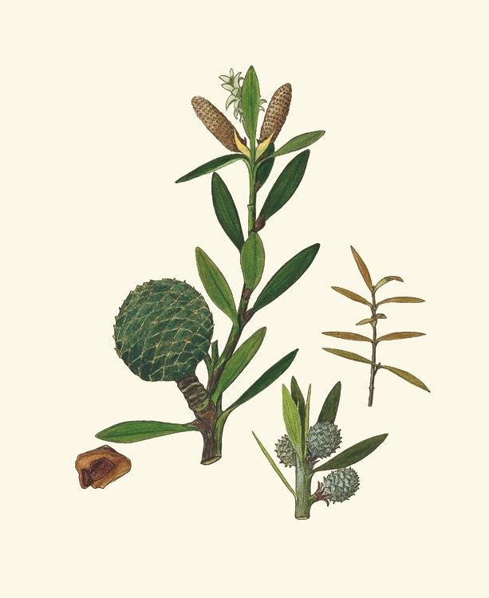
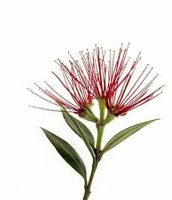
Tikanga
Thank the rākau (plant) for its medicinal properties.
It is said that the plants give more of their healing wairua if asked.
What is wairua? (How does it link to mauri?)
How can we be sustainable when harvesting the rākau (plants)?
Bless the material that you have harvested and give thanks to the rākau (plants) that gave it.
Return all unused plant material back to Papatūānuku (Mother Earth)
Why do you think we return ensued material to Papatūānuku?

Slide 6
TIKANGA TEACHER NOTES TO HELP WITH TIKANGA SLIDES AND QUESTIONS
There is a tikanga around harvesting plants from the native bush. This isn’t just so we look after the environment but also part of the healing process. So even if plants are grown in your own garden, you should still follow tikanga.
It is important to grow your knowledge of the rākau (plants) so you can use them properly and not just like an ‘over the counter’ solution. It is important to learn from a Tohunga (expert).
Say a karakia (prayer) to outline your intention and honour Tāne Mahuta (atua of the Forest) and maybe Rongo-ma-Tāne (atua of cultivated plants) and to the rākau that are considered to be our Tīpuna / Tupuna (ancestors)
Karakia is a time to let go of stress / problems you are holding on to and a time to focus on and tune into the plants.

Slide 7
TIKANGA TEACHER NOTES TO HELP WITH TIKANGA SLIDES AND QUESTIONS
Thank the rākau for its medicinal properties - it is said that the plants give more of their healing wairua (spiritual energy) when they asked.
Ideally harvest (take from) several different plants not just from one. This helps to make sure there is an ongoing sustainable resource.
Bless the material that you have harvested and give thanks to the rākau (plants) that gave it.
Return all unused plant material back to Papatūānuku (Mother Earth) to make sure the cycle of life continues.
REASONS FOR NOT CUTTING IN RAIN AND DARK
Harakeke fills with water in the rain and it is tough and hard to cut and can injure yourself by blade breaking or risk of cutting yourself
At night time - again can’t see properly risk of injuring yourself and possibly cutting wrong parts of the plant (may cut child or parent parts)

Slide 8
TASK: brainstorm in pairs / small groups about connections between rongoā rākau and te taiao and Tupu-ā-nuku and Tupu-ā-rangi
Teacher notes to help discussions
There is a strong connection between people and the whenua (land).
People and the land are connected through healing.
Must care for te taiao - be kaitiaki so we can look after our rongoā (plants) and be sustainable
The connection between whenua (land), maramataka (moon cycle) and our ngā whetu (stars) and everything that comes underneath is what makes us who we are.
We are part of the land (we came from Papatūānuku) - it is our connection to her (and our tūpuna / tīpuna) and Papatūānuku’s connection to us
Tupu-ā-nuku and Tupu-ā-rangi - connected to food from the ground and from the sky - so a strong connected to rongoā and the atua who guard over those domains

Slide 9
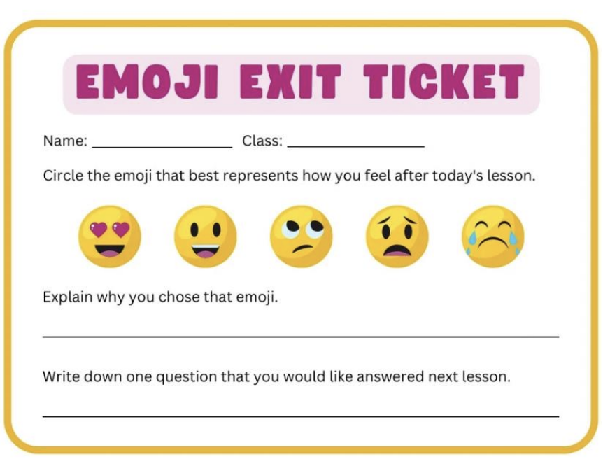
You can choose a different emoji (if there is one you think suits how you feel!
Just explain why you chose it

Slide 10
Karakia whakamutunga - Ending Prayer
Me karakia tātou
Kia whakairia te tapu
Kia wātea ai te ara
Kia tūruki whakataha ai
Kia tūruki whakataha ai
Hāumi e, Hui e
Tāiki e

