Slide 1
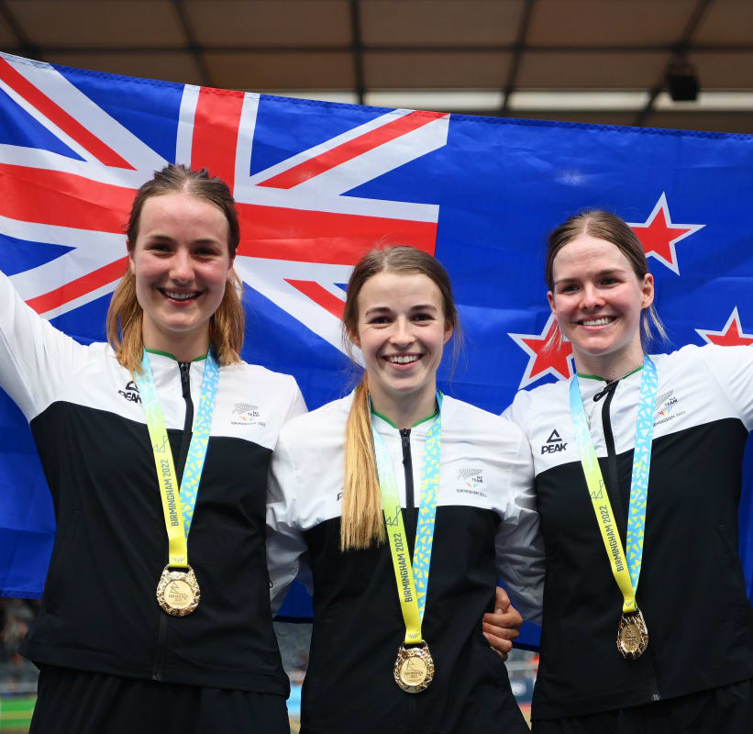
Female Representation
At the Commonwealth Games Birmingham 2022

Slide 2
Birmingham 2022 is the first major multi-sport event in history to award more medals to women than men, while the debut of women’s T20 cricket has proved one of the success stories of the competition so far.

Slide 3
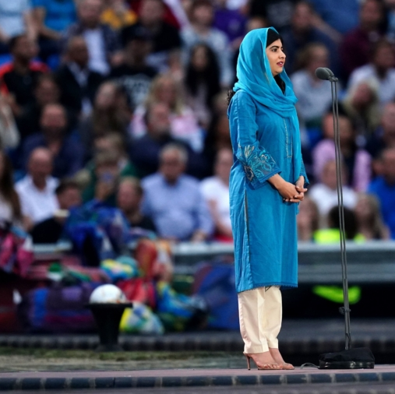
Malala Yousafzai – Human Rights Activist
Gave a powerful speech welcoming guests and spectators to Birmingham – the city she calls her home, after fleeing the Taliban.
She said the young athletes competing at the Games are a reminder that “every child deserves the chance to reach her full potential and pursue her wildest dreams”.

Slide 4
More to be done to bring true equality to the Commonwealth Games!
Only 7% of Chairs and Presidents in Olympic and Paralympic sport are women.
According to Forbes, only one of the top 50 highest paid athletes in 2020 was a woman.
In 2018 the Lancet Global Health found that more than a quarter of adults globally are insufficiently physically active and across most countries, women are less active than men, which means that millions of women globally are missing out on the physical health, mental health and social rewards of taking part in sport and activity.

