Slide 1
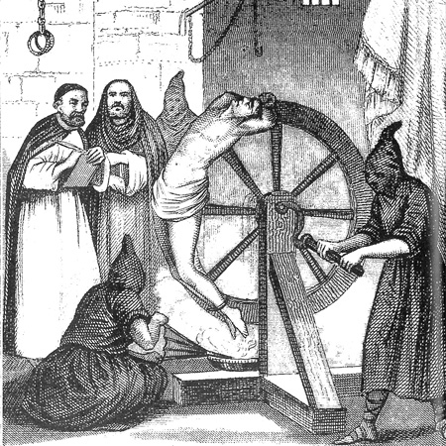
HOW DID THE CATHOLIC CHURCH KEEP CONTROL?
THE INQUISITION
LO: To know what the inquisition was and why it was hated so much.

Slide 2
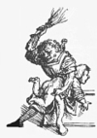
STARTER
relic
Can you solve the following:
My 1st is in ruthless and also in church.
My 2nd’s in escaping but not in the birch.
My 3rd isn’t in truth but is found in lie.
My 4th starts “Indulgence” to help you get by.
My last is in cuckoo but never in pigeon.
My whole is a word to do with religion.

Slide 3
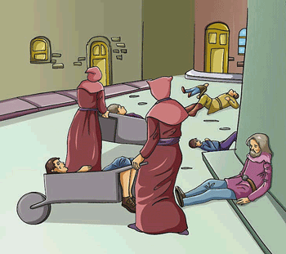
The Middle Ages
In the Early Middle Ages Christians, Jews and Muslims lived together in mutual tolerance. But then the Black Death came to Europe.
Nearly half of the population died.
There was chaos as there were not enough people to do the work.
Religious tensions increased.

Slide 4
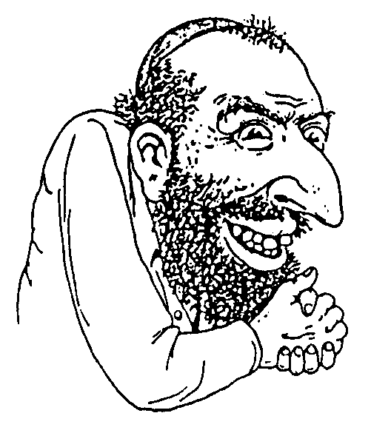
Jews were disliked.
Jews were seen as Christian killers who were interested in cannibalism and infanticide. (killing babies) People said they had poisoned the wells and caused the Black Death.
But the Catholic Church said Christians were not allowed to do these jobs – so non Christians HAD to do them.
Their typical jobs were:
Moneylenders
Rent collectors
Debt collectors.

Slide 5
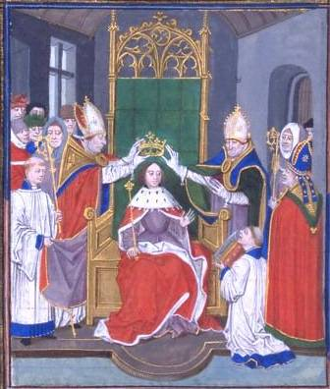
HOW COULD THE CHURCH GET AWAY WITH KILLING PEOPLE?
Before the Reformation, church and state were united.
It was hard to tell the difference between the two.
Catholic bishops installed emperors and kings.
The same emperors and kings then protected the church and its ministers.
So rebelling against the church was rebelling against the king.

Slide 6
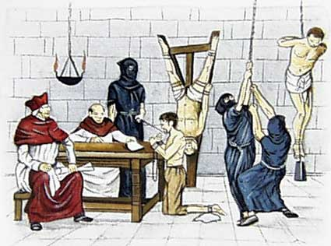
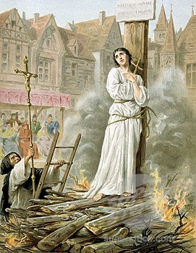
What was the Inquisition?
The Inquisition lasted for 600 years.
A very successful marriage of church and state.
The church hunted down and prosecuted heretics.
The state punished them, often by burning at the stake.

Slide 8
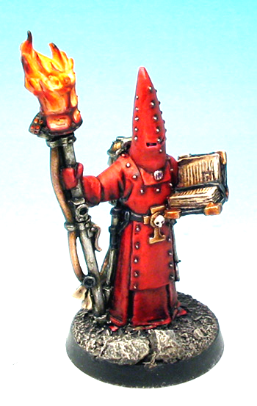
THE SPANISH INQUISITION
200,000 Jews lived in Spain. The king and Queen, Ferdinand and Isabella thought the Jews were a danger & began a campaign against them.
The Spanish Inquisition
begun in 1478
continued for 354 years!
ended in 1834
Used severe torture
Its job was to stamp out heresy but it was also used against political enemies.
Now look up & write down the definition of ‘heresy.’

Slide 9
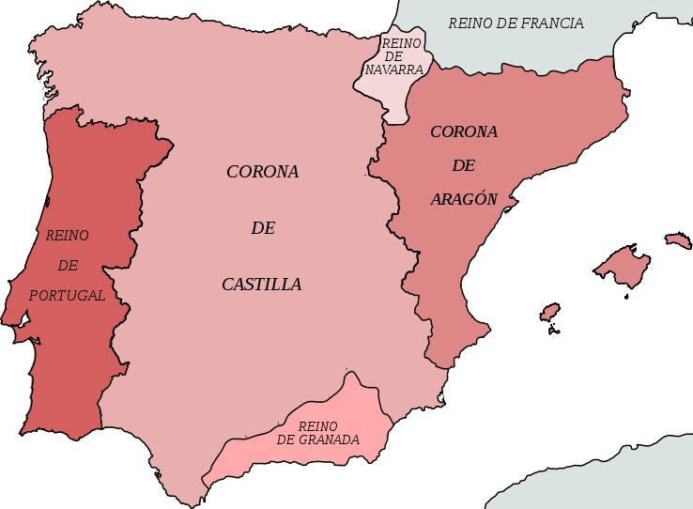
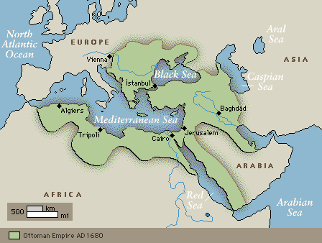
THE SPANISH INQUISITION
There were also many Muslims in Spain.
The Kingdom of Granada was ruled by the Muslim Moors.
Ferdinand and Isabella worried that the Moors would join with the Muslim Ottoman Empire and stop their trade.
They wanted the land and the wealth of Granada.
They wanted to get rid of the Muslims in Spain.

Slide 10
VICTIMS OF THE SPANISH INQUISITION
Protestants were also targets of the Spanish Inquisition. E.g. Protestants that served on merchant vessels visiting Spanish ports.
In 1492, Jews in Spain were given 2 options:
become a baptized Christian
leave Spain.
Muslims in Spain suffered a similar fate:
convert
leave
Converted Muslims were known as Moriscos.
Up to 3,000,000 Moslems left Spain between 1502 and 1615!
About 50,000 “accepted” conversion.
100,000-200,000 left Spain.
Forced Jewish converts were known as Marranos meaning “swine
In 1565, 26 English sailors were burned at the stake, and 10 times that number were imprisoned

Slide 11
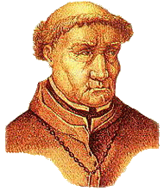
TOMAS TORQUEMADA
The most infamous Inquisitor General.
Appointed by Ferdinand and Isabella
Torquemada was a Dominican friar(monk).
He had served as confessor to Queen Isabella.
Over 100,000 people were sentenced to death as heretics under his jurisdiction.

Slide 12
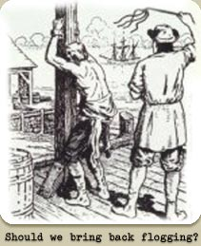
METHODS OF THE SPANISH INQUISITION
In Spain, torture was used in about 1/3 of all cases. Popular methods of torture included:
flogging

Slide 13
METHODS OF THE SPANISH INQUISITION
In Spain, torture was used in about 1/3 of all cases. Popular methods of torture included:
Burning

Slide 14
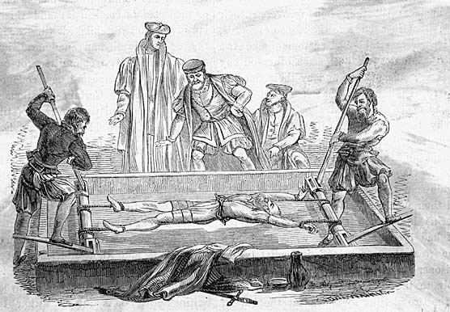
METHODS OF THE SPANISH INQUISITION
In Spain, torture was used in about 1/3 of all cases. Popular methods of torture included:
The Rack

Slide 15
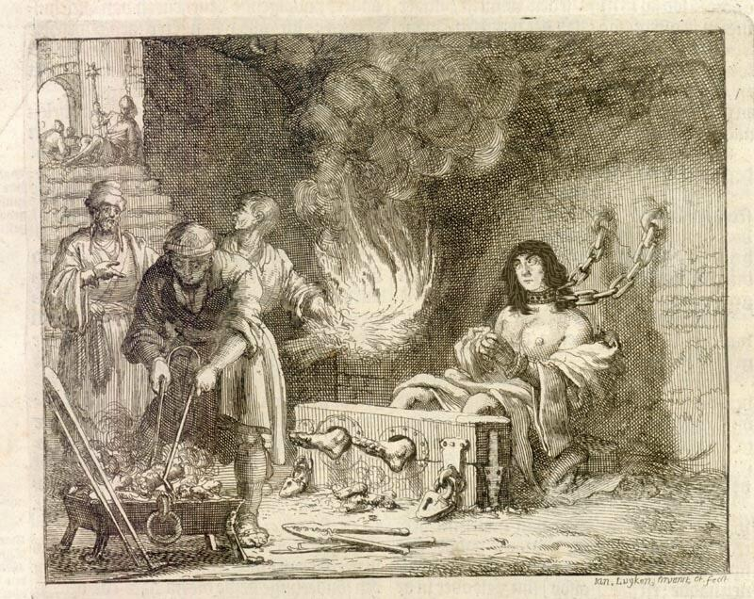
METHODS OF THE SPANISH INQUISITION
In Spain, torture was used in about 1/3 of all cases. Popular methods of torture included:
Roasting
Feet over
Burning
coals

Slide 16
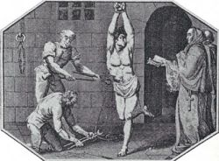
METHODS OF THE SPANISH INQUISITION
In Spain, torture was used in about 1/3 of all cases. Popular methods of torture included:
The
Garrucha
The victim’s hands would be tied behind their back, and they’d be lifted off the ground by a rope tied around the wrists.

Slide 17
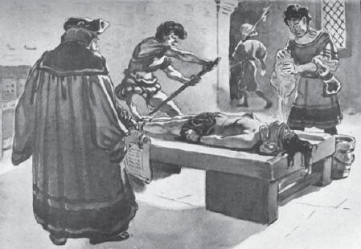
METHODS OF THE SPANISH INQUISITION
In Spain, torture was used in about 1/3 of all cases. Popular methods of torture included:
Tortura
Del Agua
The victim would be bound to the rack, with his head lower than rest of his body. The mouth would then be forced open and water would be forced into the mouth. The victim would risk suffocation if he did not “confess”.

Slide 18
TASK
Read the information sheet carefully and complete the following tasks, making sure your answers make sense.
Give 3 reasons why the Christians of Europe disliked the Jews.
Explain why kings and queens allowed the church to get away with murder.
How long did the Inquisition last?
Which King and Queen began the Spanish Inquisition?
When did the Spanish Inquisition end?
What methods did the Inquisition use to enforce Catholicism?
Which groups of people did the Spanish Inquisition target?
Who was Tomas Torquemada and why was he famous?
Describe the torture methods used by Torquemada.
How successful was the Inquisition? Give a reason for your answer.

