Slide 1
Researching a myth

Slide 2
Researching your own myth
Research a myth of your own choosing. This could be from your own culture, or a myth/culture you are interested in.
Practice your note taking skills, take dot jot notes, and write a paragraph based on your notes about your chosen myth.
Create a poster/sideshow or something of your own choosing outlining the key information that you have compiled.

Slide 3
Key information to find:
1. Origin of myth - what country or culture did the myth come from?
2. Key elements of the myth - summarise the key parts of the myth
3. Significance of chosen myth - what does this myth mean to its culture?
4. Natural phenomena that your myth is explaining - what natural event is the myth explaining?
5. An illustration

Slide 4
Research tips
Think of what type of myth you want to research, is there a particular natural event you are interested in? Or a particular culture you would like to learn more about.
Google searches: search the keywords or phrases when researching your myth. E.g if you are looking a Greek myth about earthquakes you will google ‘Greek mythology earthquakes’.
When you find a good resource, skim and scan through the document. Then take dot jot notes highlighting the important information of your myth.

Slide 5
Presenting your myth
You can present your myth in any way that you like! This could include:
SlideShow
Poster
Kahoot
Word document
Or any way you like!

Slide 6
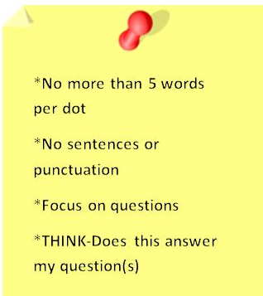
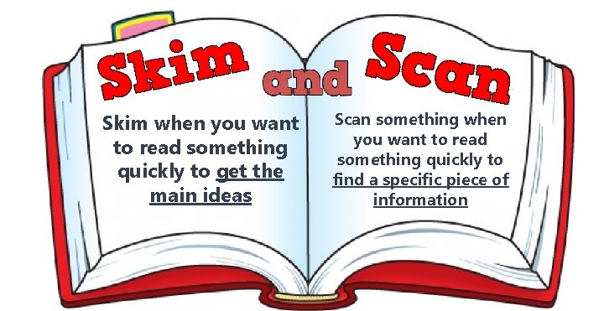
Glossary
Dot jot notes: Bullet pointed notes, writing down the key information. Using keywords, not sentences.
Skim and scan: Reading the titles, intro sentences to see if the resource is going to have the right information, without reading the whole page.

