Slide 1
How to take notes

Slide 2
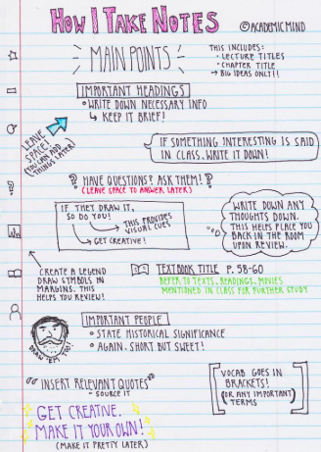
Why do I need to learn how to take notes?
so I remember what I have read/ heard during my research
so I can add my own thoughts and ideas as they happen
to help me organise my thoughts when I’m discovering new things

Slide 3
Three methods to try!
Outline Method
Top level bullet points
Lower level bullet points with more details
Cornell Method
Three sections on the paper:
note taking column
cue column - questions you have
summary
Mind map Method
topic in the middle
branches with the connected ideas

Slide 4
What does it look like?
outline system

Slide 5
Use this text to practise the Outline system.
Our cities need more green spaces
Your focus question is: What methods have cities used to create more green spaces?
outline system

Slide 6
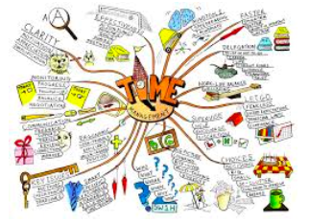
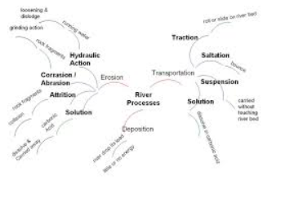
What might it look like?
It’s up to you!
mind map system

Slide 7
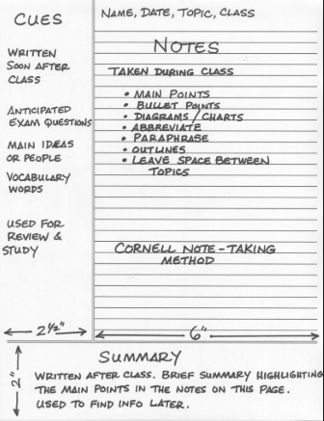
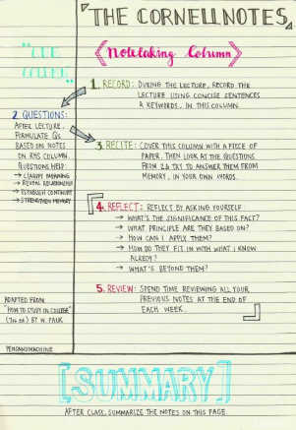
What does it look like?
cornell system

Slide 8
Do It Yourself!
Step 1: Read the article on G-Classroom.
decide which note taking system you want to use [mind map OR Cornell]
Look for text features such as subtitle to help organise your notes.
Pay attention to pictures, captions and videos that are embedded in the article.
Step 2: When you have completed your notes…
At the bottom of your page, make a note of any ideas, questions, or links you have made with other research.
Note down the article information [citing your source]

